Slide 1
Distributed Hash Tables
Ken Birman
Cornell University. CS5410 Fall 2008.

Slide 2
What is a Distributed Hash Table (DHT)?
Exactly that ☺
A service, distributed over multiple machines, with hash table semantics
  Put(key, value), Value = Get(key)
Designed to work in a peer-to-peer (P2P) environment
  No central control
  Nodes under different administrative control
But of course can operate in an “infrastructure” sense

Slide 3
More specifically
Hash table semantics:
  Put(key, value),
  Value = Get(key)
  Key is a single flat string
  Limited semantics compared to keyword search
Put() causes value to be stored at one (or more) peer(s)
Get() retrieves value from a peer
Put() and Get() accomplished with unicast routed messages
  In other words, it scales
Other API calls to support application, like notification when neighbors come and go

Slide 4
P2P “environment”
Nodes come and go at will (possibly quite frequently---a few minutes)
Nodes have heterogeneous capacities
  Bandwidth, processing, and storage
Nodes may behave badly
  Promise to do something (store a file) and not do it (free-loaders)
  Attack the system

Slide 5
Several flavors, each with variants
Tapestry (Berkeley)
  Based on Plaxton trees---similar to hypercube routing
  The first* DHT
  Complex and hard to maintain (hard to understand too!)
CAN (ACIRI), Chord (MIT), and Pastry (Rice/MSR Cambridge)
  Second wave of DHTs (contemporary with and independent of each other)
* Landmark Routing, 1988, used a form of DHT
called Assured Destination Binding (ADB)

Slide 6
Basics of all DHTs
Goal is to build some “structured” overlay network with the following characteristics:
  Node IDs can be mapped to the hash key space
  Given a hash key as a “destination address”, you can route through the network to a given node
  Always route to the same node no matter where you start from
127
111
13
97
33
81
58

Slide 7
Simple example (doesn’t scale)
Circular number space 0 to 127
Routing rule is to move counter-clockwise until current node ID ≥ key, and last hop node ID < key
Example: key = 42
Obviously you will route to node 58 from no matter where you start
127
111
13
97
33
81
58

Slide 8
Building any DHT
Newcomer always starts with at least one known member
127
111
13
97
33
81
58
24

Slide 9
Building any DHT
Newcomer always starts with at least one known member
Newcomer searches for “self” in the network
  hash key = newcomer’s node ID
  Search results in a node in the vicinity where newcomer needs to be
127
111
13
97
33
81
58
24

Slide 10
Building any DHT
Newcomer always starts with at least one known member
Newcomer searches for “self” in the network
  hash key = newcomer’s node ID
  Search results in a node in the vicinity where newcomer needs to be
Links are added/removed to satisfy properties of network
127
111
13
24
97
33
81
58

Slide 11
Building any DHT
Newcomer always starts with at least one known member
Newcomer searches for “self” in the network
  hash key = newcomer’s node ID
Search results in a node in the vicinity where newcomer needs to be
Links are added/removed to satisfy properties of network
Objects that now hash to new node are transferred to new node
127
111
13
24
97
33
81
58

Slide 12
Insertion/lookup for any DHT
Hash name of object to produce key
  Well-known way to do this
Use key as destination address to route through network
  Routes to the target node
Insert object, or retrieve object, at the target node
127
111
13
24
97
33
81
58
foo.htm→93

Slide 13
Properties of most DHTs
Memory requirements grow (something like) logarithmically with N
Routing path length grows (something like) logarithmically with N
Cost of adding or removing a node grows (something like) logarithmically with N
Has caching, replication, etc…

Slide 14
DHT Issues
Resilience to failures
Load Balance
  Heterogeneity
  Number of objects at each node
  Routing hot spots
  Lookup hot spots
Locality (performance issue)
Churn (performance and correctness issue)
Security

Slide 15
We’re going to look at four DHTs
At varying levels of detail…
  CAN (Content Addressable Network)
    ACIRI (now ICIR)
  Chord
    MIT
  Kelips
    Cornell
  Pastry
    Rice/Microsoft Cambridge

Slide 16
Things we’re going to look at
What is the structure?
How does routing work in the structure?
How does it deal with node departures?
How does it scale?
How does it deal with locality?
What are the security issues?

Slide 17
CAN structure is a cartesian coordinate space in a D dimensional torus
1
CAN graphics care of Santashil PalChaudhuri, Rice Univ

Slide 18
Simple example in two dimensions
1
2

Slide 19
Note: torus wraps on “top” and “sides”
3
1
2

Slide 20
Each node in CAN network occupies a “square” in the space
3
1
2
4

Slide 21
With relatively uniform square sizes

Slide 22
Neighbors in CAN network
Neighbor is a node that:
Overlaps d-1 dimensions
Abuts along one dimension

Slide 23
Route to neighbors closer to target
Z1
Z2
Z3
Z4…
Zn
d-dimensional space
n zones
  Zone is space occupied by a “square” in one dimension
Avg. route path length
  (d/4)(n ^{1/d})
Number neighbors = O(d)
Tunable (vary d or n)
Can factor proximity into route decision
(a,b)
(x,y)

Slide 24
Chord uses a circular ID space
Key ID Node ID
N10
K5, K10
K100
N100
Circular
ID Space
N32
K11, K30
K65, K70
N80
N60
K33, K40, K52
Successor: node with next highest ID
Chord slides care of Robert Morris, MIT

Slide 25
Basic Lookup
N5
N10
N110
“Where is key 50?”
N20
N99
“Key 50 is
At N60”
N32
N40
N80
N60
Lookups find the ID’s predecessor
Correct if successors are correct

Slide 26
Successor Lists Ensure Robust Lookup
10, 20, 32
N5
N10
20, 32, 40
5, 10, 20
N110
N20
32, 40, 60
110, 5, 10
N99
N32
40, 60, 80
99, 110, 5
N40
60, 80, 99
N80
N60
80, 99, 110
Each node remembers r successors
Lookup can skip over dead nodes to find blocks
Periodic check of successor and predecessor links
Notes:
All r successors have to fail before we have a problem.
List ensures we find actual current successor.

Slide 27
Chord “Finger Table” Accelerates Lookups
To build finger tables, new node searches for the key values for each finger
To do it efficiently, new nodes obtain successor’s finger table, and use as a hint to optimize the search
¼
½
1/8
1/16
1/32
1/64
1/128
N80
Notes:
Log(N) means we don’t have to track all nodes. Easy to maintain finger info.

Slide 28
Chord lookups take O(log N) hops
N5
N10
N110
K19
N20
N99
N32
Lookup(K19)
N80
N60
Notes:
Maybe note that fingers point to the first relevant node.

Slide 29
Drill down on Chord reliability
Interested in maintaining a correct routing table (successors, predecessors, and fingers)
Primary invariant: correctness of successor pointers
  Fingers, while important for performance, do not have to be exactly correct for routing to work
  Algorithm is to “get closer” to the target
  Successor nodes always do this

Slide 30
Maintaining successor pointers
Periodically run “stabilize” algorithm
  Finds successor’s predecessor
  Repair if this isn’t self
This algorithm is also run at join
Eventually routing will repair itself
Fix_finger also periodically run
  For randomly selected finger

Slide 31
Initial: 25 wants to join correct ring (between 20 and 30)
20
20
20
25
25
30
30
25
25 finds successor, and tells successor (30) of itself
30
20 runs “stabilize”:
20 asks 30 for 30’s predecessor
30 returns 25
20 tells 25 of itself

Slide 32
This time, 28 joins before 20 runs “stabilize”
20
20
20
28
25
28
25
30
25
30
28
30
28 finds successor, and tells successor (30) of itself
20 runs “stabilize”:
20 asks 30 for 30’s predecessor
30 returns 28
20 tells 28 of itself

Slide 33
20
20
20
25
25
28
28
25
28
30
30
25 runs “stabilize”
30
20 runs “stabilize”

Slide 34
Pastry also uses a circular number space
d471f1
d467c4
Difference is in how the “fingers” are created
Pastry uses prefix match overlap rather than binary splitting
More flexibility in neighbor selection
d462ba
d46a1c
d4213f
Route(d46a1c)
d13da3
65a1fc

Slide 35
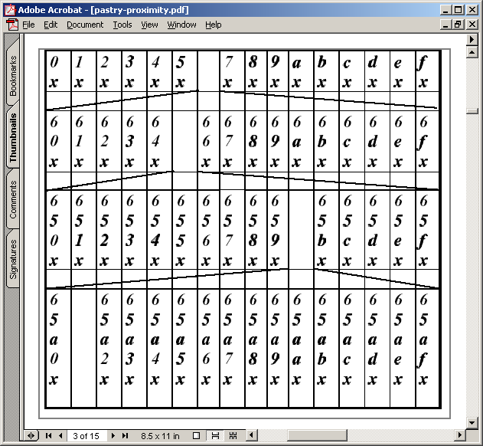
Pastry routing table (for node 65a1fc)
Pastry nodes also have a “leaf set” of immediate neighbors up and down the ring
Similar to Chord’s list of successors

Slide 36
Pastry join
X = new node, A = bootstrap, Z = nearest node
A finds Z for X
In process, A, Z, and all nodes in path send state tables to X
X settles on own table
  Possibly after contacting other nodes
X tells everyone who needs to know about itself
Pastry paper doesn’t give enough information to understand how concurrent joins work
  18th IFIP/ACM, Nov 2001

Slide 37
Pastry leave
Noticed by leaf set neighbors when leaving node doesn’t respond
  Neighbors ask highest and lowest nodes in leaf set for new leaf set
Noticed by routing neighbors when message forward fails
  Immediately can route to another neighbor
  Fix entry by asking another neighbor in the same “row” for its neighbor
  If this fails, ask somebody a level up

Slide 38
For instance, this neighbor fails

Slide 39
Ask other neighbors
Try asking some neighbor in the same row for its 655x entry
If it doesn’t have one, try asking some neighbor in the row below, etc.

Slide 40
CAN, Chord, Pastry differences
CAN, Chord, and Pastry have deep similarities
Some (important???) differences exist
  CAN nodes tend to know of multiple nodes that allow equal progress
    Can therefore use additional criteria (RTT) to pick next hop
  Pastry allows greater choice of neighbor
    Can thus use additional criteria (RTT) to pick neighbor
  In contrast, Chord has more determinism
    Harder for an attacker to manipulate system?

Slide 41
Security issues
In many P2P systems, members may be malicious
If peers untrusted, all content must be signed to detect forged content
  Requires certificate authority
  Like we discussed in secure web services talk
  This is not hard, so can assume at least this level of security

Slide 42
Security issues: Sybil attack
Attacker pretends to be multiple system
  If surrounds a node on the circle, can potentially arrange to capture all traffic
  Or if not this, at least cause a lot of trouble by being many nodes
Chord requires node ID to be an SHA-1 hash of its IP address
  But to deal with load balance issues, Chord variant allows nodes to replicate themselves
A central authority must hand out node IDs and certificates to go with them
  Not P2P in the Gnutella sense

Slide 43
General security rules
Check things that can be checked
  Invariants, such as successor list in Chord
Minimize invariants, maximize randomness
  Hard for an attacker to exploit randomness
Avoid any single dependencies
  Allow multiple paths through the network
  Allow content to be placed at multiple nodes
But all this is expensive…

Slide 44
Load balancing
Query hotspots: given object is popular
  Cache at neighbors of hotspot, neighbors of neighbors, etc.
  Classic caching issues
Routing hotspot: node is on many paths
  Of the three, Pastry seems most likely to have this problem, because neighbor selection more flexible (and based on proximity)
  This doesn’t seem adequately studied

Slide 45
Load balancing
Heterogeneity (variance in bandwidth or node capacity
Poor distribution in entries due to hash function inaccuracies
One class of solution is to allow each node to be multiple virtual nodes
  Higher capacity nodes virtualize more often
  But security makes this harder to do

Slide 46
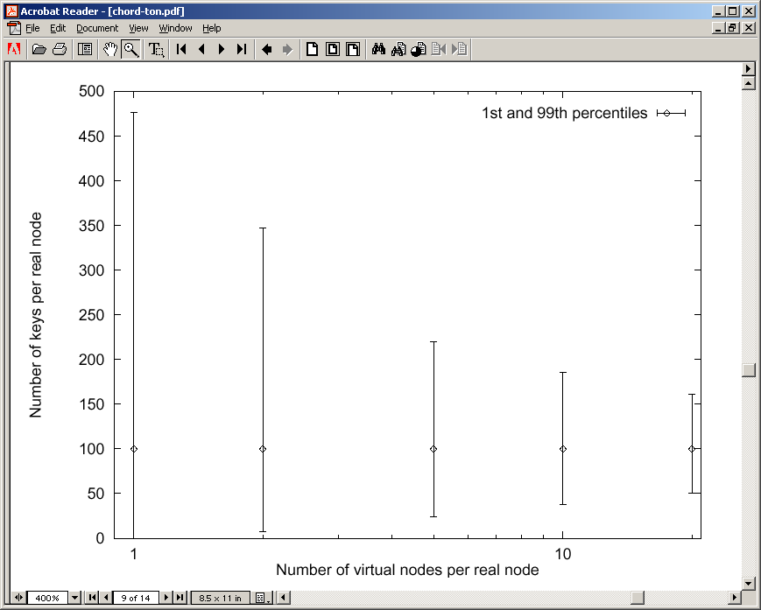
Chord node virtualization
10K nodes, 1M objects
20 virtual nodes per node has much better load balance, but each node requires ~400 neighbors!

Slide 47
Primary concern: churn
Churn: nodes joining and leaving frequently
Join or leave requires a change in some number of links
Those changes depend on correct routing tables in other nodes
  Cost of a change is higher if routing tables not correct
  In chord, ~6% of lookups fail if three failures per stabilization
But as more changes occur, probability of incorrect routing tables increases

Slide 48
Control traffic load generated by churn
Chord and Pastry appear to deal with churn differently
Chord join involves some immediate work, but repair is done periodically
  Extra load only due to join messages
Pastry join and leave involves immediate repair of all effected nodes’ tables
  Routing tables repaired more quickly, but cost of each join/leave goes up with frequency of joins/leaves
  Scales quadratically with number of changes???
  Can result in network meltdown???

Slide 49
Kelips takes a different approach
Network partitioned into √N “affinity groups”
Hash of node ID determines which affinity group a node is in
Each node knows:
  One or more nodes in each group
  All objects and nodes in own group
But this knowledge is soft-state, spread through peer-to-peer “gossip” (epidemic multicast)!

Slide 50
Kelips
110 knows about other members – 230, 30…
Affinity Groups:
peer membership thru consistent hash
Affinity group view
id | hbeat | rtt
30 | 234 | 90ms
230 | 322 | 30ms
0
1
2
N
−
1
110
230
202
N
members per affinity group
30
Affinity group pointers

Slide 51
Kelips
202 is a “contact” for 110 in group 2
Affinity Groups:
peer membership thru consistent hash
Affinity group view
id | hbeat | rtt
30 | 234 | 90ms
230 | 322 | 30ms
0
1
2
N
−
1
110
Contacts
N
230
202
members per affinity group
group | contactNode
… | …
2 | 202
30
Contact pointers

Slide 52
Kelips
“cnn.com” maps to group 2. So 110 tells group 2 to “route” inquiries about cnn.com to it.
Affinity Groups:
peer membership thru consistent hash
Affinity group view
id | hbeat | rtt
30 | 234 | 90ms
230 | 322 | 30ms
0
1
2
N
−
1
110
Contacts
N
230
202
members per affinity group
group | contactNode
… | …
2 | 202
30
Resource Tuples
Gossip protocol replicates data cheaply
resource | info
… | …
cnn.com | 110

Slide 53
How it works
Kelips is entirely gossip based!
  Gossip about membership
  Gossip to replicate and repair data
  Gossip about “last heard from” time used to discard failed nodes
Gossip “channel” uses fixed bandwidth
  … fixed rate, packets of limited size

Slide 54
Gossip 101
Suppose that I know something
I’m sitting next to Fred, and I tell him
  Now 2 of us “know”
Later, he tells Mimi and I tell Anne
  Now 4
This is an example of a push epidemic
Push-pull occurs if we exchange data

Slide 55
Gossip scales very nicely
Participants’ loads independent of size
Network load linear in system size
Information spreads in log(system size) time
1.0
% infected
0.0
Time →

Slide 56
Gossip in distributed systems
We can gossip about membership
  Need a bootstrap mechanism, but then discuss failures, new members
Gossip to repair faults in replicated data
  “I have 6 updates from Charlie”
If we aren’t in a hurry, gossip to replicate data too

Slide 57
Gossip about membership
Start with a bootstrap protocol
  For example, processes go to some web site and it lists a dozen nodes where the system has been stable for a long time
  Pick one at random
Then track “processes I’ve heard from recently” and “processes other people have heard from recently”
Use push gossip to spread the word

Slide 58
Gossip about membership
Until messages get full, everyone will known when everyone else last sent a message
  With delay of log(N) gossip rounds…
But messages will have bounded size
  Perhaps 8K bytes
  Then use some form of “prioritization” to decide what to omit – but never send more, or larger messages
  Thus: load has a fixed, constant upper bound except on the network itself, which usually has infinite capacity

Slide 59
Back to Kelips: Quick reminder
Affinity Groups:
peer membership thru consistent hash
Affinity group view
id | hbeat | rtt
30 | 234 | 90ms
230 | 322 | 30ms
0
1
2
N
−
1
110
Contacts
N
230
202
members per affinity group
group | contactNode
… | …
2 | 202
30
Contact pointers

Slide 60
How Kelips works
Node 175 is a contact for Node 102 in some affinity group
175
Hmm…Node 19 looks like a much better contact in affinity group 2
RTT: 235ms
Node 102
19
RTT: 6 ms
Gossip data stream
Gossip about everything
Heuristic to pick contacts: periodically ping contacts to check liveness, RTT… swap so-so ones for better ones.

Slide 61
Replication makes it robust
Kelips should work even during disruptive episodes
  After all, tuples are replicated to √N nodes
  Query k nodes concurrently to overcome isolated crashes, also reduces risk that very recent data could be missed
… we often overlook importance of showing that systems work while recovering from a disruption

Slide 62
Chord can malfunction if the network partitions…
Transient Network Partition
USA
Europe
0
0
255
255
30
248
30
248
241
241
64
64
202
202
199
108
199
108
177
177
123
123

Slide 63
… so, who cares?
Chord lookups can fail… and it suffers from high overheads when nodes churn
  Loads surge just when things are already disrupted… quite often, because of loads
  And can’t predict how long Chord might remain disrupted once it gets that way
Worst case scenario: Chord can become inconsistent and stay that way
The Fine Print
The scenario you have been shown is of low probability. In all likelihood, Chord would repair itself after any partitioning failure that might really arise. Caveat emptor and all that.

Slide 64
Control traffic load generated by churn
O(Changes x Nodes)?
None
O(changes)
Kelips
Chord
Pastry

Slide 65
Take-Aways?
Surprisingly easy to superimpose a hash-table lookup onto a potentially huge distributed system!
  We’ve seen three O(log N) solutions and one O(1) solution (but Kelips needed more space)
Sample applications?
  Peer to peer file sharing
  Amazon uses DHT for the shopping cart
  CoDNS: A better version of DNS

