Slide 1
MapReduce:
Simplified Data Processing on Large Clusters
These are slides with a history. I found them on the web... They are apparently based on Dan Weld’s class at U. Washington, (who in turn based his slides on those by Jeff Dean, Sanjay Ghemawat, Google, Inc.)

Slide 2
Motivation
Large-Scale Data Processing
  Want to use 1000s of CPUs
    But don’t want hassle of managing things
MapReduce provides
  Automatic parallelization & distribution
  Fault tolerance
  I/O scheduling
  Monitoring & status updates

Slide 3
Map/Reduce
Map/Reduce
  Programming model from Lisp
  (and other functional languages)
Many problems can be phrased this way
Easy to distribute across nodes
Nice retry/failure semantics

Slide 4
Map in Lisp (Scheme)
Unary operator
(map f list [list₂ list₃ …])
(map square ‘(1 2 3 4))
  (1 4 9 16)
(reduce + ‘(1 4 9 16))
  (+ 16 (+ 9 (+ 4 1) ) )
  30
(reduce + (map square (map – l₁ l₂))))
Binary operator

Slide 5
Map/Reduce ala Google
map(key, val) is run on each item in set
  emits new-key / new-val pairs
reduce(key, vals) is run for each unique key
emitted by map()
  emits final output
Often, one application will need to run map/reduce many times in succession

Slide 6
count words in docs
  Input consists of (url, contents) pairs
  map(key=url, val=contents):
    For each word w in contents, emit (w, “1”)
  reduce(key=word, values=uniq_counts):
    Sum all “1”s in values list
    Emit result “(word, sum)”

Slide 7
Count,
Illustrated
  map(key=url, val=contents):
    For each word w in contents, emit (w, “1”)
  reduce(key=word, values=uniq_counts):
    Sum all “1”s in values list
    Emit result “(word, sum)”
  see 1
  bob 1
  run 1
  see 1
  spot 1
  throw 1
  bob 1
  run 1
  see 2
  spot 1
  throw 1
  see bob throw
  see spot run

Slide 8
Grep
  Input consists of (url+offset, single line)
  map(key=url+offset, val=line):
    If contents matches regexp, emit (line, “1”)
  reduce(key=line, values=uniq_counts):
    Don’t do anything; just emit line

Slide 9
Reverse Web-Link Graph
Map
  For each URL linking to target, …
  Output <target, source> pairs
Reduce
  Concatenate list of all source URLs
  Outputs: <target, list (source)> pairs

Slide 10
Index maps words to files
Compute an Inverted Index
Map
  For each file f and each word in the file w
  Output(f,w) pairs
Reduce
  Merge, eliminating duplicates

Slide 11
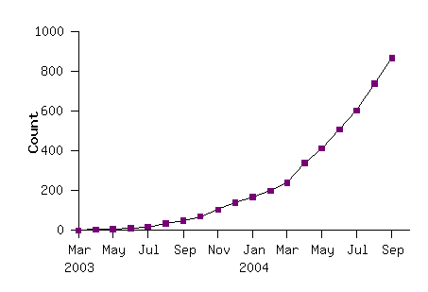
Model is Widely Applicable
MapReduce Programs In Google Source Tree
Example uses:
distributed grep |  | distributed sort |  | web link-graph reversal
term-vector / host |  | web access log stats |  | inverted index construction
document clustering |  | machine learning |  | statistical machine translation
... |  | ... |  | ...

Slide 12
Implementation Overview
Typical cluster:
      100s/1000s of 2-CPU x86 machines, 2-4 GB of memory
      Limited bisection bandwidth
      Storage is on local IDE disks
      GFS: distributed file system manages data (SOSP'03)
      Job scheduling system: jobs made up of tasks, scheduler assigns tasks to machines
Implementation is a C++ library linked into user programs

Slide 13
Execution
How is this distributed?
  Partition input key/value pairs into chunks, run map() tasks in parallel
  After all map()s are complete, consolidate all emitted values for each unique emitted key
  Now partition space of output map keys, and run reduce() in parallel
If map() or reduce() fails, reexecute!

Slide 14
Job Processing
TaskTracker 0
TaskTracker 1
TaskTracker 2
JobTracker
TaskTracker 3
TaskTracker 4
TaskTracker 5
“grep”
Client submits “grep” job, indicating code and input files
JobTracker breaks input file into k chunks, (in this case 6). Assigns work to ttrackers.
After map(), tasktrackers exchange map-output to build reduce() keyspace
JobTracker breaks reduce() keyspace into m chunks (in this case 6). Assigns work.
reduce() output may go to NDFS

Slide 15
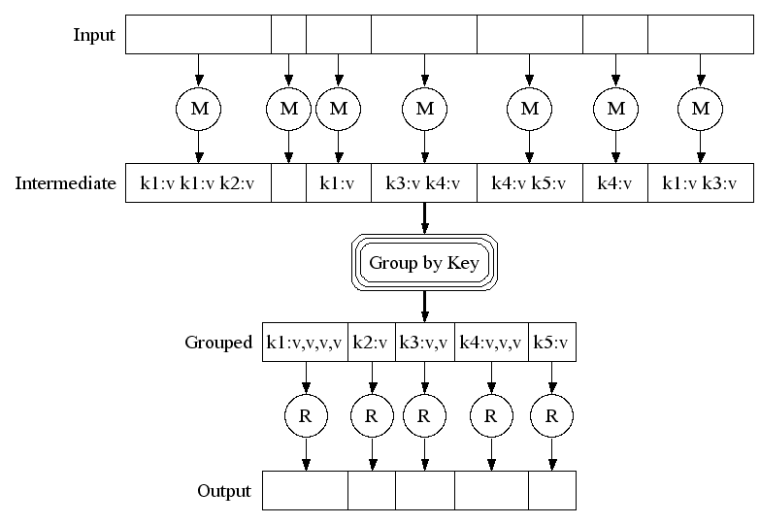
Execution

Slide 16
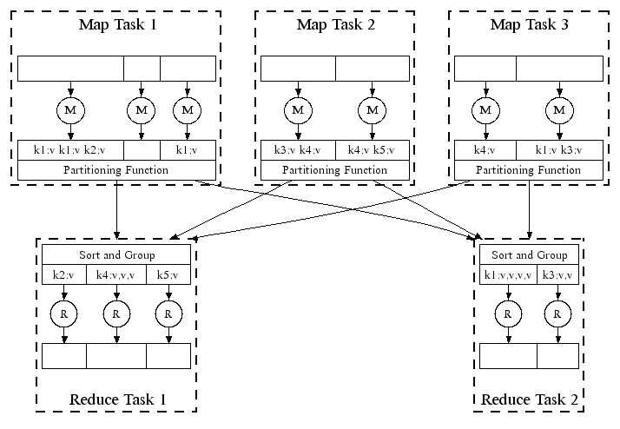
Parallel Execution

Slide 17
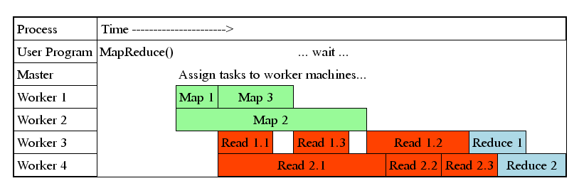
Task Granularity & Pipelining
Fine granularity tasks: map tasks >> machines
  Minimizes time for fault recovery
  Can pipeline shuffling with map execution
  Better dynamic load balancing
Often use 200,000 map & 5000 reduce tasks, running on 2000 machines

Slide 18
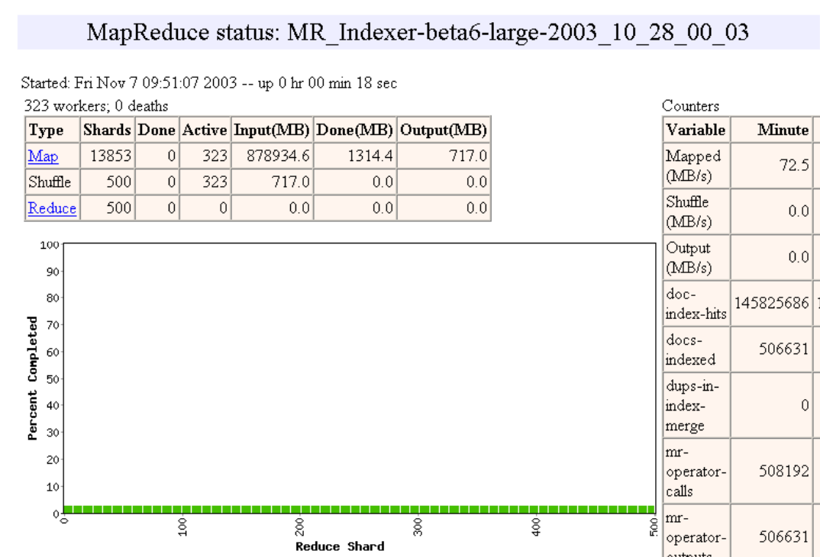

Slide 19
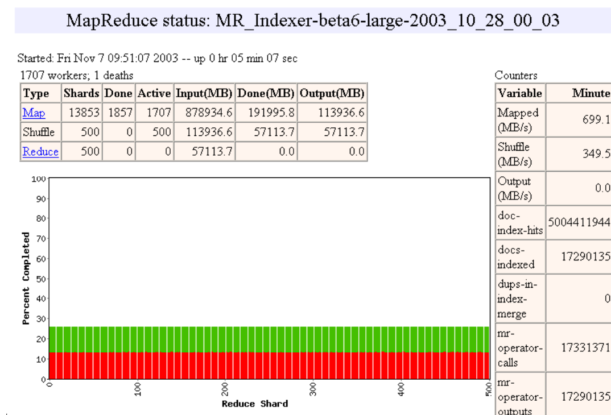

Slide 20
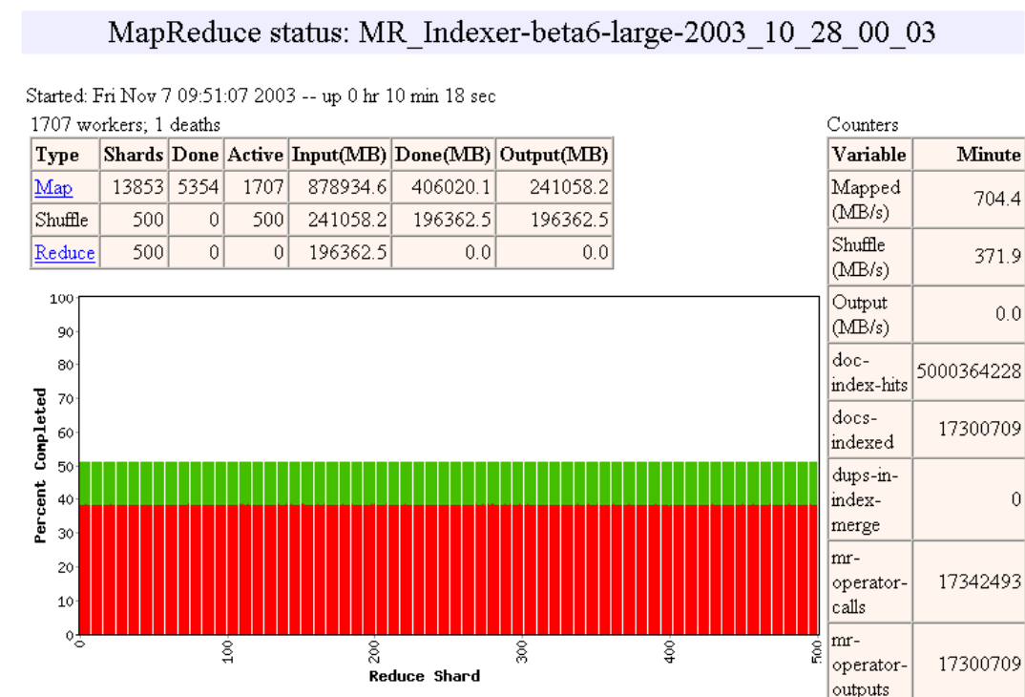

Slide 21
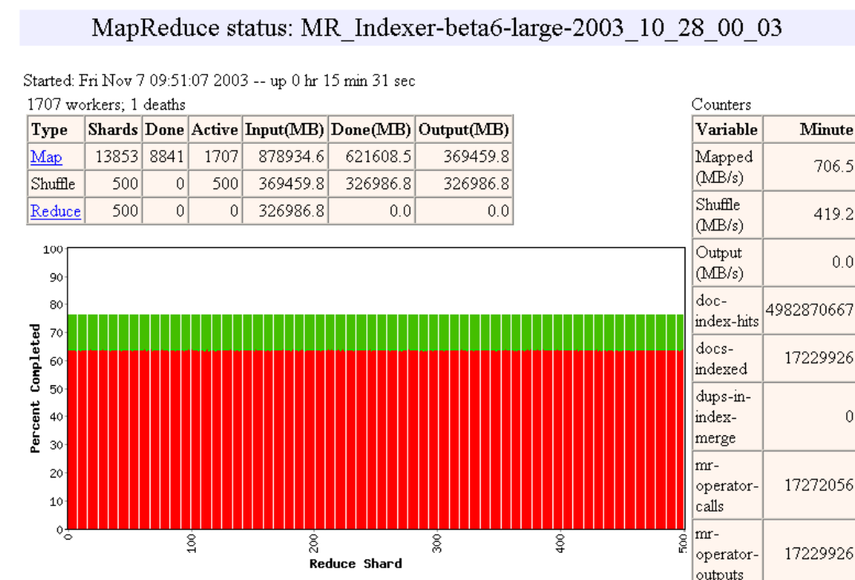

Slide 22
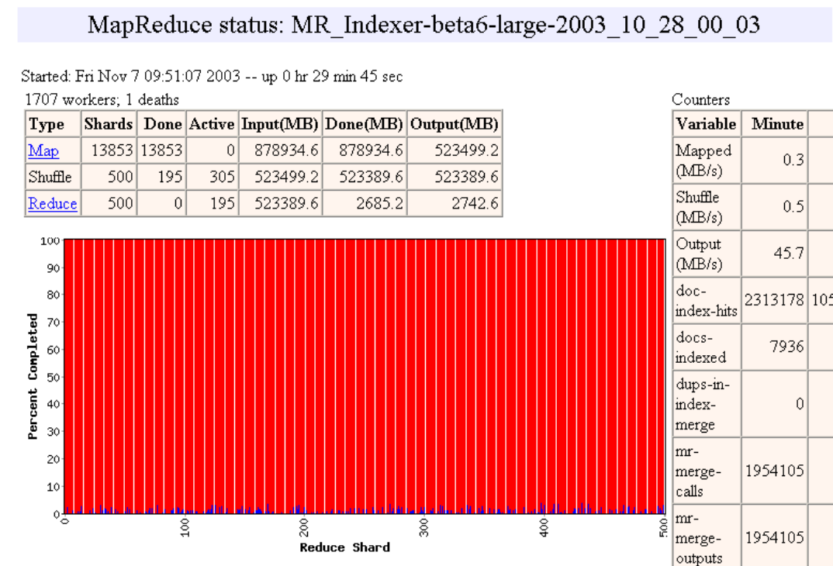

Slide 23
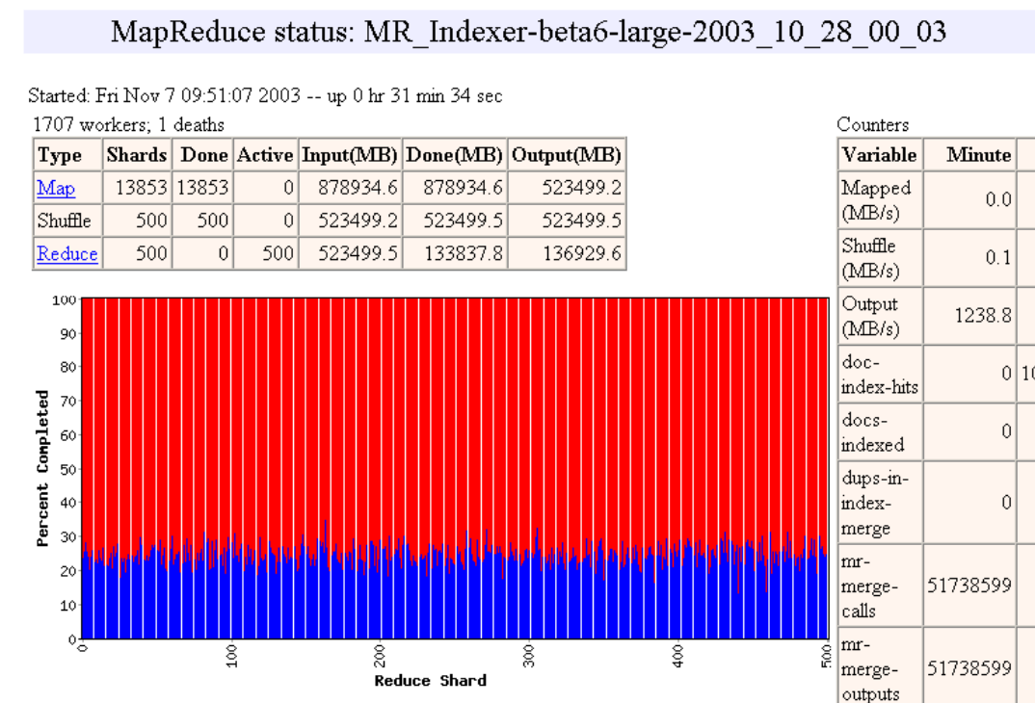

Slide 24
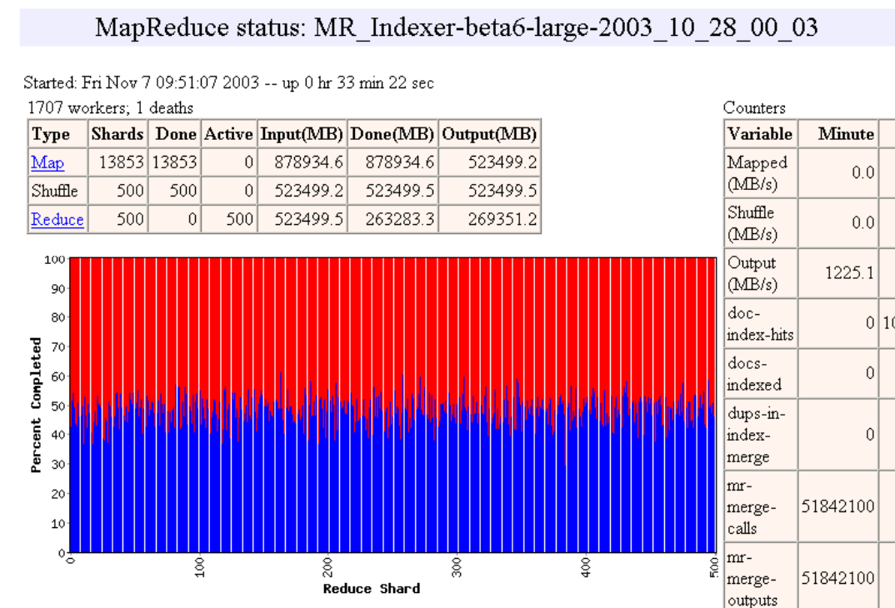

Slide 25
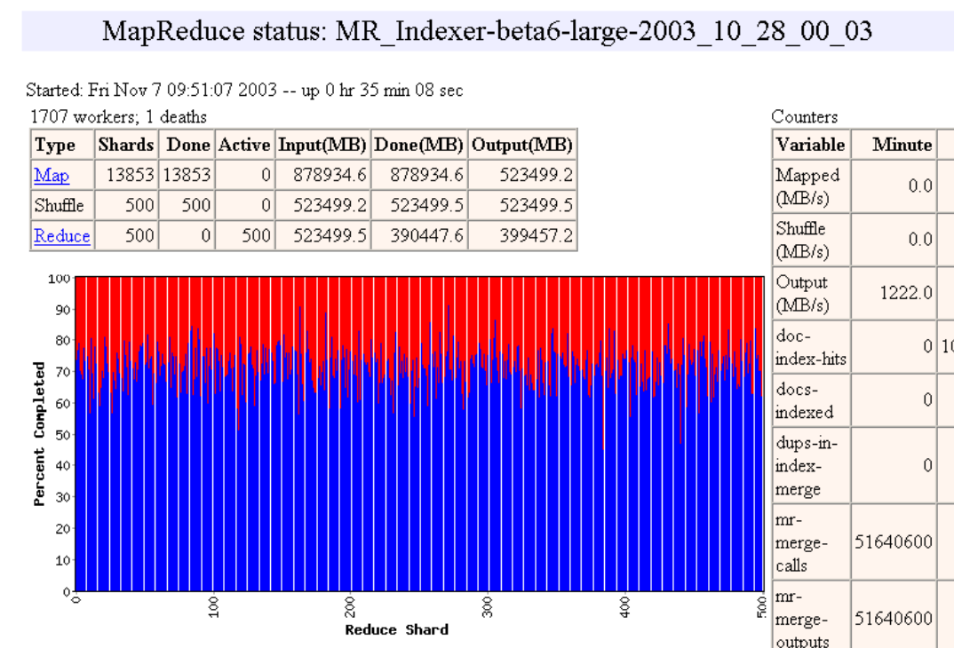

Slide 26
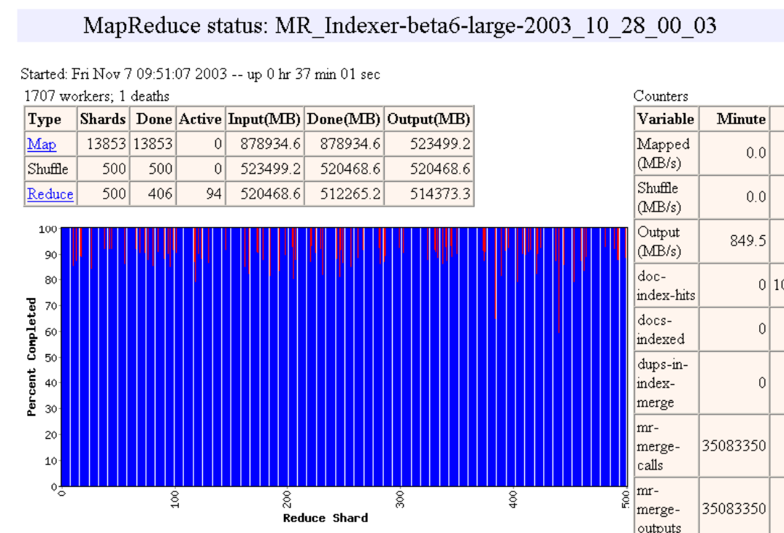

Slide 27


Slide 28


Slide 29
Fault Tolerance / Workers
Handled via re-execution
  Detect failure via periodic heartbeats
  Re-execute completed + in-progress map tasks
  Re-execute in progress reduce tasks
  Task completion committed through master
Robust: lost 1600/1800 machines once → finished ok
Semantics in presence of failures: “at least once”

Slide 30
Master Failure
Could handle, presumably using the kind of replication mechanisms we’ll be studying in near future
But don't yet
  (runs are short enough so that master failure is unlikely)

Slide 31
Refinement:
Redundant Execution
Slow workers significantly delay completion time
  Other jobs consuming resources on machine
  Bad disks w/ soft errors transfer data slowly
  Weird things: processor caches disabled (!!)
Solution: Near end of phase, spawn backup tasks
  Whichever one finishes first "wins"
Dramatically shortens job completion time

Slide 32
Refinement:
Locality Optimization
Master scheduling policy:
  Asks GFS for locations of replicas of input file blocks
  Map tasks typically split into 64MB (GFS block size)
  Map tasks scheduled so GFS input block replica are on same machine or same rack
Effect
  Thousands of machines read input at local disk speed
    Without this, rack switches limit read rate

Slide 33
Refinement
Skipping Bad Records
Map/Reduce functions might fail for some inputs
  Best solution is to debug & fix
    Not always possible ~ third-party source libraries
  On segmentation fault:
    Send UDP packet to master from signal handler
    Include sequence number of record being processed
  If master sees two failures for same record:
    Next worker is told to skip the record

Slide 34
Other Refinements
Sorting guarantees
  within each reduce partition
Compression of intermediate data
Combiner
  Useful for saving network bandwidth
Local execution for debugging/testing
User-defined counters

Slide 35
Performance
Tests run on cluster of 1800 machines:
  4 GB of memory
  Dual-processor 2 GHz Xeons with Hyperthreading
  Dual 160 GB IDE disks
  Gigabit Ethernet per machine
  Bisection bandwidth approximately 100 Gbps
Two benchmarks:
MR_GrepScan 1010 100-byte records to extract records matching a rare pattern (92K matching records)
MR_SortSort 1010 100-byte records (modeled after TeraSort
benchmark)

Slide 36
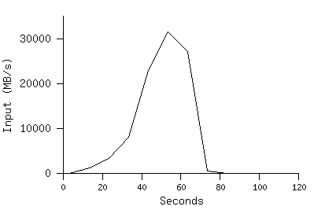
MR_Grep
Locality optimization helps:
1800 machines read 1 TB at peak ~31 GB/s
W/out this, rack switches would limit to 10 GB/s
Startup overhead is significant for short jobs

Slide 37
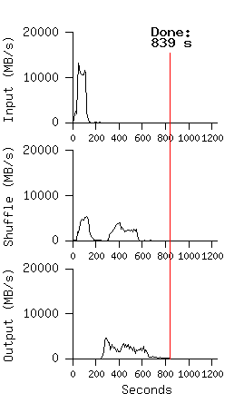
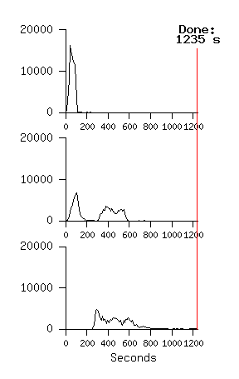
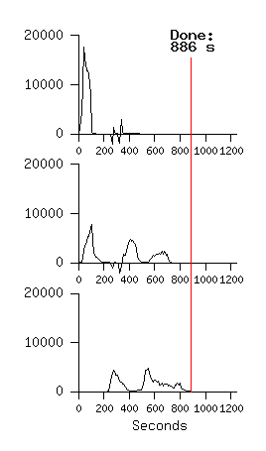
MR_Sort
Normal No backup tasks 200 processes killed
Backup tasks reduce job completion time a lot!
System deals well with failures

Slide 38
Experience
Rewrote Google's production indexing
System using MapReduce
  Set of 10, 14, 17, 21, 24 MapReduce operations
  New code is simpler, easier to understand
    3800 lines C++ → 700
  MapReduce handles failures, slow machines
  Easy to make indexing faster
    add more machines

Slide 39
Usage in Aug 2004
Number of jobs 29,423
Average job completion time 634 secs
Machine days used 79,186 days
Input data read 3,288 TB
Intermediate data produced 758 TB
Output data written 193 TB
Average worker machines per job 157
Average worker deaths per job 1.2
Average map tasks per job 3,351
Average reduce tasks per job 55
Unique map implementations 395
Unique reduce implementations 269
Unique map/reduce combinations 426

Slide 40
Underlying technologies used
Implementation of Map/Reduce made use of other cloud computing services available at Google
  System management tools track the available nodes, configurations, current loads
  Chubby “locking” tool for synchronization
  Google file system (GFS) provides convenient storage, makes it easy to gather the inputs needed for Reduce (write locally, anywhere, and read anywhere)
  Big Table: a table-structured database, runs over GFS

Slide 41
Related Work
Programming model inspired by functional language primitives
Partitioning/shuffling similar to many large-scale sorting systems
  NOW-Sort ['97]
Re-execution for fault tolerance
  BAD-FS ['04] and TACC ['97]
Locality optimization has parallels with Active Disks/Diamond work
  Active Disks ['01], Diamond ['04]
Backup tasks similar to Eager Scheduling in Charlotte system
  Charlotte ['96]
Dynamic load balancing solves similar problem as River's distributed queues
  River ['99]

Slide 42
Conclusions
MapReduce proven to be useful abstraction
Greatly simplifies large-scale computations
Easy to use:
  focus on problem,
  let library deal w/ messy details

