Slide 1
Cloud Computing and Edge Computing
Ken Birman
Cornell University. CS5410 Fall 2008.

Slide 2
Welcome to CS5140!
A course on cloud computing, edge computing, and related systems technologies
We’re using a textbook written by Professor Birman, (a bit out of date). Copies on reserve.
Grading mostly based on three assignments aimed at hands-on experience with the things we’re learning in class
Background: Java or C++ (or C#), familiar with threads, comfortable writing programs, had an architecture course and an operating systems course.

Slide 3
Two side-by-side revolutions
Cloud computing: trend is to move more and more computing functions into large shared data centers
  Amazon EC2 “hosts” data centers for customers
  Google runs all sorts of office applications, email, etc on their systems
  Yahoo! wants to be a one-source computing solution
  IBM has a vision of computing “like electric power”
Edge computing: direct interactions among computers (peers) out in the Internet
  For example, multi-user games, VR immersion

Slide 4
Cloud Computing Concept
Email, file storage, IM, search
Databases, spreadsheets, office apps
Client systems use web technologies
Web services
Google/IBM/Amazon/Yahoo! host the services

Slide 5
Supporting technologies
Infrastructure
  Core management and scheduling functions
  Event notification services
  Storage systems (GFS)
  Monitoring, debugging, tuning assistance
Increasingly: virtualization
Cloud “enablers”
  Map-Reduce
  BigTable
  Astrolabe
  Amazon’s shopping cart
Even higher level?
  Tools for building and analyzing massive graphs

Slide 6
… Sadly, we can’t do everything!
In CS5140 we don’t have time to cover all of these topics, so we’ll focus on infrastructure tools
  You can’t build things like Map-Reduce without them!
  But you won’t learn to use Hadoop (a popular open-source Map-Reduce implementation) in this class
Even within the infrastructure space, we’ll pick and choose our topics to get at some of the key ideas
Secondary issue: we also want to look at the edge

Slide 7

Will the next big thing happen on the edge of the network?
…. VR immersion… Distributed programming by “drag and drop”

Slide 8
Pause for a short demo…
http://liveobjects.cs.cornell.edu

Slide 9
Live objects are…
An integration tool – a “thin” layer that lets us glue components together into event-driven applications
  A kind of “drag and drop” programming tool
Common framework unifies replication technologies
Example Applications
Photo sharing that works | Games and virtual worlds
Collaboration tools | Emergency response
Office automation | Mobile services
New Internet Services | Coordinated planning
Interactive television | Social networking

Slide 10
But they also depend on data center resources
Data centers host maps, databases, rendering software
Think of the “static” content as coming from a data center, and streams of events reflecting real-time content coming directly from sensors and “synthetic content sources”, combined on your end-user node
All of this needs to scale to massive deployments

Slide 11
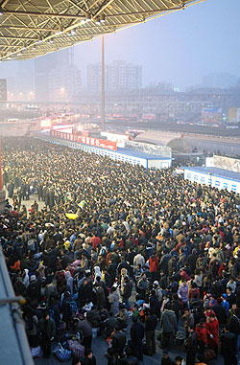
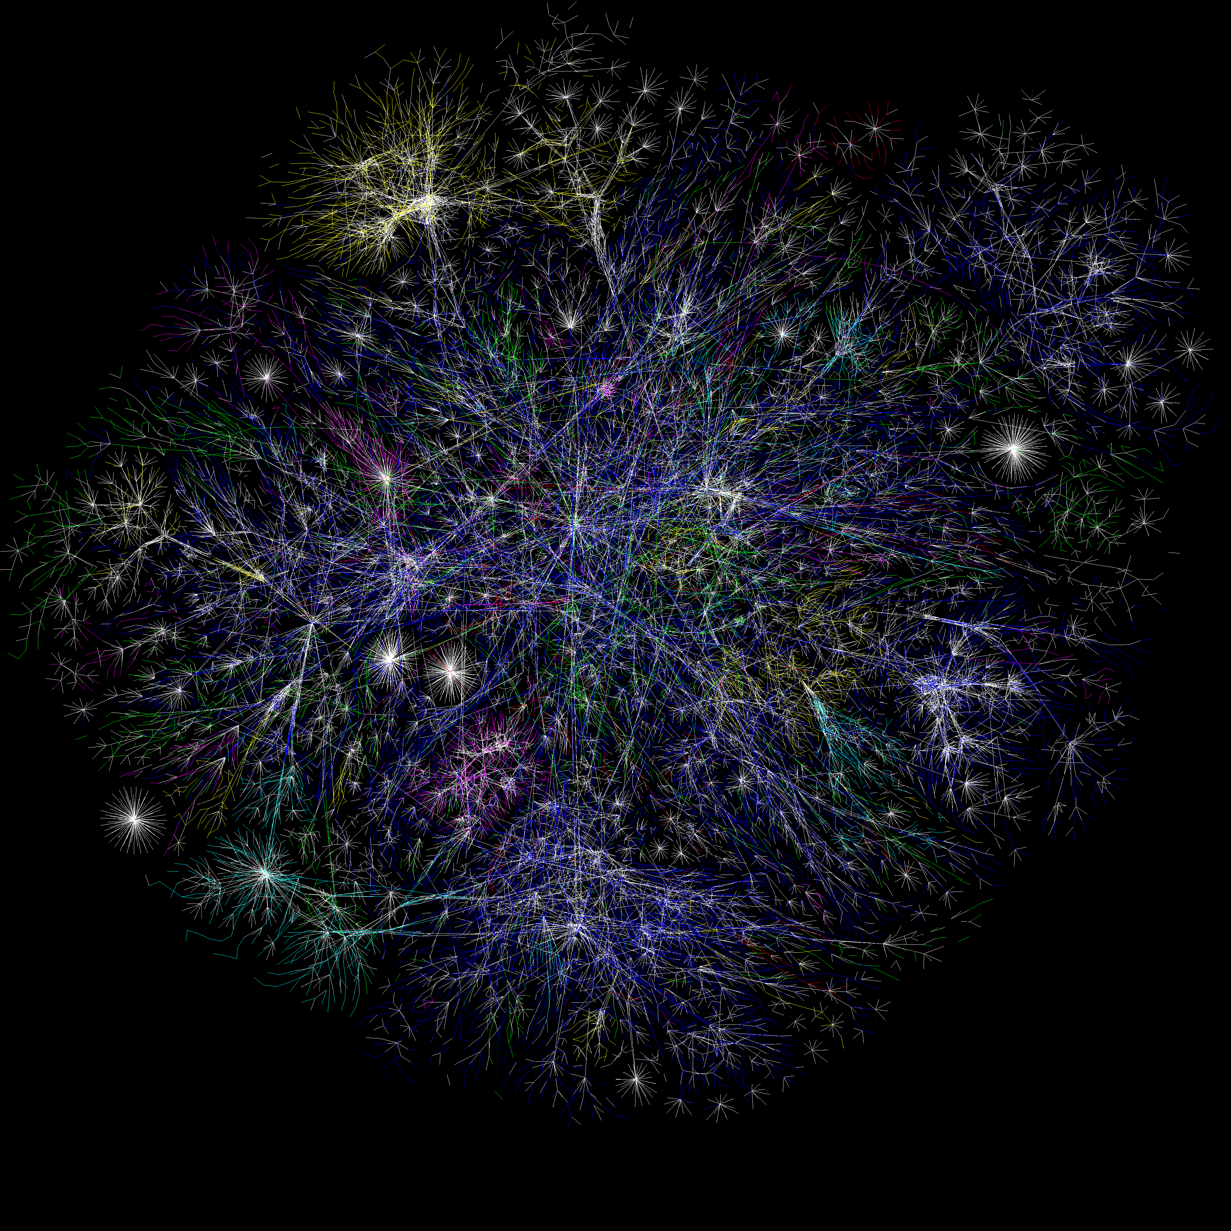

It’s a big, big world out on the edge….

Slide 12
Our goals today
In CS5140, we’ll peel back the covers
  Try and understand major technologies used to implement cloud computing platforms
    How did IBM/Amazon/Google/etc build their cloud computing infrastructure?
    What tools do all of these systems employ? How are they implemented, and what are the cost/performance tradeoffs?
    How robust are they?
  And also, how to build your own cloud applications
    Key issue: to scale well, they need to replicate functionality
The underlying standards: Web Services and CORBA

Slide 13
How does this overlap with edge technologies?
The edge is a world of peer-to-peer solutions
  BitTorrent, Napster/Gnutella, PPLive, Skype, and even Live Objects
  How are these built? What issues need to be addressed when systems live out in the wild (in the Internet)?
But those edge solutions are invariably supported by some kind of cloud service, and in the future the integration is going to become more significant
What happens when we graft edge solutions to cloud platforms?

Slide 14
Connecting the cloud to the edge
The cloud is a good place to
  Store massive amounts of content
  Keep precomputed information, account information
  Run scalable services
The edge is a good place to
  Capture data from the real world (sensors, cameras…)
  Share high-rate video, voice, event streams, “updates”
  Support direct collaboration, interaction

Slide 15
Topics we’ll cover
[9/3/08] Web Services and SOA standards. CORBA and OO standards
[9/8/08] Key components of cloud computing platforms
[9/10/08] Cloud computing applications and Map-Reduce
[9/15/08] Thinking about distributed systems: Models of time and event ordering
[9/17/08] Clock synchronization and the limits of real-time
[9/22/08] Consensus on event ordering: The GMS Service(1)
[9/24/08] The GMS Service(2)
[9/29/08] State machine concept. Possible functionality that our GMS can support
[10/1/08] Replication: basic goals. Ricochet
[10/6/08] Replication with stronger semantics: Virtual synchrony
[10/8/08] Replication with consensus semantics: Paxos
[10/15/08] Transactional subsystems and Web Services support for the transactional model
[10/20/08] How transactional servers are implemented
[10/22/08] Gossip-based replication and system monitoring. Astrolabe
[10/27/08] DHTs. Chord, Pastry, Kelips
[10/29/08] T-Man
[11/03/08] Trusted computing issues seen in cloud settings. Practical Byzantine Agreement
[11/05/08] Interconnecting cloud platforms with Maelstrom. Mirrored file systems.
[11/10/08] Life on the Edge: Browsers. BitTorrent
[11/12/08] Sending complex functions to edge systems: Javascript and AJAX
[11/17/08] In flight web page and data modifications and implications. Web tripwires
[11/19/08] Pure edge computing: Gnutella
[11/24/08] Resilient Overlay Networks. PPLive

Slide 16
Stylistic comments
One way to approach CS5140 would focus on a how-to way of using standards and packages
  For example, Microsoft favors Indigo as their web services solution for Windows platforms
  We could spend 12 weeks learning everything we can about Indigo, do projects using Indigo, etc.
  You would emerge as an “Indigo expert”

Slide 17
Stylistic comments
A second extreme would be to completely ignore the web services standards and focus entirely on the theory
  We would discuss ways of thinking about distributed systems
  Models for describing protocols
  Ways of proving things about them
You would be left to apply these ideas “as an exercise”

Slide 18
CS5140: Pursuing the middle
The class will try and live somewhere in the middle
  About half of our lectures are on very concrete real systems, like BitTorrent or Chubby, and how they work
  And about half our lectures are concerned with the platform standards and structures and how they look
  A few lectures focus on the underlying theory
Homework assignments will involve building real (but simple) distributed systems using these ideas
  For this, we’ll work with Windows platforms & technology

Slide 19
Let’s look at an example
To illustrate the way the class will operate, let’s look at a typical example of a problem that cuts across these three elements
  It arises in a standard web services context
  But it raises harder questions
  Ultimately, theoretical tools help us gain needed clarity

Slide 20
ATC Architecture
NETWORK INFRASTRUCTURE
ATC State
ATC status is a kind of temporal database: for each ATC sector, it tells us what flights might be in that sector and when they will be there
Notes:
Our long term vision offers the Horus system as a potential component of the global/mobile military information infrastructure. This must be a platform in which it is possible to construct highly assured communications and computing systems while using COTS hardware and software.
Here we see a typical C4-I application in which strategic and tactical planners coordinate an air and ground strike by combining information from the field, space, and intelligence databases. To achieve such systems and guarantee their availability when and where we need it, it will be necessary to have a technology such as Horus at our disposal.
Horus combines the mechanisms needed to provide fault-tolerance through software, security through message filtering mechanisms which will soon be linked to Kerberos signature and encryption tools, and realtime guarantees.
Horus is presented to users in the form of a process group computing environment. Applications are encouraged to make use of groups of processes for purposes such as data replication or functional replication for fault-tolerance; Horus groups are unusual in being presentable in varied forms (through wrappers) and having flexible semantics (depending on the stack of Lego-style building blocks used in support of the group mechanisms selected by the developer).

Slide 21
Server replication
Let’s think about the service that tracks the status of ATC sectors
  Client systems are like web browsers
  Server is like a web service. ATC is a “cloud” but one with special needs: it speaks with “one voice”
Now, an ATC needs highly available servers.
  Else a crash could leave controller unable to make decisions
  So: how can we make a service highly available?

Slide 22
Server replication
Key issue: we need to maintain that “one voice” property
  Behavior of our highly available service needs to be indistinguishable from that of a traditional service running on some single node that just doesn’t fail
Most obvious option: “primary/backup”
  We run two servers on separate platforms
  The primary sends a log to the backup
  If primary crashes, the backup soon catches up and can take over

Slide 23
A primary-backup scenario…
primary
backup
log
Clients initially connected to primary, which keeps
backup up to date. Backup collects the log

Slide 24
Split brain Syndrome…
primary
backup
Transient problem causes some links to break but not all.
Backup thinks it is now primary, primary thinks backup is down

Slide 25
Split brain Syndrome
Safe for US227 to land on Ithaca’s NW runway
primary
backup
Safe for NW111 to land on Ithaca’s NW runway
Some clients still connected to primary, but one has switched
to backup and one is completely disconnected from both

Slide 26
Oh no! But could this happen?
How do web service systems detect failures?
  The specifications don’t really answer this question
  A web client senses a failure if it can’t connect to a server, or if the connection breaks
  And the connections are usually TCP
So, how does TCP detect failures?
  Under the surface, TCP sends data in IP packets, and the receiver acknowledges receipt.
  TCP channels break if a timeout occurs.

Slide 27
Provoking a transient fault
Build a fairly complex network with some routers, multiple network segments, etc
Run TCP over it in the standard way
Now disrupt some core component
  TCP connections will break over a 90 second period
  So… restore service after perhaps 30 seconds. Some break, but some don’t.

Slide 28
Implication?
We end up with multiple servers that might each think they are in charge of our ATC system!
An ATC System with a split brain could malfunction disastrously!
  For example, suppose the service is used to answer the question “is anyone flying in such-and-such a sector of the sky”
  With the split-brain version, each half might say “nope”… in response to different queries!

Slide 29
Can we fix this problem?
Sure. Just have the backup unplug the primary
But less draconian solutions are also possible
  We’ll look at this issue later in the class
  Need “agreement” on which machines are up and which have crashed
  Can’t implement “agreement” on a purely 1-to-1 (also called “end-to-end”) basis.
    Separate decisions can always lead to inconsistency
    So we need a “membership service”… and this is fundamentally not an end-to-end concept!

Slide 30
End-to-End argument
Commonly cited as a justification for not tackling reliability in “low levels” of a platform
Originally posed in the Internet:
  Suppose an IP packet will take n hops to its destination, and can be lost with probability p on each hop
  Now, say that we want to transfer a file of k records that each fit in one IP (or UDP) packet
  Should we use a retransmission protocol running “end-to-end” or n TCP protocols in a chain?

Slide 31
End-to-End argument
source
dest
Loss rate: p%
Probability of successful transit: (1-p)^{n},
Expected packets lost: k-k*(1-p)^{n}

Slide 32
Saltzer et. al. analysis
If p is very small, then even with many hops most packets will get through
  The overhead of using TCP protocols in the links will slow things down and won’t often benefit us
  And we’ll need an end-to-end recovery mechanism “no matter what” since routers can fail, too.
Conclusion: let the end-to-end mechanism worry about reliability

Slide 33
Generalized End-to-End view?
Low-level mechanisms should focus on speed, not reliability
The application should worry about “properties” it needs
OK to violate the E2E philosophy if E2E mechanism would be much slower

Slide 34
E2E is visible in J2EE and .NET
If something fails, these technologies report timeouts
  But they also report timeouts when nothing has failed
  And when they report timeouts, they don’t tell you what failed
  And they don’t offer much help to fix things up after the failure, either
Timeouts and transient faults can’t be distinguished
  Thus we can always detect failures.
  But we’ll sometimes make mistakes.

Slide 35
But why do cloud systems use end-to-end failure detection?
ATC example illustrated a core issue
Existing platforms
  Lack automated management features
  Inherit features of the Internet… even ones that embody inappropriate behavior
  In this example, we saw that TCP handles errors in ad-hoc, inconsistent ways
Developers often forced to step outside of the box… and may succeed, but might stumble.
In CS5140 we’ll try and tackle some of these questions in a more principled way

Slide 36
Even this case illustrates choice
We have many options, if we are willing to change the failure semantics of our platform
  Just use a single server and wait for it to restart
    This common today, but too slow for ATC
    Cloud computing systems usually need at least a few seconds
  Give backup a way to physically “kill” the primary, e.g. unplug it
    If backup takes over… primary shuts down
  Or require some form of “majority vote” and implement this in the cloud computing platform itself
    System maintains agreement on its own structure
Later we’ll see what the last of these options entails

Slide 37
Elements of cloud computing
One perspective: the laundry list of tools and technologies we saw earlier
A second perspective: a collection of abstractions and assumptions that the cloud needs to implement, and that the developer can then “trust”
  For example, if the cloud were to implement a failure detection mechanism, the developer could trust it, and split brain problems would be avoided
  We’ll generalize this way of thinking. The cloud is a provider of abstractions. Specific tools implement those abstractions

Slide 38
ATC example illustrates…
A form of replication (one form among many)
An example of a consistency need (one kind of consistency but not the only kind)
A type of management “implication” associated with that consistency need
A deeper question of what it means for a system to agree on the state of its own members

Slide 39
How can a system track its own membership?
We’ve discussed the idea that a cloud might offer users some form of VMM abstraction
  E.g. Amazon.com might tell Target.com “we’ll host your data center” but rather than dedicate one machine for each server Target thinks it needs, Amazon could virtualize the servers and schedule them efficiently
So… let’s virtualize the concept of failure handling

Slide 40
Typical client-server scenario
TCP used for connections
Each channel has its
own timers
If a timeout occurs,
clients “fail-over”
to the backup
primary
backup

Slide 41
Split brain scenario
Potential for inconsistency
Each client makes its own
decisions
Outcome can be
inconsistent
Concern:
“split brain” behavior
primary
???
backup

Slide 42

Role of an Oracle
Hear and obey. The primary is down. I have spoken!!!
An all-seeing eye.
Clients must obey it
If the oracle makes a mistake, we “do as it says” anyhow
This eliminates our
fear of inconsistency.
Now we just hope
mistakes are rare!
Track membership
crash
primary
backup

Slide 43
Oracle
A kind of all-seeing eye that dictates the official policy for the whole data center
  If the Oracle says that node X is up, we keep trying to talk to node X
  If the Oracle says node X is down, we give up
An Oracle imposes a form of consistency

Slide 44
Oracle
Later we’ll see that an Oracle can be implemented in a decentralized way
  Some (perhaps all) nodes run a service
  The service elects a leader, and the leader makes decisions (if you think a node is faulty, you tell it)
  If the leader fails, a majority election is used to elect a new leader
By continously requiring majority consent, we guarantee that split-brain cannot occur.

Slide 45
Stepping back
So one goal of CS5140 is to look at these issues on the boundary of
  What technologies can and can’t do
  What we can do to overcome or evade the limits
  The associated theory
A second goal is to think about how to structure systems into more standard pieces

Slide 46
Back to the edge…
Today’s focus was on issues see in cloud settings.
But similar questions arise in peer-to-peer systems used for file sharing, telephony, games, and even live objects
  Not the identical notion of consistency and the style of solutions is different
  We’ll look at P2P replication… event notification… building structured overlays… well known applications

Slide 47
Wrapping up
CS5140 lectures will look at technologies and issues such as the ones just reviewed
CS5140 projects will
  Give you hands-on experience using Windows to build web services and clients that talk to them
  And some limited experience using the solutions we identify in class in the context of those services
Grading: Mostly based on the three assignments
  First two will be done individually; third can be done in small teams

Slide 48
Meng credit
The CS5140 project can be used for Meng project credit
  You must sign up for CS7900 credit with Ken Birman
  We recommend 3 credits, letter grade
  Your grade will be identical in CS5140, CS7900
  You are expected to tackle a slightly more ambitious problem to get the extra credit
Typically, cs7900 entails doing a more detailed experimental evaluation of assignment three and reporting your findings

