Slide 1
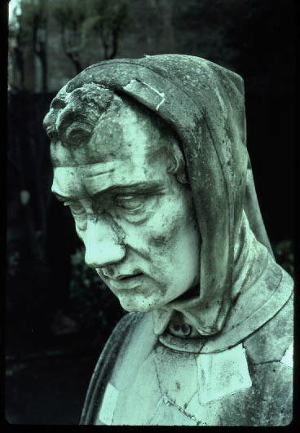
Fibonacci numbers Golden Ratio, recurrences
Fibonacci
(Leonardo Pisano) 1170-1240?
Statue in Pisa Italy
Lecture 27
CS2110 – Fall 2018

Slide 2
Announcements
A7: NO LATE DAYS. No need to put in time and comments. We have to grade quickly. No regrade requests for A7. Grade based only on your score on a bunch of sewer systems.
Please check submission guidelines carefully. Every mistake you make in submitting A7 slows down grading of A7 and consequent delay of publishing tentative course grades.
Sewer system generated from seed -3026730162232494481 has no coins!

Slide 3
Announcements
Final is optional! As soon as we grade A7 and get it into the CMS, we determine tentative course grades.
Complete “assignment” Accept course grade? on the CMS by Wednesday night.
If you accept it, that IS your grade. It won’t change.
Don’t accept it? Take final. Can lower and well as raise grade.
More past finals are now on Exams page of course website. Not all answers yet.

Slide 4
Announcements
We try to make final fair.
Our experience: For majority of students, it doesn’t affect their grade. More raise their grade than lower their grade.
One semester: One semester Total taking final: 87 75 Raised grade: 8 27 Lowered grade: 5 5

Slide 5
Announcements
Course evaluation: Completing it is part of your course assignment. Worth 1% of grade.
Must be completed by Saturday night. 1 DEC
Please complete for Gries and for Bracy
We then get a file that says who completed the evaluation.
We do not see your evaluations until after we submit grades to to the Cornell system.
We never see names associated with evaluations.

Slide 6
Announcements
Office hours:
Gries: today, Thursday, 1-3
Bracy: moved from today, 11-12 to tomorrow, Friday, 11-12

Slide 7
Fibonacci function
But sequence described much earlier in India:
Virahaṅka 600–800
Gopala before 1135 Hemacandra about 1150
fib(0) = 0
fib(1) = 1
fib(n) = fib(n-1) + fib(n-2) for n ≥ 2
0, 1, 1, 2, 3, 5, 8, 13, 21, …
In his book in 120 titled Liber Abaci
Has nothing to do with the
famous pianist Liberaci
The so-called Fibonacci numbers in ancient and medieval India.
Parmanad Singh, 1985
pdf on course website

Slide 8
Fibonacci function (year 1202)
fib(0) = 0
fib(1) = 1
fib(n) = fib(n-1) + fib(n-2) for n ≥ 2
/** Return fib(n). Precondition: n ≥ 0.*/
public static int f(int n) {
if ( n <= 1) return n;
return f(n-1) + f(n-2);
}
0, 1, 1, 2, 3, 5, 8, 13, 21, 34, 55
We’ll see that this is a lousy way to compute f(n)

Slide 9
Golden ratio Φ = (1 + √5)/2 = 1.61803398…
Divide a line into two parts:
Call long part a and short part b
a
b
(a + b) / a = a / b
Solution is the golden ratio, Φ
See webpage:
http://www.mathsisfun.com/numbers/golden-ratio.html

Slide 10
Φ = (1 + √5)/2 = 1.61803398…
0, 1, 1, 2, 3, 5, 8, 13, 21, 34, 55
a/b
8/5 = 1.6
13/8 = 1.625…
21/13= 1.615…
34/21 = 1.619…
55/34 = 1.617…
fib(n) / fib(n-1) is close to Φ.
So Φ * fib(n-1) is close to fib(n)
Use formula to calculate fib(n) from fib(n-1)
In fact,
limit f(n)/fib(n-1) = Φ n -> ∞
Golden ratio and Fibonacci numbers: inextricably linked

Slide 11
Golden ratio Φ = (1 + √5)/2 = 1.61803398…
Find the golden ratio when we divide a line into two parts a and b such that
(a + b) / a = a / b = Φ
a/b
8/5 = 1.6
13/8 = 1.625…
21/13= 1.615…
34/21 = 1.619…
55/34 = 1.617…
Golden rectangle
a
a
b
For successive Fibonacci numbers a, b , a/b is close to Φ
but not quite it Φ . 0, 1, 1, 2, 3, 5, 8, 13, 21, 34, 55, …

Slide 12
Fibonacci, golden ratio, golden angle
0, 1, 1, 2, 3, 5, 8, 13, 21, 34, 55
limit f(n)/fib(n-1) = golden ratio = 1.6180339887…
n -> ∞
360/1.6180339887… = 222.492235…
360 – 222.492235… = 137.5077 golden angle

Slide 13
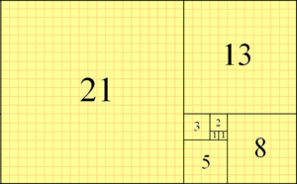
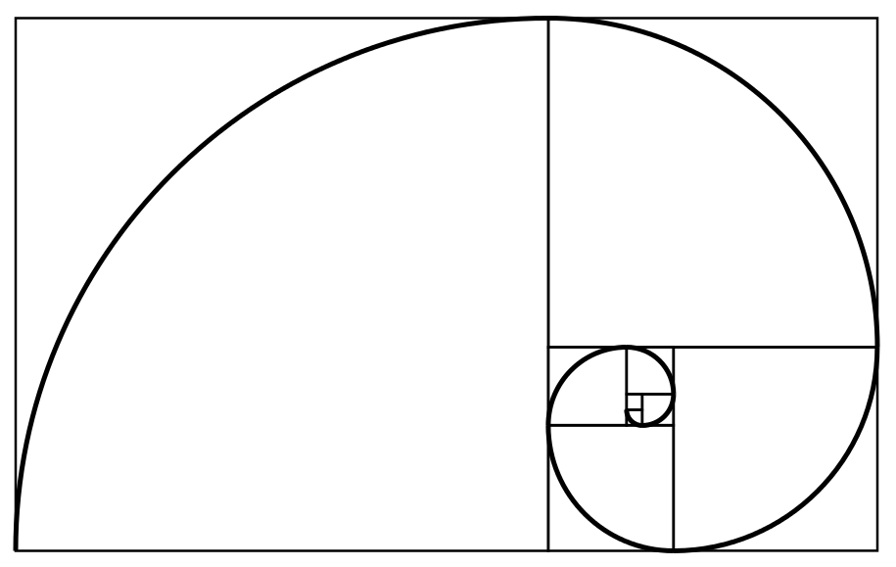
Fibonacci function (year 1202)
Downloaded from wikipedia
Golden rectangle
Fibonacci tiling
Fibonacci spiral
0, 1, 1, 2, 3, 5, 8, 13, 21, 34 …

Slide 14
The Parthenon

Slide 15
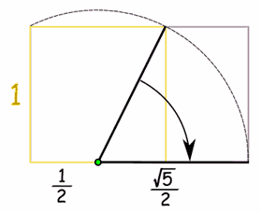
Drawing a golden rectangle with ruler and compass
a
b
How to draw a golden rectangle
golden rectangle
hypotenuse: √(1*1 + (½)(½)) = √(5/4)

Slide 16
fibonacci and bees
0
MB 1
FB 1
FB MB 2
FB MB FB 3
FB MB FB FB MB 5
FB MB FB FB MB FB MB FB 8
MB: male bee, FB: female bee
Male bee has only a mother
Female bee has mother and father
The number of ancestors at any level is a Fibonnaci number

Slide 17
Fibonacci in Pascal’s Triangle
1
1
2
3
5
1
0
1
2
3
4
5
6
7
8
8
1
1
13
1
2
1
21
1
3
3
1
1
4
6
4
1
1
5
10
10
5
1
1
6
15
20
15
6
1
1
7
21
35
35
21
7
1
p[i][j] is the number of ways i elements can be chosen from a set of size j

Slide 18
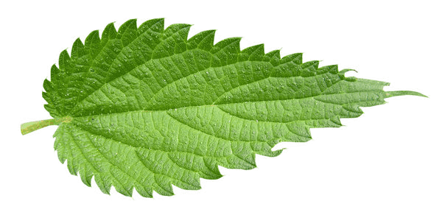
Suppose you are a plant
You want to grow your leaves so that they all get a good amount of sunlight. You decide to grow them at successive angles of 180 degrees
Pretty stupid plant! The two bottom leaves get VERY little sunlight!

Slide 19
Suppose you are a plant
You want to grow your leaves so that they all get a good amount of sunlight. 90 degrees, maybe?
Where does the fifth leaf go?

Slide 20
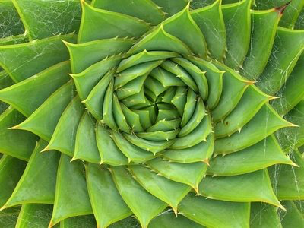
Fibonacci in nature
The artichoke uses the Fibonacci pattern to spiral the sprouts of its flowers.
360/(golden ratio) = 222.492
The artichoke sprouts its leafs at a constant amount of rotation: 222.5 degrees (in other words the distance between one leaf and the next is 222.5 degrees).
Recall: golden angle
topones.weebly.com/1/post/2012/10/the-artichoke-and-fibonacci.html

Slide 21
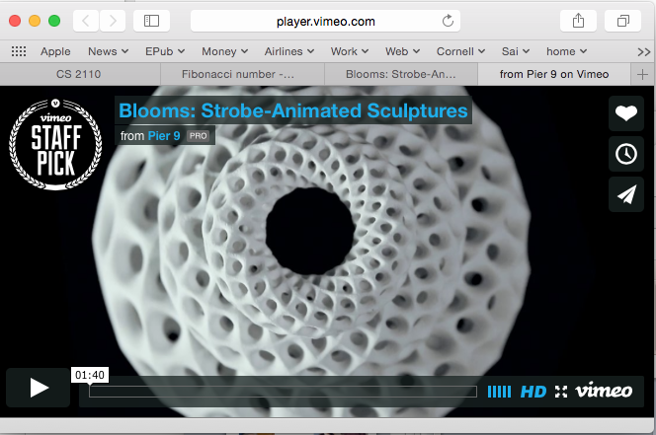
Blooms: strobe-animated sculptures
www.instructables.com/id/Blooming-Zoetrope-Sculptures/

Slide 22
Uses of Fibonacci sequence in CS
Fibonacci search
Fibonacci heap data strcture
Fibonacci cubes: graphs used for interconnecting parallel and distributed systems

Slide 23
Fibonacci search of sorted b[0..n-1]
binary search: cut in half at each step
Fibonnacci search: (n = 144)
cut by Fibonacci numbers
e1
e1
0 n
__________________
__________________
0 144
e1 = (n-0)/2
e1 = 0 + 89
0 e1
e2
e2
_________
0 e1
___________
e2 = (e1-0)/2
e2 = 0 + 55
_____
_______
e2 e1
e2 e1
2 3 5 8 13 21 34 55 89 144

Slide 24
Fibonacci search history
David Ferguson. Fibonaccian searching. Communications of the ACM, 3(12) 1960: 648
Wiki: Fibonacci search divides the array into two parts that have sizes that are consecutive Fibonacci numbers. On average, this leads to about 4% more comparisons to be executed, but only one addition and subtraction is needed to calculate the indices of the accessed array elements, while classical binary search needs bit-shift, division or multiplication.
If the data is stored on a magnetic tape where seek time depends on the current head position, a tradeoff between longer seek time and more comparisons may lead to a search algorithm that is skewed similarly to Fibonacci search.

Slide 25
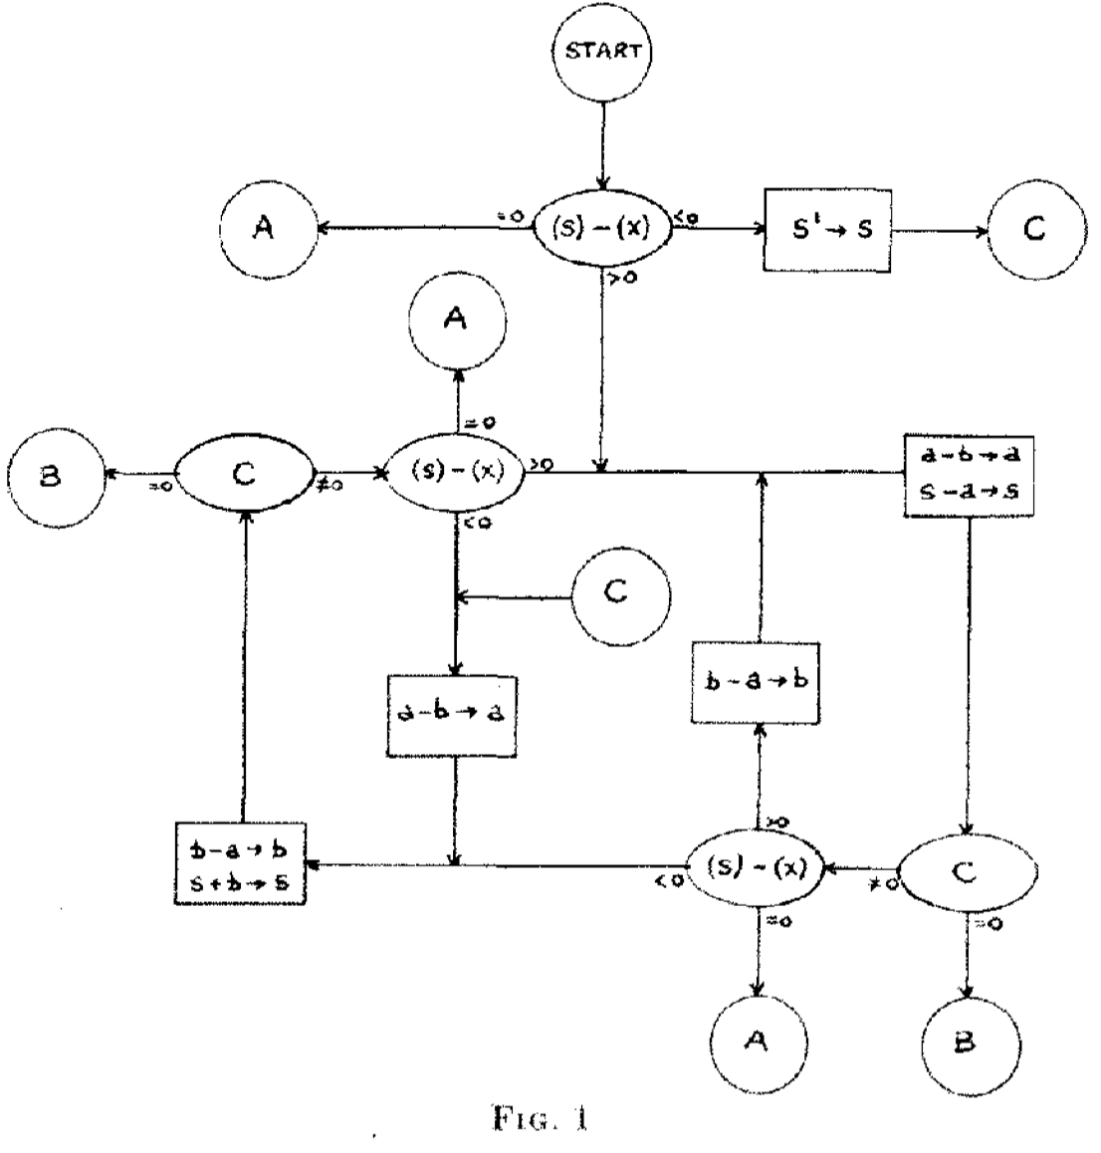
Fibonacci search
David Ferguson.
Fibonaccian searching.
This flowchart is how Ferguson describes the algorithm in this 1-page paper. There is some English verbiage but no code.
Only high-level language available at the time: Fortran.

Slide 26
LOUSY WAY TO COMPUTE: O(2^n)
/** Return fib(n). Precondition: n ≥ 0.*/
public static int f(int n) {
if ( n <= 1) return n;
return f(n-1) + f(n-2);
}
Calculates f(15) 8 times! What is complexity of f(n)?
20
19
18
18
17
17
16
17
16
16
15
16
15
15
14

Slide 27
Recursion for fib: f(n) = f(n-1) + f(n-2)
T(0) = a T(n): Time to calculate f(n)
T(1) = a Just a recursive function
T(n) = a + T(n-1) + T(n-2) “recurrence relation”
We can prove that T(n) is O(2^{n})
It’s a “proof by induction”.
Proof by induction is not covered in this course.
But we can give you an idea about why T(n) is O(2^{n})
T(n) <= c*2^{n} for n >= N

Slide 28
Recursion for fib: f(n) = f(n-1) + f(n-2)
T(0) = a
T(1) = a
T(n) = a + T(n-1) + T(n-2)
T(n) <= c*2^{n} for n >= N
T(2)
= <Definition>
a + T(1) + T(0)
≤ <look to the left>
a + a * 2¹ + a * 2⁰
T(0) = a ≤ a * 2⁰
T(1) = a ≤ a * 2¹
= <arithmetic>
a * (4)
= <arithmetic>
a * 2²

Slide 29
Recursion for fib: f(n) = f(n-1) + f(n-2)
T(0) = a
T(1) = a
T(n) = T(n-1) + T(n-2)
T(n) <= c*2^{n} for n >= N
T(3)
= <Definition>
a + T(2) + T(1)
≤ <look to the left>
a + a * 2² + a * 2¹
T(0) = a ≤ a * 2⁰
T(1) = a ≤ a * 2¹
= <arithmetic>
a * (7)
T(2) = 2a ≤ a * 2²
≤ <arithmetic>
a * 2³

Slide 30
Recursion for fib: f(n) = f(n-1) + f(n-2)
T(0) = a
T(1) = a
T(n) = T(n-1) + T(n-2)
T(n) <= c*2^{n} for n >= N
T(4)
= <Definition>
a + T(3) + T(2)
T(0) = a ≤ a * 2⁰
≤ <look to the left>
a + a * 2³ + a * 2²
T(1) = a ≤ a * 2¹
= <arithmetic>
a * (13)
T(2) ≤ a * 2²
≤ <arithmetic>
a * 2⁴
T(3) ≤ a * 2³

Slide 31
Recursion for fib: f(n) = f(n-1) + f(n-2)
T(0) = a
T(1) = a
T(n) = T(n-1) + T(n-2)
T(n) <= c*2^{n} for n >= N
T(5)
= <Definition>
a + T(4) + T(3)
T(0) = a ≤ a * 2⁰
≤ <look to the left>
a + a * 2⁴ + a * 2³
T(1) = a ≤ a * 2¹
T(2) ≤ a * 2²
= <arithmetic>
a * (25)
T(3) ≤ a * 2³
≤ <arithmetic>
a * 2⁵
T(4) ≤ a * 2⁴
WE CAN GO ON FOREVER LIKE THIS

Slide 32
Recursion for fib: f(n) = f(n-1) + f(n-2)
T(0) = a
T(1) = a
T(n) = T(n-1) + T(n-2)
T(n) <= c*2^{n} for n >= N
T(k)
= <Definition>
a + T(k-1) + T(k-2)
T(0) = a ≤ a * 2⁰
≤ <look to the left>
a + a * 2^{k-1} + a * 2^{k-2}
T(1) = a ≤ a * 2¹
T(2) ≤ a * 2²
= <arithmetic>
a * (1 + 2^{k-1 +} 2^{k-2})
T(3) ≤ a * 2³
≤ <arithmetic>
a * 2^{k}
T(4) ≤ a * 2⁴

Slide 33
Caching
As values of f(n) are calculated, save them in an ArrayList.
Call it a cache.
When asked to calculate f(n) see if it is in the cache.
If yes, just return the cached value.
If no, calculate f(n), add it to the cache, and return it.
Must be done in such a way that if f(n) is about to be cached, f(0), f(1), … f(n-1) are already cached.

Slide 34
Caching
/** For 0 ≤ n < cache.size, fib(n) is cache[n]
* If fibCached(k) has been called, its result in in cache[k] */
public static ArrayList<Integer> cache= new ArrayList<>();
/** Return fibonacci(n). Pre: n >= 0. Use the cache. */
public static int fibCached(int n) {
if (n < cache.size()) return cache.get(n);
if (n == 0) { cache.add(0); return 0; }
if (n == 1) { cache.add(1); return 1; }
int ans= fibCached(n-2) + fibCached(n-1);
cache.add(ans);
return ans;
}

Slide 35
Linear algorithm to calculate fib(n)
/** Return fib(n), for n >= 0. */
public static int f(int n) {
if (n <= 1) return 1;
int p= 0; int c= 1; int i= 2;
// invariant: p = fib(i-2) and c = fib(i-1)
while (i < n) {
int fibi= c + p; p= c; c= fibi;
i= i+1;
}
return c + p;
}

Slide 36
Logarithmic algorithm!
f₀ = 0
f₁ = 1
f_{n+2} = f_{n+1} + f_{n}
0 1
1 1
f_{n}
f_{n+1}
f_{n+1}
f_{n+2}
=
0 1
1 1
0 1
1 1
f_{n}
f_{n+1}
f_{n+1}
f_{n+2}
f_{n+2}
f_{n+3}
0 1
1 1
=
=
k
0 1
1 1
f_{n}
f_{n+1}
f_{n+k}
f_{n+k+1}
=

Slide 37
Logarithmic algorithm!
f₀ = 0
f₁ = 1
f_{n+2} = f_{n+1} + f_{n}
k
0 1
1 1
f_{n}
f_{n+1}
f_{n+k}
f_{n+k+1}
=
k
0 1
1 1
f₀
f₁
f_{k}
f_{k+1}
=
You know a logarithmic algorithm for exponentiation —recursive and iterative versions
Gries and Levin
Computing a Fibonacci number in log time.
IPL 2 (October 1980), 68-69.

Slide 38
Another log algorithm!
Define φ = (1 + √5) / 2 φ’ = (1 - √5) / 2
The golden ratio again.
Prove by induction on n that
fn = (φ^{n} - φ’^{n}) / √5

