Slide 1
Hashing
CS2110

Slide 2
Announcements
Submit Prelim 2 conflicts by Thursday night
A6 is due Nov 7 (tomorrow!)

Slide 3
Ideal Data Structure
Data Structure | add(val x) | get(int i) | contains(val x)
ArrayList
LinkedList
Goal:
2
1
3
0
$$O(n)$$
$$O(1)$$
$$O(n)$$
$$O(1)$$
$$O(n)$$
$$O(n)$$
2
1
3
0
$$O(1)$$
$$O(1)$$
$$O(1)$$
AKA add, lookup, search

Slide 4
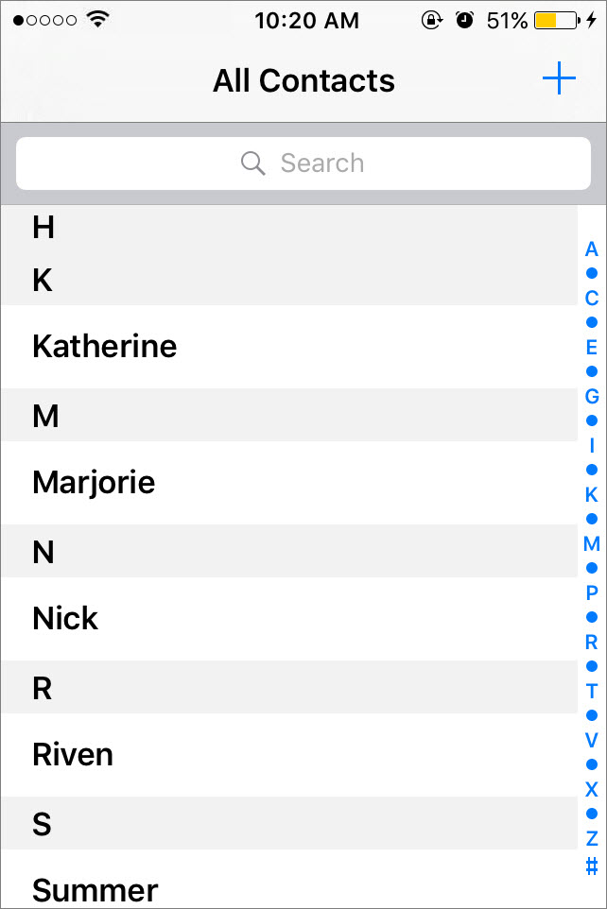
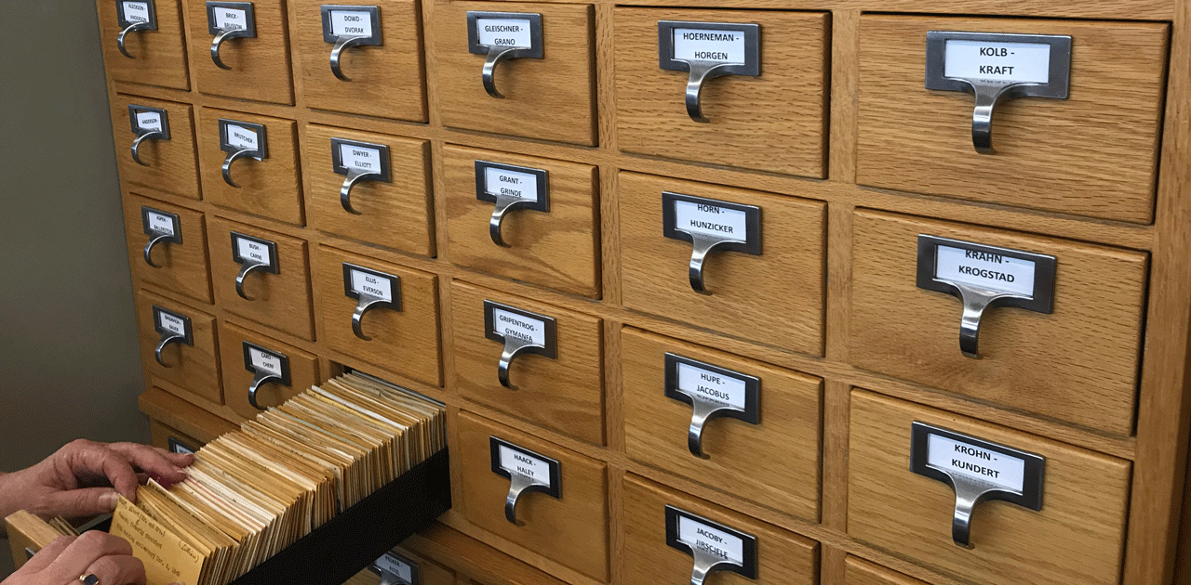
Mystery Data Structure in Your Life
What do these data structures have in common?

Slide 5
New Data Structure
: Hash Set
Data Structure | add(val x) | get(int i) | contains(val x)
ArrayList
LinkedList
2
1
3
0
$$O(n)$$
$$O(1)$$
$$O(n)$$
$$O(1)$$
$$O(n)$$
$$O(n)$$
2
1
3
0
HashSet
0 1 2 3
$$O(1)$$
$$O(1)$$
$$O(1)$$
3
1
2
Expected time
Worst-case: $O(n)$
AKA add, lookup, search

Slide 6
Intuition behind a Hash Set
Idea: finding an element in an array takes constant time when you know which index it is stored in.
So… let’s place elements in the array based on their starting letter! (A=0, B=1, …)
CA
# of
1st letter
2
add(“CA”)
0 | 1 | 2 | 3 | 4 | 5 | 6 | 7 | 8 | 9 | 10 | 11 | 12 | 13 | 14 | 15 | 16 | … | 25
 |  |  |  |  |  |  |  |  |  |  |  | MA | NY | OR | PA
b
CA
DE
# of
1st letter
3
contains(“DE”)
Notes:
add/update/lookup/delete
analyse running time (naïve version)

Slide 7
What could possibly go wrong?
0 | 1 | 2 | 3 | 4 | 5 | 6 | 7 | 8 | 9 | 10 | 11 | 12 | 13 | 14 | 15 | 16 | … | 25
AL |  | CA | DE |  | FL | GA |  |  |  |  |  | MA | NY | OR | PA
b
Some buckets get used quite a bit!
called Collisions
Not all buckets get used

Slide 8
Hash Functions
Requirements:
deterministic
return a number*
1
0
1
4
Properties of a good hash:
fast
collision-resistant
evenly distributed
hard to invert
3
* the number is either in [0..n-1] where n is the size of the Hash Set, or you compute the hash and then % n, constraining it to be in [0…n-1]
Notes:
if the values are equal then…
If hashes are equal then…
For non-integer, encode as int (e.g., ascii)
sum_{i=0}^{n-1} s[i]* 31^{n-1-i}
Finding good hash functions is hard. SHA-3 2006-2015.

Slide 9
Example: hashCode()
Method defined in java.lang.Object
Default implementation: uses memory address of object
If you override equals, you must override hashCode!!!
String overrides hashCode:
$$s.hashCode() := s[0]∗{31}^{n−1} + s[1]∗{31}^{n−2} + … + s[n−1]$$
Do we like this hashCode?

Slide 10
Can we have perfect hash functions?
Perfect hash functions map each value to a different index in the hash table
Impossible in practice
Don’t know size of the array
Number of possible values far far exceeds the array size
No point in a perfect hash function if it takes too much time to compute

Slide 11
Collision Resolution
Two ways of handling collisions:
Chaining 2. Open Addressing

Slide 12
Chaining (1)
add(“NY”)
Each bucket is the beginning of a Linked List
NY
# of
1st letter
13
add(“NY”)
0 | 1 | 2 | 3 | 4 | 5 | 6 | 7 | 8 | 9 | 10 | 11 | 12 | 13 | 14 | 15 | 16 | … | 25
b
CA
MA
NY
OR
PA
CO
Notes:
run through lookup method (requires linear search)

Slide 13
Chaining (2)
add(“NY”)
add(“NJ”)
Each bucket is the beginning of a Linked List
NJ
# of
1st letter
13
add(“NJ”)
0 | 1 | 2 | 3 | 4 | 5 | 6 | 7 | 8 | 9 | 10 | 11 | 12 | 13 | 14 | 15 | 16 | … | 25
b
CA
MA
NY
OR
PA
Note: Would be better to add elements to the head of the linked list.
CO
NJ
Notes:
run through lookup method (requires linear search)

Slide 14
Chaining (3)
add(“NY”)
add(“NJ”)
get(”NJ")
Each bucket is the beginning of a Linked List
NJ
# of
1st letter
13
get(“NJ”)
0 | 1 | 2 | 3 | 4 | 5 | 6 | 7 | 8 | 9 | 10 | 11 | 12 | 13 | 14 | 15 | 16 | … | 25
b
CA
MA
NY
OR
PA
CO
NJ
Notes:
run through lookup method (requires linear search)

Slide 15
Chaining in Action
Insert the following elements (in order) into an array of size 6:
if code > n, use (code % n_buckets)
element | a | b | c | d | e
hashCode | 0 | 9 | 17 | 11 | 19
0
1
2
3
4
5
a
e
b
c
d

Slide 16
Open Addressing (1)
add(“NY”)
Probing: Find another available space
NY
# of
1st letter
13
add(“NY”)
0 | 1 | 2 | 3 | 4 | 5 | 6 | 7 | 8 | 9 | 10 | 11 | 12 | 13 | 14 | 15 | 16 | … | 25
 |  | CA | CO |  |  |  |  |  |  |  |  | MA |  | OR | PA
b
NY
Notes:
run through lookup method (requires linear search)

Slide 17
Open Addressing (2)
add(“NY”)
add(“NJ”)
Probing: Find another available space
NJ
# of
1st letter
13
add(“NJ”)
0 | 1 | 2 | 3 | 4 | 5 | 6 | 7 | 8 | 9 | 10 | 11 | 12 | 13 | 14 | 15 | 16 | … | 25
 |  | CA | CO |  |  |  |  |  |  |  |  | MA |  | OR | PA
b
NY
NJ
search
for space
Notes:
run through lookup method (requires linear search)

Slide 18
Open Addressing (3)
add(“NY”)
add(“NJ”)
Probing: Find another available space
...
get(”NJ")
NJ
# of
1st letter
13
get(“NJ”)
0 | 1 | 2 | 3 | 4 | 5 | 6 | 7 | 8 | 9 | 10 | 11 | 12 | 13 | 14 | 15 | 16 | … | 25
 |  | CA | CO |  |  |  |  |  |  |  |  | MA |  | OR | PA
b
NY
NJ
What could possibly go wrong?
add(“NY”),add(“NJ”),get(“NY”),get(“NJ”)
Search for NJ
(stop searching if element is NULL)
Notes:
run through lookup method (requires linear search)

Slide 19
Deletion Problem w/Open Addressing
add(“NY”)
Probing: Find another available space
add(“NJ”)
get(”NY")
get(”NJ")
0 | 1 | 2 | 3 | 4 | 5 | 6 | 7 | 8 | 9 | 10 | 11 | 12 | 13 | 14 | 15 | 16 | … | 25
 |  | CA | CO |  |  |  |  |  |  |  |  | MA |  | OR | PA
b
NY
NJ
Search for NJ
(stops searching b/c element b[13] is NULL!)
Notes:
run through lookup method (requires linear search)

Slide 20
Deletion Solution for Open Addressing
add(“NY”)
Probing: Find another available space
add(“NJ”)
get(”NY")
Need to mark element as “not present”
Indicates to search that it should keep looking
get(”NJ")
0 | 1 | 2 | 3 | 4 | 5 | 6 | 7 | 8 | 9 | 10 | 11 | 12 | 13 | 14 | 15 | 16 | … | 25
 |  | CA | CO |  |  |  |  |  |  |  |  | MA |  | OR | PA
b
NY
NY
NP
NJ
Search for NJ
(searches until it finds a NULL element or the present element it’s looking for)
Notes:
run through lookup method (requires linear search)

Slide 21
Different probing strategies
When a collision occurs, how do we search for an empty space?
clustering:
problem where nearby hashes have very similar probe sequence so we get more collisions
linear probing:
search the array in order:
i, i+1, i+2, i+3 . . .
quadratic probing: search the array in nonlinear sequence:
i, i+1², i+2², i+3² . . .
In order to have access to every bucket, important for size to be a prime number when using quadratic probing.
Notes:
discuss caching vs. clustering
clustering is more problematic with linear probing. Quadratic probing attempts to solve this
Reason why clustering is particularly bad: With chaining, if lots of keys hash to the same index it will decrease performance. But keys can hash to nearby indices without affecting each other. With probing, if two keys hash to indices nearby in the probe sequence, it will affect the performance of both.

Slide 22
Linear Probing in Action
Insert the following elements (in order) into an array of size 5:
element | a | b | c | d
hashCode | 0 | 8 | 17 | 12
0
1
2
3
4
a
c
b
d
probe #1
inserting d:
i
full!
probe #2
inserting d:
i+1
full!
probe #3
inserting d:
i+2
has
space!

Slide 23
Quadratic Probing in Action
Insert the following elements (in order) into an array of size 5:
element | a | b | c | d
hashCode | 0 | 8 | 17 | 12
0
1
2
3
4
a
d
c
b
probe #3
inserting d:
i+2²
has
space!
probe #1
inserting d:
i
full!
probe #2
inserting d:
i+1²
full!

Slide 24
Load Factor
Load factor
If load factor = ½, expected # of probes is 2.
What happens when the array becomes too full?
i.e. load factor gets a lot bigger than ½?
no longer expected constant time operations
best range
0
1
waste of memory
too slow
Notes:
When array becomes too full:
with open addressing it becomes impossible to insert
with chaining, still possible but the operations slow down
Solution: same concept as ArrayLists:
when it gets too full, copy to a larger array
sometimes decrease size if too small, but remove is a much less common operation and it is likely that it will have to grow again soon anyway
typically double the size of the array

Slide 25
Resizing
Solution: Dynamic resizing
double the size*
reinsert / rehash all elements to new array
Why not simply copy into first half?
*if using quadratic probing, use a prime >2n
Notes:
Example for why you cannot just copy blindly to larger array: Object e has hashcode 5. In a table of length 4 this hashes to 1 due to modding. When doubled to length 8, this hashes to 5

Slide 26
Collision Resolution Summary
Chaining
Open Addressing
store entries in separate chains (linked lists)
can have higher load factor/degrades gracefully as load factor increases
store all entries in table
use linear or quadratic probing to place items
uses less memory
clustering can be a problem — need to be more careful with choice of hash function

Slide 27
Application: Hash Map
Map<K,V>{
void put(K key, V value);
void update(K key, V value);
V get(K key);
V remove(K key);
}
Use the key for lookups
Store the value
Example: key is the word, value is its definition
Notes:
Note: also called Map, associative array
used to implement database indexes, caches,
Possible implementations:
Array: put O(1) if space, update O(n) get O(n) remove O(n)
LinkedList: put O(1) update O(n) get O(n) remove O(n)
Tree: put O(1)/O(log n)/O(n) update O(log n)/O(n) get O(log n)/O(n) remove O(log n)/O(n)

Slide 28
Hash Map (1)
put(“New York”,“NY”)
“New York”
# of
1st letter
13
0 | 1 | 2 | 3 | 4 | 5 | 6 | 7 | 8 | 9 | 10 | 11 | 12 | 13 | 14 | 15 | 16 | … | 25
b
CA
MA
NY
OR
PA
CO
Notes:
run through lookup method (requires linear search)

Slide 29
Hash Map (2)
put(“New York”,“NY”)
get(“California”)
“California”
# of
1st letter
2
0 | 1 | 2 | 3 | 4 | 5 | 6 | 7 | 8 | 9 | 10 | 11 | 12 | 13 | 14 | 15 | 16 | … | 25
b
CA
MA
NY
OR
PA
CO
NJ
Notes:
run through lookup method (requires linear search)

Slide 30
HashMap in Java
Computes hash using key.hashCode()
No duplicate keys
Uses chaining to handle collisions
Default load factor is .75
Java 8 attempts to mitigate worst-case performance by switching to a BST-based chaining!

Slide 31
Hash Maps in the Real World
Network switches
Distributed storage
Database indexing
Index lookup (e.g., Dijkstra's shortest-path algorithm)
Useful in lots of applications…

Slide 32
Appendix: Applications
Error Detection
Integrity
Password Storage
For the curious!

Slide 33
Application: Error Detection
Hash functions are used for error detection
E.g., hash of uploaded file should be the same as hash of original file (if different, file was corrupted)

Slide 34
Application: Integrity
Hash functions are used to "sign" messages
Provides integrity guarantees in presence of an active adversary
Principals share some secret sk
Send (m, h(m,sk))

Slide 35
Application: Password Storage
Hash functions are used to store passwords
Could store plaintext passwords
Problem: Password files get stolen
Could store (username, h(password))
Problem: password reuse
Instead, store (username, s, h(password, s))

