Slide 1
GRAPHS
Lecture 17
CS2110

Slide 2
Announcements
A5 Heaps Due October 27
Prelim 2 in ~3 weeks: Thursday Nov 15
A4 being graded right now
Mid-Semester College Transitions Survey on Piazza

Slide 3
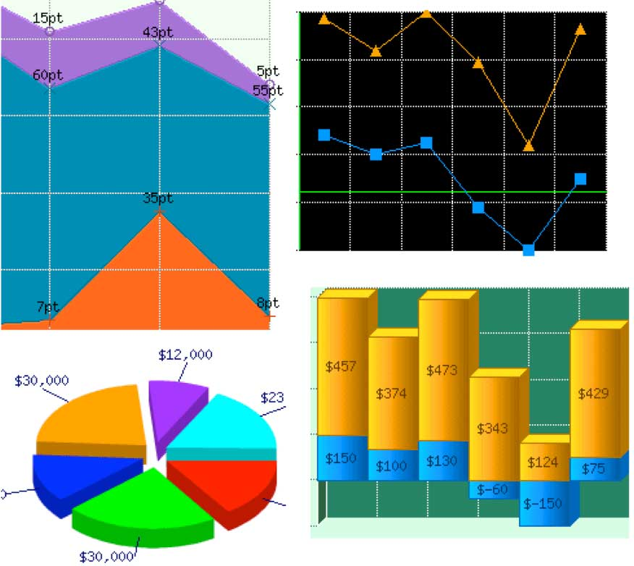
These aren't the graphs we're looking for

Slide 4
Graphs
A graph is a data structure
A graph has:
a set of vertices
a set of edges between vertices
Graphs are a generalization of trees

Slide 5
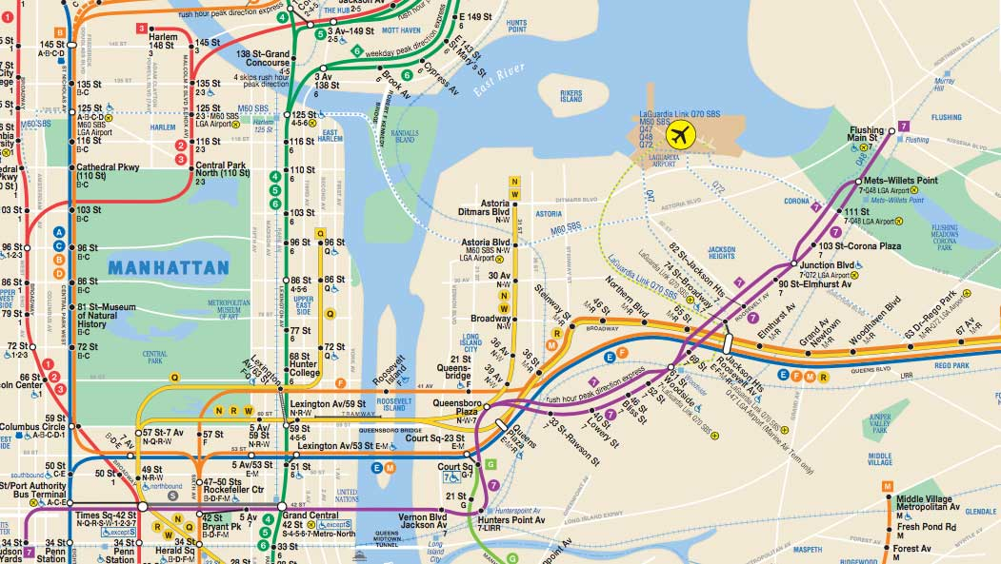
This is a graph

Slide 6
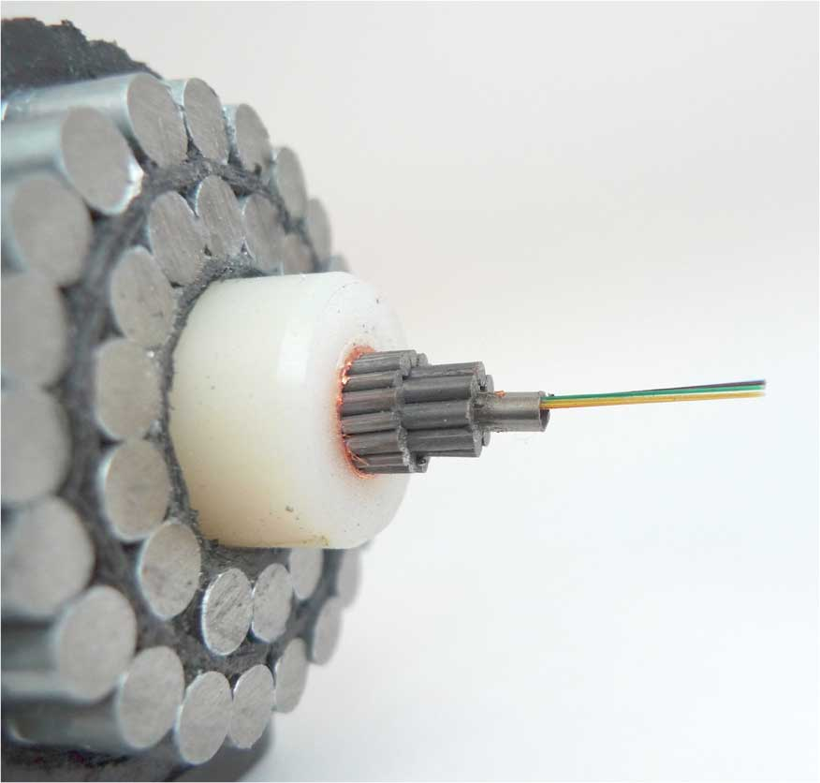
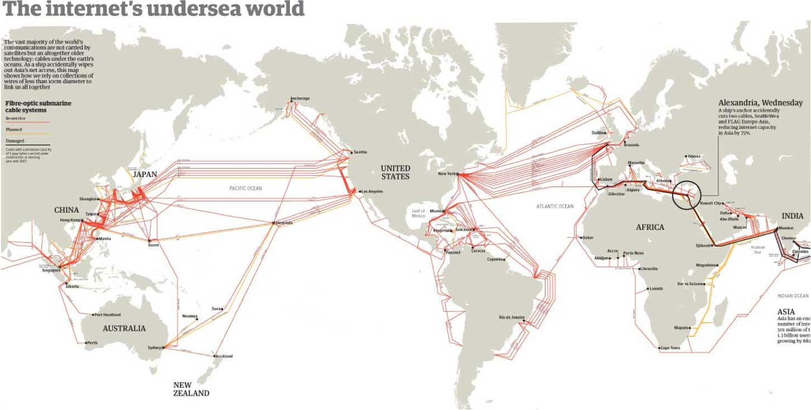
This is a graph

Slide 7
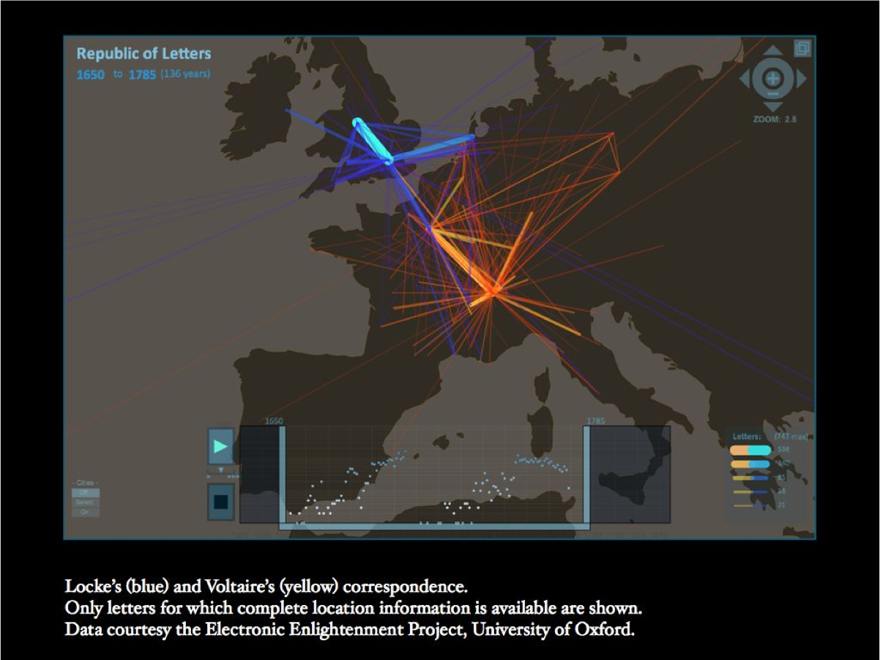
A Social Network Graph

Slide 8
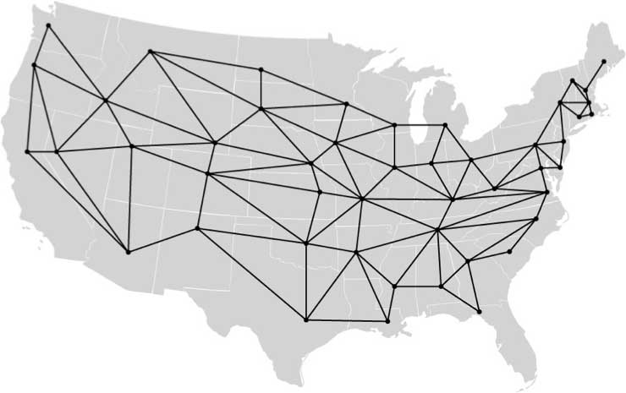
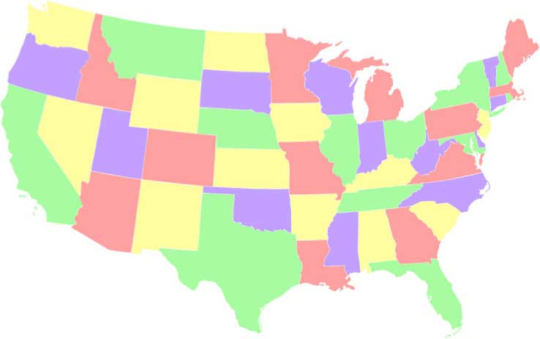
Viewing the map of states as a graph
http://www.cs.cmu.edu/~bryant/boolean/maps.html
Each state is a point on the graph, and neighboring states are connected by an edge.
Do the same thing for a map of the world showing countries

Slide 9
Graphs
K₅
K_{3,3}

Slide 10
Undirected graphs
A undirected graph is a pair (V, E) where
V is a (finite) set
E is a set of pairs (u, v) where u,v ∈ V
Often require u ≠ v (i.e., no self-loops)
Element of V is called a vertex or node
Element of E is called an edge or arc
|V| = size of V, often denoted by n
|E| = size of E, often denoted by m
A
B
C
E
D
V = {A, B, C, D, E}
E = {(A, B), (A, C), (B, C), (C, D)}
|V| = 5
|E| = 4

Slide 11
Directed graphs
A directed graph (digraph) is a lot like an undirected graph
V is a (finite) set
E is a set of ordered pairs (u, v) where u,v ∈ V
A
B
C
Every undirected graph can be easily converted to an equivalent directed graph via a simple transformation:
Replace every undirected edge with two directed edges in opposite directions
… but not vice versa
E
D
V = {A, B, C, D, E}
E = {(A, C), (B, A), (B, C), (C, D),
(D, C)}
|V| = 5
|E| = 5

Slide 12
Graph terminology
Vertices u and v are called
the source and sink of the directed edge (u, v), respectively
the endpoints of (u, v) or {u, v}
Two vertices are adjacent if they are connected by an edge
The outdegree of a vertex u in a directed graph is the number of edges for which u is the source
The indegree of a vertex v in a directed graph is the number of edges for which v is the sink
The degree of a vertex u in an undirected graph is the number of edges of which u is an endpoint
A
1
2
C
B
E
D
A
2
B
C
0
E
D

Slide 13
More graph terminology
A path is a sequence v₀,v₁,v₂,...,v_{p} of vertices such that for 0 ≤ i < p,
(v_{i}, v_{i+1})∈E if the graph is directed
{v_{i}, v_{i+1}}∈E if the graph is undirected
The length of a path is its number of edges
A path is simple if it doesn’t repeat any vertices
A cycle is a path v₀, v₁, v₂, ..., v_{p} such that v₀ = v_{p}
A cycle is simple if it does not repeat any vertices except the first and last
A graph is acyclic if it has no cycles
A directed acyclic graph is called a DAG
Path A,C,D
A
B
C
E
D
DAG
A
B
C
E
D
Not a DAG

Slide 14
Is this a DAG?
B
D
C
Yes!
It is a DAG.
A
F
E
Intuition:
If it’s a DAG, there must be a vertex with indegree zero
This idea leads to an algorithm
A digraph is a DAG if and only if we can iteratively delete indegree-0 vertices until the graph disappears

Slide 15
Topological sort
2
4
3
1
6
5
We just computed a topological sort of the DAG
This is a numbering of the vertices such that all edges go from lower- to higher-numbered vertices
Useful in job scheduling with precedence constraints

Slide 16
Topological sort
k= 0;
// inv: k nodes have been given numbers in 1..k in such a way that
if n1 <= n2, there is no edge from n2 to n1.
while (there is a node of in-degree 0) {
Let n be a node of in-degree 0;
Give it number k;
Delete n and all edges leaving it from the graph.
k= k+1;
}
A
B
C
D
E
F
0
1
k=
0
→1
1
→
0
2
B
D
2
→1
Abstract algorithm
Don’t really want to change the graph.
Will have to use some data structures to support this efficiently.
C
A
F
0
E
3
3
→2

Slide 17
Graph coloring
A coloring of an undirected graph is an assignment of a color to each node such that no two adjacent vertices get the same color
How many colors are needed to color this graph?
B
D
C
A
F
E

Slide 18
An application of coloring
Vertices are tasks
Edge (u, v) is present if tasks u and v each require access to the same shared resource, and thus cannot execute simultaneously
Colors are time slots to schedule the tasks
Minimum number of colors needed to color the graph = minimum number of time slots required
B
D
C
A
F
E

Slide 19
Coloring a graph
How many colors are needed to color the states so that no two adjacent states have the same color?
Asked since 1852
1879: Kemp publishes a proof that only 4 colors are needed!
1880: Julius Peterson finds a flaw in Kemp's proof…

Slide 20
Four Color Theorem
Every planar graph is 4-colorable [Appel & Haken, 1976]
The proof rested on checking that 1,936 special graphs had a certain property.
They used a computer to check that those 1,936 graphs had that property!
Basically the first time a computer was needed to check something. Caused a lot of controversy.
Gries looked at their computer program, a recursive program written in the assembly language of the IBM 7090 computer, and found an error, which was safe (it said something didn’t have the property when it did) and could be fixed. Others did the same.
Since then, there have been improvements. And a formal proof has even been done in the Coq proof system.

Slide 21
Planarity
A graph is planar if it can be drawn in the plane without any edges crossing
Is this graph planar?
B
D
C
A
F
E

Slide 22
Planarity
A graph is planar if it can be drawn in the plane without any edges crossing
Is this graph planar?
Yes!
B
D
C
A
F
E

Slide 23
Planarity
A graph is planar if it can be drawn in the plane without any edges crossing
Is this graph planar?
Yes!
B
D
C
A
F
E

Slide 24
Detecting Planarity
Kuratowski's Theorem:
A graph is planar if and only if it does not contain a copy of K₅ or K_{3,3} (possibly with other nodes along the edges shown)
K₅
K_{3,3}

Slide 25
John Hopcroft & Robert Tarjan
Turing Award in 1986 “for fundamental achievements in the design and analysis of algorithms and data structures”
One of their fundamental achievements was a linear-time algorithm for determining whether a graph is planar.
Notes:
They worked together coincidentally. Hopcroft took a sabbatic at Stanford. There was little room. So he and Tarjan, a PhD student, were asked to share a room, since Tarjan was interested in data structures. And they started talking. The result was several algorithms, including their famous planarity checker.

Slide 26
David Gries & Jinyun Xue
Tech Report, 1988
Abstract: We give a rigorous, yet, we hope, readable, presentation of the Hopcroft-Tarjan linear algorithm for testing the planarity of a graph, using more modern principles and techniques for developing and presenting algorithms that have been developed in the past 10-12 years (their algorithm appeared in the early 1970's). Our algorithm not only tests planarity but also constructs a planar embedding, and in a fairly straightforward manner. The paper concludes with a short discussion of the advantages of our approach.
Notes:
Later, Gries looked at their algorithm and had great difficulty understanding it. He and a postdoc developed it afresh using stepwise refinement and loop invariants and other sound principles. They published a tech report on it in 1986.

Slide 27
Bipartite graphs
A directed or undirected graph is bipartite if the vertices can be partitioned into two sets such that no edge connects two vertices in the same set
The following are equivalent
G is bipartite
G is 2-colorable
G has no cycles of odd length
A
1
B
2
C
3
D

Slide 28
Representations of graphs
1
2
4
3
Adjacency List
Adjacency Matrix
1 2 3 4
1
2
3
4
1
2
4
0 1 0 1
0 0 1 0
0 0 0 0
0 1 1 0
2
3
3
4
2
3

Slide 29
Graph Quiz
Which of the following two graphs are DAGs?
Directed Acyclic Graph
Graph 1:
Graph 2:
1 2 3
1
2
3
1
3
2
0 1 1
0 0 0
0 1 0
2
3
3
1
Notes:
TODO: make this a piazza poll

Slide 30
Graph 1
3
1
Is this a DAG?
2
1
3
2
2
3
3
1

Slide 31
Graph 2
3
1
2
Is this a DAG?
1 2 3
1
2
3
0 1 1
0 0 0
0 1 0

Slide 32
Adjacency Matrix vs. Adjacency List
1 2 3 4
1
2
3
4
1
2
4
v = number of vertices
e = number of edges
d(u) = degree of u
= no. edges leaving u
0 1 0 1
0 0 1 0
0 0 0 0
0 1 1 0
2
3
3
4
2
3
Matrix | Property | List
 | Space
 | Time to enumerate all edges
 | Time to answer “Is there an edge from u1 to u2 ?”
 | better for
O(v²)
O(v²)
O(1)
dense graphs
O(v + e)
O(v + e)
O(d(u1))
sparse graphs

Slide 33
Graph algorithms
Search
Depth-first search
Breadth-first search
Shortest paths
Dijkstra's algorithm
Minimum spanning trees
Jarnik/Prim/Dijkstra algorithm
Kruskal's algorithm

