Slide 1
Concurrency 3
CS 2110 – Spring 2017

Slide 2
Announcements
Course evaluations: we care.
We care so much we make it 1% of your grade.
At the end of May 11th, we see a list of which students submitted evaluations.
After grades are submitted, we see the anonymized content of the evaluations.
We read them all.
When giving feedback, please strive for specificity and constructiveness.

Slide 3
Axiomatic Basis for Computer Programming.
Tony Hoare, 1969
Provide a definition of programming language statements not in terms of how they are executed but in terms of proving them correct.
{precondition P}
Statement S
{Postcondition Q)
Meaning: If P is true, then execution of S is guaranteed to terminate and with Q true

Slide 4
Assignment statement x= e;
{true}
x= 5;
{x = 5}
{x+1 >= 0}
x= x + 1;
{x >= 0}
{2*x = 82}
x= 2*x;
{x = 82}
Definition of notation:
P[x:= e] (read P with x replaced by e) stands for a copy of expression P in which each occurrence of x is replaced by e
Example: (x >= 0)[x:= x+1] = x+1 >= 0
Definition of the assignment statement:
{P[x:= e]}
x= e;
{P}

Slide 5
Assignment statement x:= e;
Definition of the assignment statement:
{P[x:= e]}
x= e;
{P}
{x+1 >= 0}
x= x + 1;
{x >= 0}
{2*x = 82}
x= 2*x;
{x = 82}
{ }
x= 2.0*x*y + z;
{x = x/6}
x = x/6
2.0xy + z = (2.0xy + z)/6
2.0xy + z = (2.0xy + z)/6

Slide 6
If statement defined as an “inference rule”:
Definition of if statement: If
Then
{P}
if (B) ST
else SF
{Q}
{P && B} ST {Q} and
{P && !B} SF {Q}
The then-part, ST, must end with Q true
The else-part, SF, must end with Q true

Slide 7
Hoare’s contribution 1969:
Axiomatic basis: Definition of a language in terms of how to prove a program correct.
But it is difficult to prove a program correct after the fact. How do we develop a program and its proof hand-in-hand?
Dijkstra showed us how to do that in 1975.
His definition, called “weakest preconditions” is defined in such a way that it allows us to “calculate” a program and its proof of correctness hand-in-hand, with the proof idea leading the way.
Dijkstra: A Discipline of Programming. Prentice Hall, 1976.
A research monograph
Gries: The Science of Programming. Springer Verlag, 1981.
Undergraduate text.

Slide 8
How to prove concurrent programs correct.
Use the principle of non-interference
T1 and T2 are proved correct in isolation.
What happens when T1 and T2 execute simultaneously?
How many execution orders are there?
Thread T1
{P0}
S1;
{P1}
S2;
{P2}
…
Sn;
{Pn}
Thread T2
{Q0}
Z1;
{Q1}
Z2;
{Q2}
…
Zm;
{Qm}

Slide 9

How to prove concurrent programs correct.
Use the principle of non-interference
T1 and T2 are proved correct in isolation.
What happens when T1 and T2 execute simultaneously?
How many execution orders are there?
S1;
S2;
…
Sn;
Z1;
Z2;
…
Zm;
m+n instructions to execute:
choose m of them for the Z’s
S’s in the rest.
$$\left({m+n \atop m}\right)=\frac{\left(m+n\right)! }{m!∗n!}=a very big number$$

Slide 10
How to prove concurrent programs correct.
Thread T1
{P0}
S1;
{P1}
S2;
{P2}
…
Sn;
{Pn}
Thread T2
{Q0}
Z1;
{Q1}
Z2;
{Q2}
…
Zm;
{Qm}
Turn what previously seemed to be an exponential problem, looking at all executions, into a problem of size n*m.
Prove that execution of T1 does not interfere with the proof of T2, and vice versa.
Basic notion: Execution of Si does not falsify an assertion in T2:
e.g. {Pi && Q1} S2 {Q1}

Slide 11
Interference freedom.
Susan Owicki’s Cornell thesis, under Gries, in 1975.
Thread T1
{P0}
S1;
{P1}
S2;
{P2}
…
Sn;
{Pn}
Thread T2
{Q0}
Z1;
{Q1}
Z2;
{Q2}
…
Zm;
{Qm}
A lot of progress since then! But still, there are a lot of hard issues to solve in proving concurrent programs correct in a practical manner.
Prove that execution of T1 does not interfere with the proof of T2, and vice versa.
Basic notion: Execution of Si does not falsify an assertion in T2:
e.g. {Pi && Q1} S2 {Q1}

Slide 12
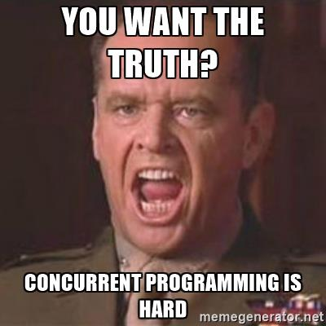
The Harsh Truth

Slide 13
On the bright side…

Slide 14

A new way to melt your computer!

Slide 15
A new way to melt your computer!
public class ForkBomb extends Thread {
public static void main(String[] args) {
(new ForkBomb()).start();
}
public @Override void run() {
(new ForkBomb()).start();
(new ForkBomb()).start();
}
}

Slide 16

A new way to melt your computer!

Slide 17
Atomicity
int x = 0;
x++;
Thread 1
x++;
Thread 2
What is the value of x?
Can be either 1 or 2!

Slide 18
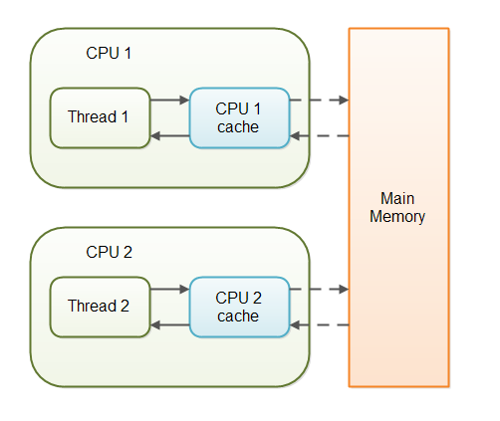
Caching and Volatile
Concurrent programming is hard.
Concurrent programming on real hardware is even harder!
Data is stored in caches
Only written to main memory occasionally
Huge efficiency gains!
Huge concurrency headaches!

Slide 19
Caching and Volatile
Concurrent programming is hard.
Concurrent programming on real hardware is even harder!
Volatile keyword
  Fields can be declared volatile
  All local changes are made visible to other threads
Does not guarantee atomicity!
  x+= 1 still does get, add, set; these may still be interleaved

Slide 20
Atomicity
volatile int x = 0;
x++;
Thread 1
x++;
Thread 2
What is the value of x?
Can be either 1 or 2!
Notes:
Volatility prevents data from being out of sync for a long time because of caching
If one thread only reads the value, volatile would be necessary (to guarantee you have the latest value) and sufficient.

Slide 21
Can we get atomicity without locks?
class AtomicInteger, AtomicReference<T>, …
  Represents a value
method set(newValue)
  has the effect of writing to a volatile variable
method get()
  returns the current value
If the OS controls thread execution, how can the language ever guarantee atomicity?
  New concurrency primitives: atomic operations.

Slide 22
Compare and Set (CAS)
boolean compareAndSet(expectedValue, newValue)
  If value doesn’t equal expectedValue, return false
  if equal, store newValue in value and return true
  executes as a single atomic action!
  supported by many processors – as hardware instructions
  does not use locks!
AtomicInteger n = new AtomicInteger(5);
n.compareAndSet(3, 6); // return false – no change
n.compareAndSet(5, 7); // returns true – now is 7

Slide 23
Incrementing with CAS
/** Increment n by one. Other threads use n too. */
public static void increment(AtomicInteger n) {
int i = n.get();
while (n.compareAndSet(i, i+1))
i = n.get();
}
// AtomicInteger has increment methods that do this

Slide 24
Lock-Free Data Structures
Usable by many concurrent threads
using only atomic actions – no locks!
compare and swap is your best friend
but it only atomically updates one variable at a time!
Let’s look at one!
Lock-free binary search tree [Ellen et al., 2010]
http://www.cs.vu.nl//~tcs/cm/cds/ellen.pdf

Slide 25
Concurrency in other languages
Concurrency is an OS-level concern
Platform-independent languages often provide abstractions on top of these.
  Java, Python, Matlab, ...
Different platforms have different concurrency APIs for compiled languages.
  Unix/Linux: POSIX Threads (Pthreads)
  Mac OS (based on Unix!): Pthreads, NSThread
  Windows APIs
  iOS: ??
  Android: ??

Slide 26


Graph Search
Do you need to travel to a node to visit it?
vs

Slide 27
Graph Search
Do you need to travel to a node to visit it?
  Depends on what information you have about the graph.
Self-driving car (e.g., Uber) with nothing but sensors:
  needs to explore to find its destination.
Self-driving car (e.g. Waymo) with Google Maps:
  compute a path, then follow it.

Slide 28
Graph Search
Let’s consider BFS.
/** Visit all nodes REACHABLE* from u. Pre: u is unvisited. */
public static void bfs(int u) {
Queue q= (u);
while q is not empty) {
u= q.popFirst();
if (u has not been visited) {
visit u;
for each edge (u, v) leaving u:
q.append(v);
}
}
}
E
A
C
B
X

Slide 29
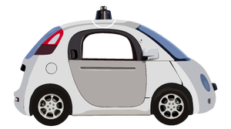
Graph Search
Let’s consider BFS if you’re Google.
/** Visit all nodes REACHABLE* from u. Pre: u is unvisited. */
public static void bfs(int u) {
Queue q= (u);
while q is not empty) {
u= q.popFirst();
if (u has not been visited) {
visit u;
for each edge (u, v) leaving u:
q.append(v);
}
}
}
E
A
C
B
X

Slide 30

Graph Search
Let’s consider BFS if you’re Uber (no Google Maps!*).
/** Visit all nodes REACHABLE* from u. Pre: u is unvisited. */
public static void bfs(int u) {
Queue q= (u);
while q is not empty) {
u= q.popFirst();
if (u has not been visited) {
visit u;
for each edge (u, v) leaving u:
q.append(v);
}
}
}
E
A
C
B
X
*allegedly

Slide 31
If a method moves a robot…
Your method’s spec needs to say where the robot starts and ends in all possible scenarios.
/** Drive in a square with side length size, starting out in the current direction. Car ends in the same location and direction as it started. */
public void driveInSquare(int size) {
for (int i = 0; i < 4; i += 1) {
forward(size);
turn(90);
}
}

Slide 32
Wrapping up the course
What is this course good for?
Where can you go from here?

Slide 33
Coding Interviews
A quick web search reveals: We’ve taught you most of what you need for coding interviews.
          https://www.reddit.com/r/cscareerquestions/comments/20ahfq/heres_a_pretty_big_list_of_programming_interview/
    http://maxnoy.com/interviews.html
      …
Your interviewer will be impressed* if you:
    Write specs before you write methods.
    Talk about/write invariants for your loops.
    ...
*If not, don’t work there.

Slide 34
What else is there?
This course scratches the surface of many subfields of CS.
Topics that have 4000-level courses:
  Analysis of algorithms
  Computational complexity
  Compilers (parsing, grammars)
  Programming Languages (formal semantics, ...)
  Applied Logic (correctness proofs, ...)
  Operating Systems (concurrency, caching, …)
  Artificial Intelligence (graph searching, ...)
...among others.
*If not, don’t work there.

