Slide 1
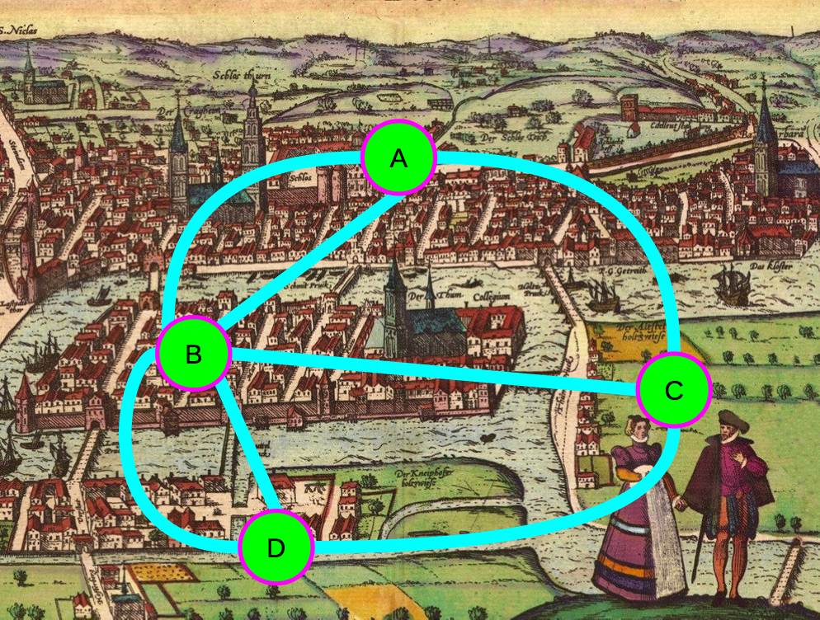
Graphs - I
CS 2110, Spring 2017
Leonhard Euler. 1736
7 Bridges of Konigsberg

Slide 2
A graph: a bunch of points connected by lines. The lines could be undirected or directed

Slide 3
Hidden Figures
If you haven’t seen this movie, we expect you to sign up for one of the two showings and show up and see it.
It is a valuable experience, showing you some of the history not only of computing but of women and African Americans. It needs to be seen. We will spend some time discussing it in a later lecture.
Get on the CMS and sign up for it TODAY. Do not wait.
We are paying for it! We have guaranteed a minimum number of students will show up. If you don’t, we pay anyway.

Slide 4
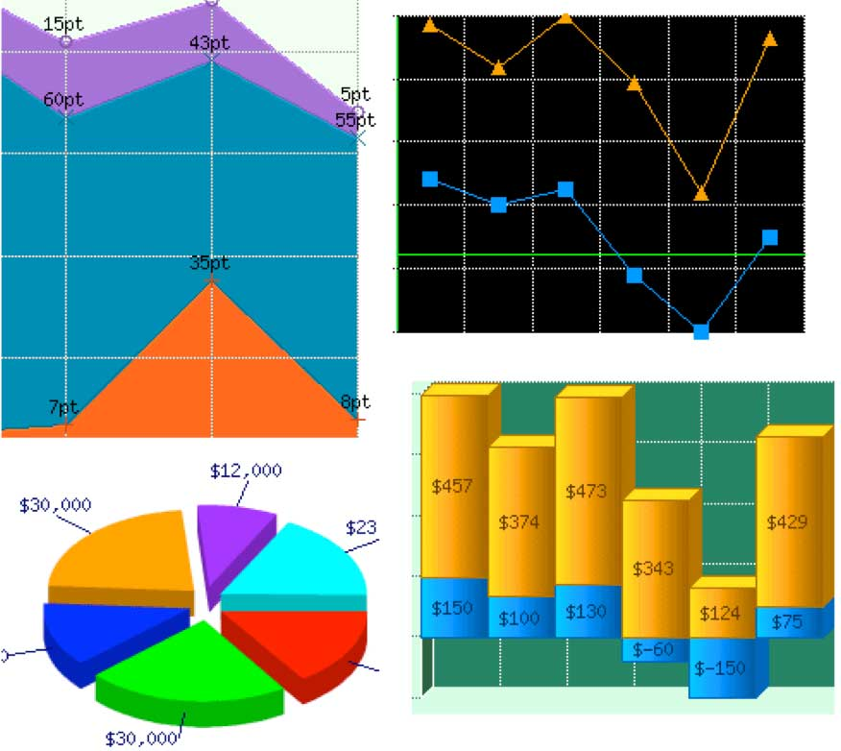
These aren’t the graphs we’re interested in

Slide 5
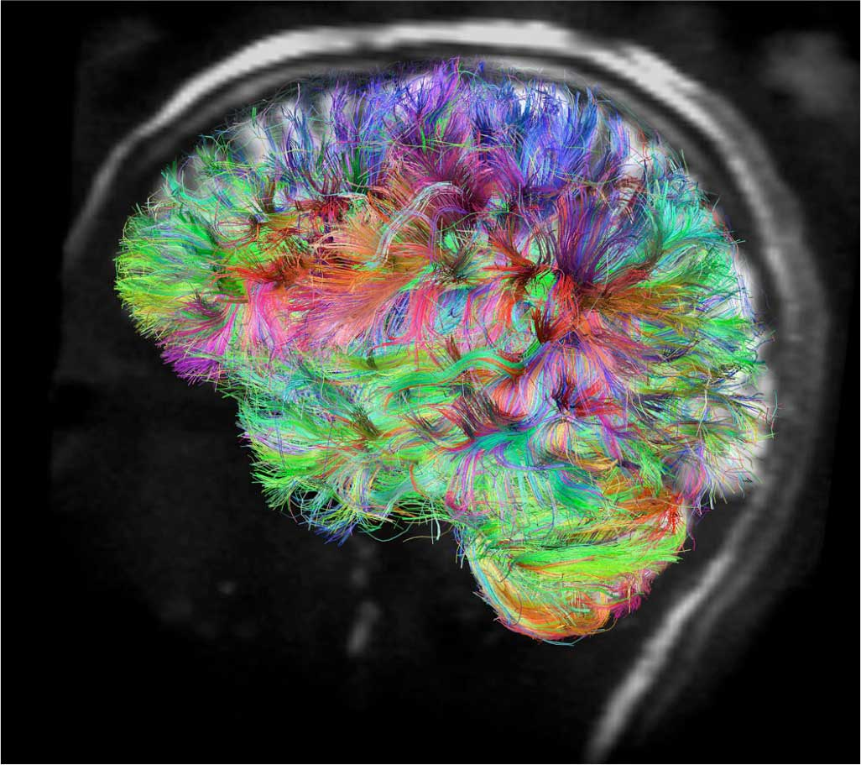
This is
V.J. Wedeen and L.L. Wald, Martinos Center for Biomedical Imaging at MGH

Slide 6
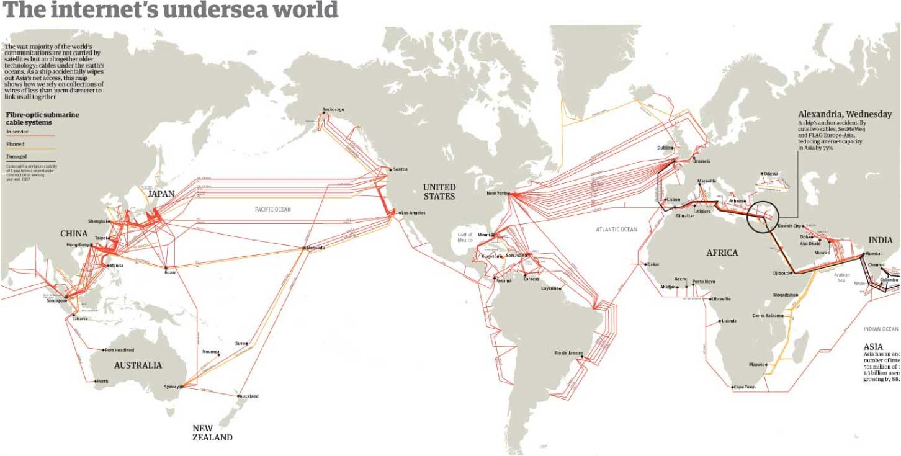
And so is this

Slide 7
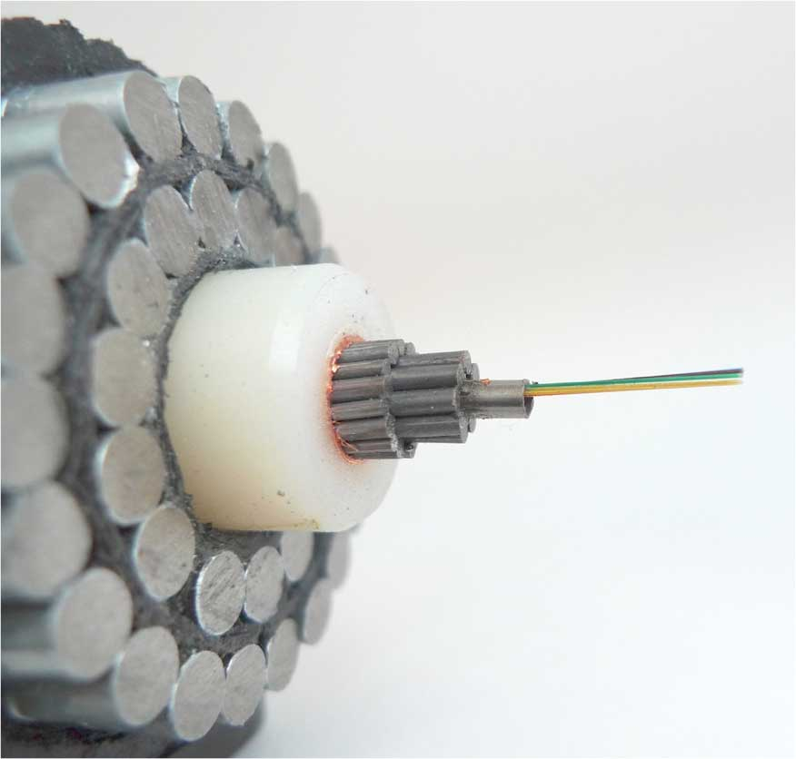
This carries Internet traffic across the oceans

Slide 8
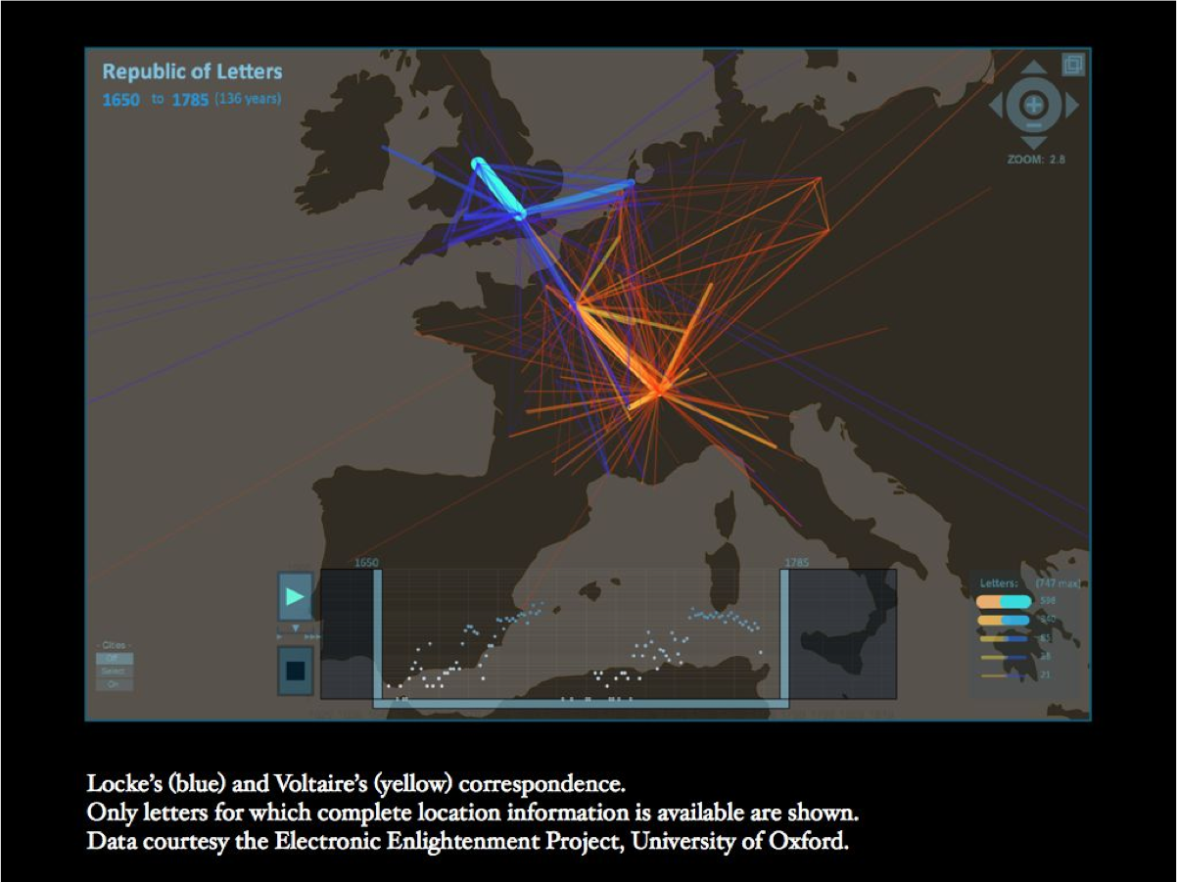
An older social graph

Slide 9
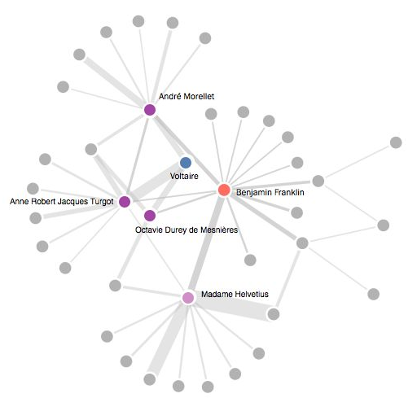
An older social graph
Voltaire and Benjamin Franklin

Slide 10
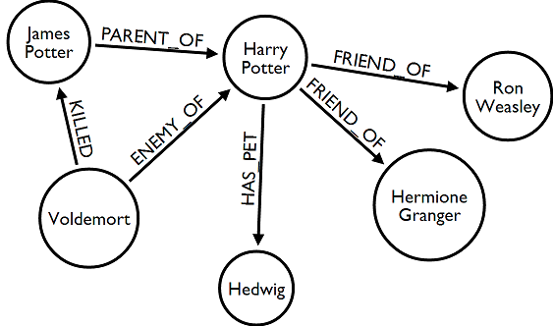
A fictional social graph

Slide 11
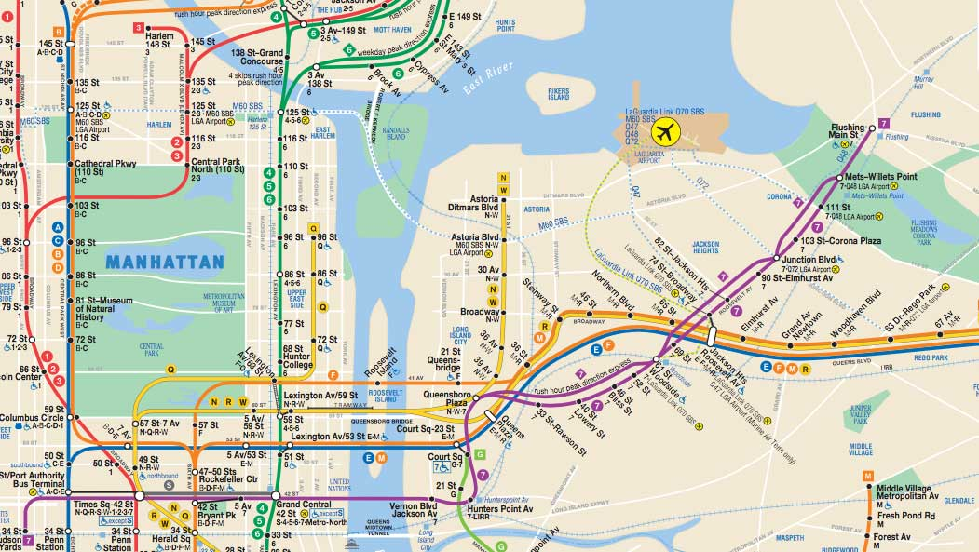
A transport graph: NY subway system

Slide 12
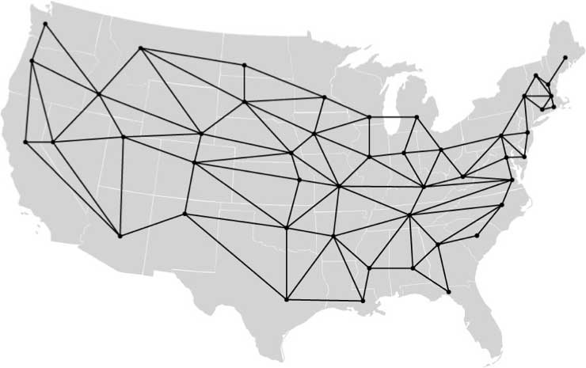
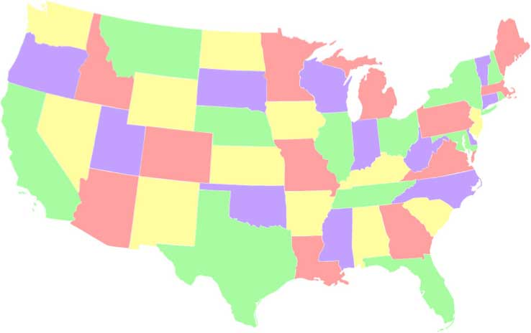
Viewing the map of states as a graph
http://www.cs.cmu.edu/~bryant/boolean/maps.html
Each state is a point on the graph, and neighboring states are connected by an edge.
Do the same thing for a map of the world showing countries

Slide 13
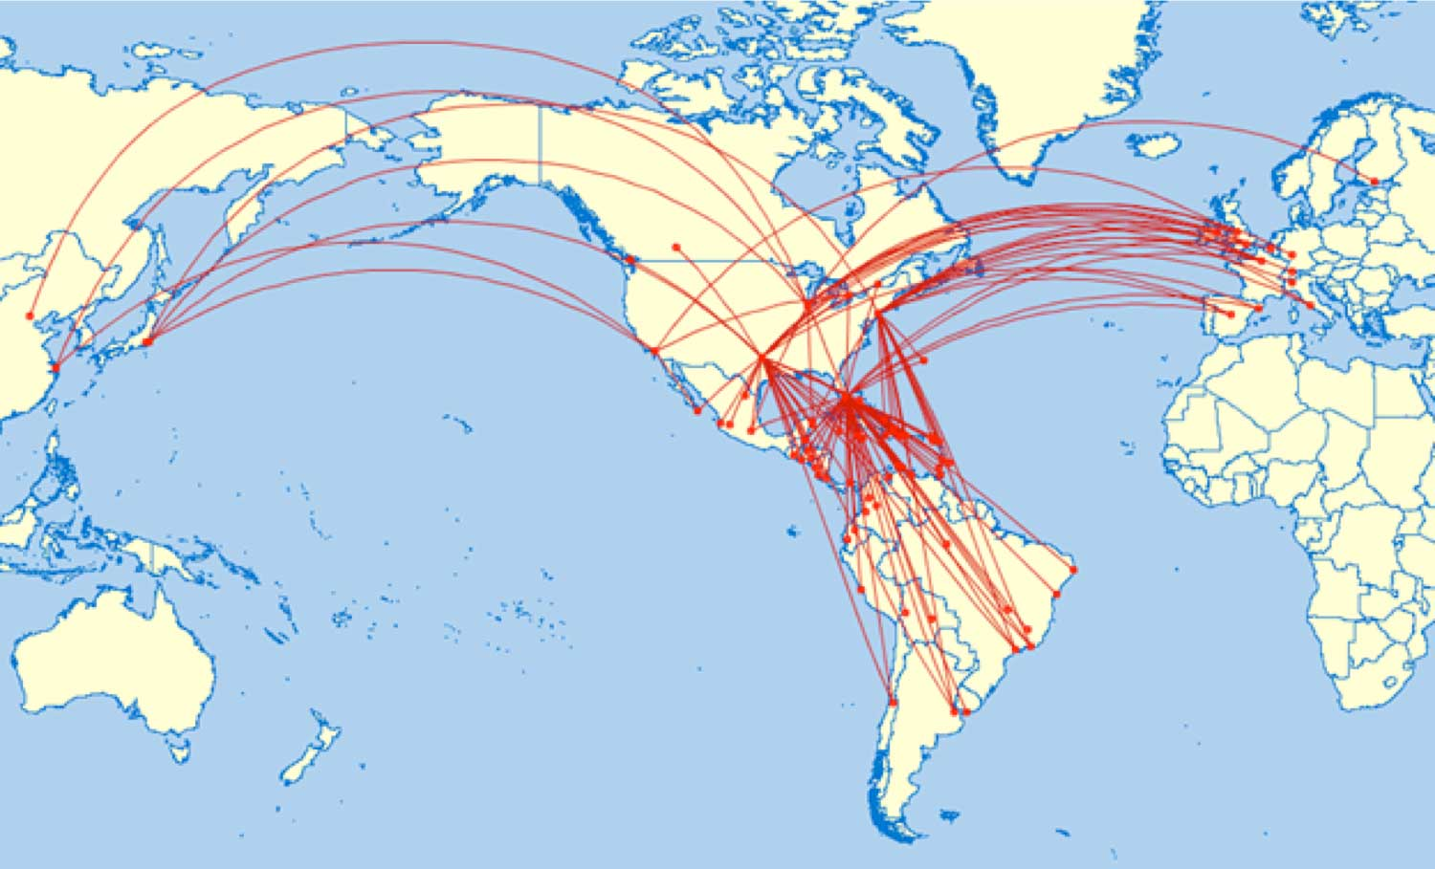
Another transport graph

Slide 14
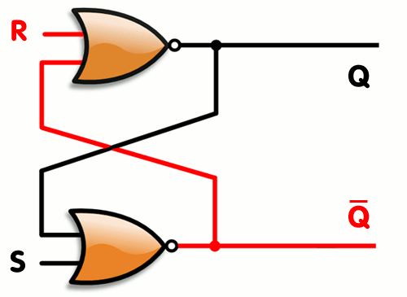
A circuit graph (flip-flop)

Slide 15
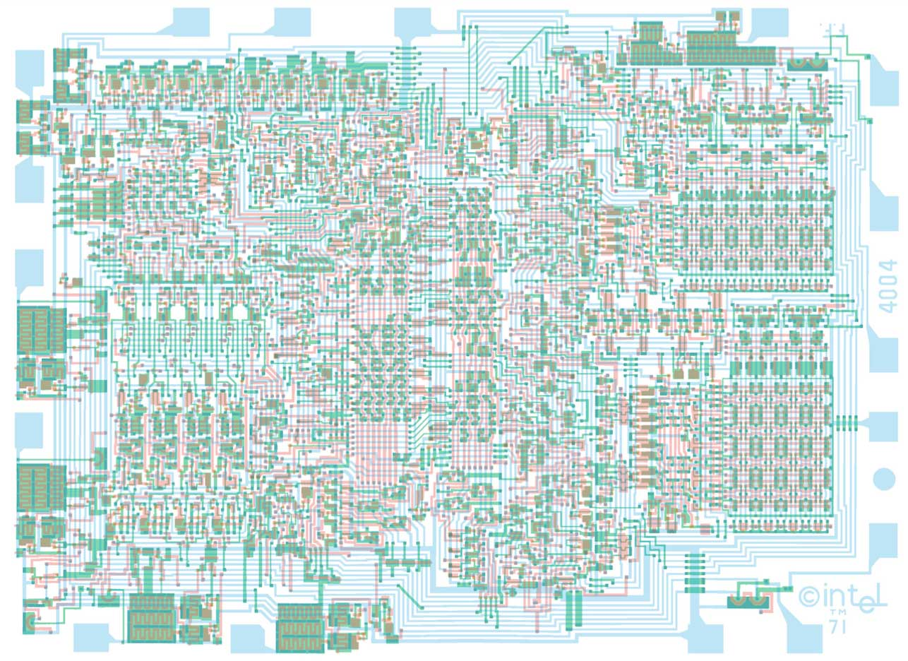
A circuit graph (Intel 4004)

Slide 16

This is not a graph, this is a cat

Slide 17
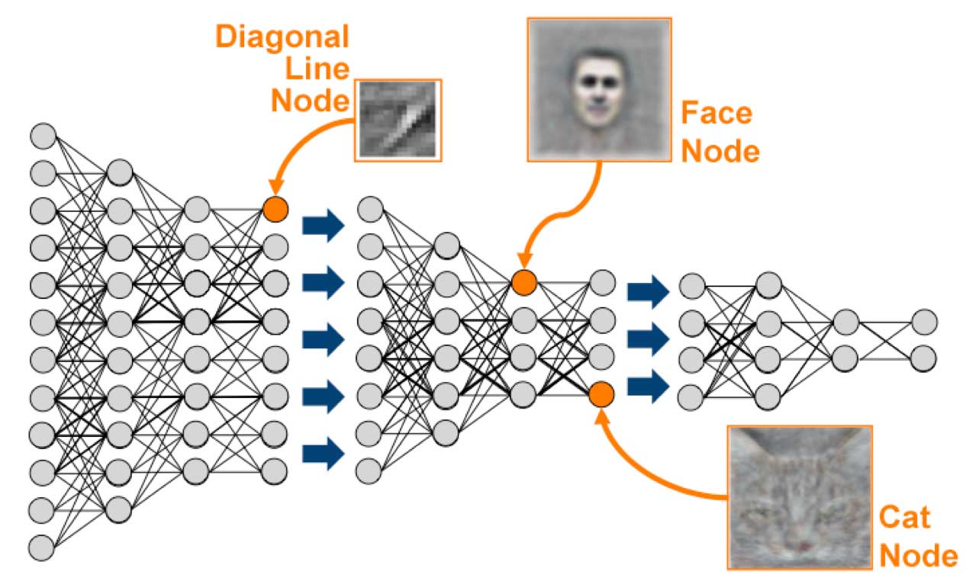
This is a graph(ical model) that has learned to recognize cats

Slide 18
Some abstract graphs
K₅
K_{3,3}

Slide 19
Applications of Graphs
Communication networks
Social networks
Routing and shortest path problems
Commodity distribution (network flow)
Traffic control
Resource allocation
Numerical linear algebra (sparse matrices)
Geometric modeling (meshes, topology, …)
Image processing (e.g. graph cuts)
Computer animation (e.g. motion graphs)
Systems biology
Digital humanities (e.g. Republic of Letters)
…

Slide 20
Directed graphs
A
A directed graph (digraph) is a pair (V, E) where
V is a (finite) set
E is a set of ordered pairs (u, v) where u,v ∈ V
Often require u ≠ v (i.e. no self-loops)
Element of V is called a vertex or node
Element of E is called an edge or arc
|V| = size of V, often denoted by n
|E| = size of E, often denoted by m
B
C
D
E
V = {A, B, C, D, E}
E = {(A, C), (B, A), (B, C), (C, D),
(D, C)}
|V| = 5
|E| = 5

Slide 21
Undirected Graphs
An undirected graph is just like a directed graph!
… except that E is now a set of unordered pairs {u, v} where u,v ∈ V
Every undirected graph can be easily converted to an equivalent directed graph via a simple transformation:
Replace every undirected edge with two directed edges in opposite directions
… but not vice versa
A
B
C
D
E
V = {A, B, C, D, E}
E = {{A,C}, {B,A},
{B,C}, {C,D}}
|V| = 5
|E| = 4

Slide 22
Graph terminology
Vertices u and v are called
the source and sink of the directed edge (u, v), respectively
the endpoints of (u, v) or {u, v}
Two vertices are adjacent if they are connected by an edge
The outdegree of a vertex u in a directed graph is the number of edges for which u is the source
The indegree of a vertex v in a directed graph is the number of edges for which v is the sink
The degree of a vertex u in an undirected graph is the number of edges of which u is an endpoint
A
B
C
E
D
A
B
C
E
D

Slide 23
More graph terminology
A
Path A,C,D
A path is a sequence v₀,v₁,v₂,...,v_{p} of vertices such that for 0 ≤ i < p,
(v_{i}, v_{i+1})∈E if the graph is directed
{v_{i}, v_{i+1}}∈E if the graph is undirected
The length of a path is its number of edges
A path is simple if it doesn’t repeat any vertices
A cycle is a path v₀, v₁, v₂, ..., v_{p} such that v₀ = v_{p}
A cycle is simple if it does not repeat any vertices except the first and last
A graph is acyclic if it has no cycles
A directed acyclic graph is called a DAG
B
C
E
D
DAG
A
B
C
E
D
Not a DAG

Slide 24
Is this a DAG?
B
D
C
A
F
E
Intuition:
If it’s a DAG, there must be a vertex with indegree zero
This idea leads to an algorithm
A digraph is a DAG if and only if we can iteratively delete indegree-0 vertices until the graph disappears

Slide 25
Is this a DAG?
B
D
C
F
E
Intuition:
If it’s a DAG, there must be a vertex with indegree zero
This idea leads to an algorithm
A digraph is a DAG if and only if we can iteratively delete indegree-0 vertices until the graph disappears

Slide 26
Is this a DAG?
D
C
F
E
Intuition:
If it’s a DAG, there must be a vertex with indegree zero
This idea leads to an algorithm
A digraph is a DAG if and only if we can iteratively delete indegree-0 vertices until the graph disappears

Slide 27
Is this a DAG?
D
F
E
Intuition:
If it’s a DAG, there must be a vertex with indegree zero
This idea leads to an algorithm
A digraph is a DAG if and only if we can iteratively delete indegree-0 vertices until the graph disappears

Slide 28
Is this a DAG?
F
E
Intuition:
If it’s a DAG, there must be a vertex with indegree zero
This idea leads to an algorithm
A digraph is a DAG if and only if we can iteratively delete indegree-0 vertices until the graph disappears

Slide 29
Is this a DAG?
F
Intuition:
If it’s a DAG, there must be a vertex with indegree zero
This idea leads to an algorithm
A digraph is a DAG if and only if we can iteratively delete indegree-0 vertices until the graph disappears

Slide 30

Is this a DAG?
YES!
Intuition:
If it’s a DAG, there must be a vertex with indegree zero
This idea leads to an algorithm
A digraph is a DAG if and only if we can iteratively delete indegree-0 vertices until the graph disappears

Slide 31
Topological sort
2
4
3
1
6
5
We just computed a topological sort of the DAG
This is a numbering of the vertices such that all edges go from lower- to higher-numbered vertices
Useful in job scheduling with precedence constraints

Slide 32
Topological sort
k= 0;
// inv: k nodes have been given numbers in 1..k in such a way that
if n1 <= n2, there is no edge from n2 to n1.
while (there is a node of in-degree 0) {
Let n be a node of in-degree 0;
Give it number k;
Delete n and all edges leaving it from the graph.
k= k+1;
}
2
4
Abstract algorithm
Don’t really want to change the graph.
Will have to invent data structures to make it efficient.
3
1
6
5

Slide 33
Graph coloring
A coloring of an undirected graph is an assignment of a color to each node such that no two adjacent vertices get the same color
How many colors are needed to color this graph?
B
D
C
A
F
E

Slide 34
Graph coloring
A coloring of an undirected graph is an assignment of a color to each node such that no two adjacent vertices get the same color
How many colors are needed to color this graph?
B
D
C
A
F
E

Slide 35
An application of coloring
Vertices are tasks
Edge (u, v) is present if tasks u and v each require access to the same shared resource, and thus cannot execute simultaneously
Colors are time slots to schedule the tasks
Minimum number of colors needed to color the graph = minimum number of time slots required
B
D
C
A
F
E

Slide 36
Planarity
A graph is planar if it can be drawn in the plane without any edges crossing
Is this graph planar?
B
D
C
A
F
E

Slide 37
Planarity
A graph is planar if it can be drawn in the plane without any edges crossing
Is this graph planar?
Yes!
B
D
C
A
F
E

Slide 38
Planarity
A graph is planar if it can be drawn in the plane without any edges crossing
Is this graph planar?
Yes!
B
D
C
A
F
E

Slide 39
Detecting Planarity
Kuratowski's Theorem:
A graph is planar if and only if it does not contain a copy of K₅ or K_{3,3} (possibly with other nodes along the edges shown)
K₅
K_{3,3}

Slide 40

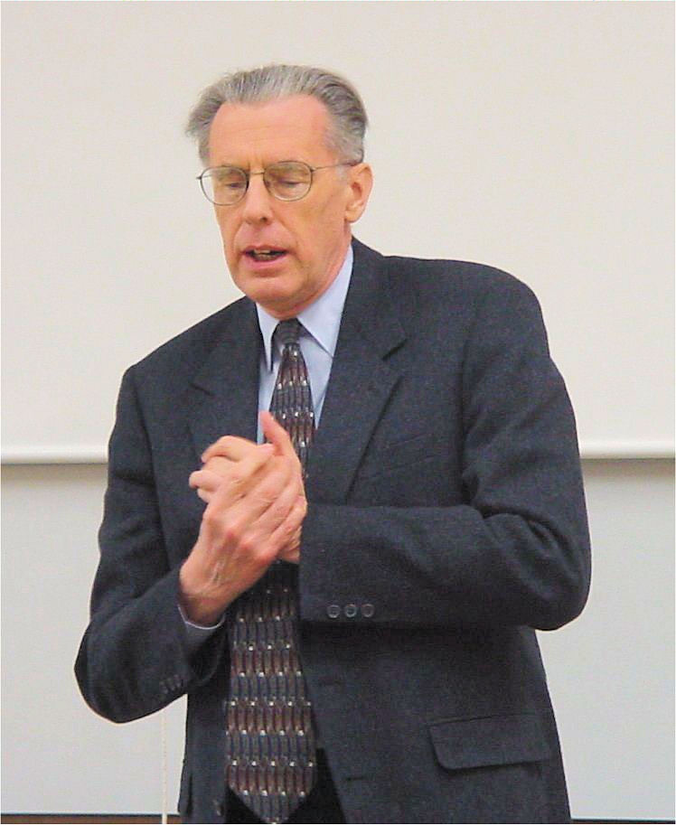
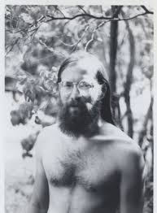

Detecting Planarity
In the early 1970’s, Cornell Prof John Hopcroft spent a sabbatical at Stanford and worked with PhD student Bob Tarjan. They developed the first linear-time algorithm for testing whether a graph was planar. They later received the ACM Turing Award for their work on algorithms.
Tarjan was hired at one point in the 1970’s into our department, but the Ithaca weather was too depressing for him and he left for Princeton.

Slide 41
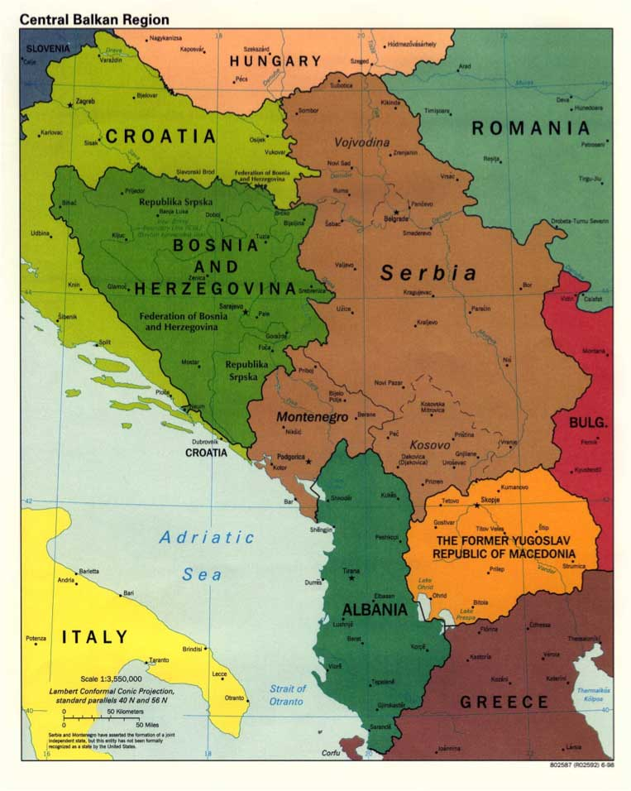
Coloring a graph:
How many colors are needed to color the countries so that no two adjacent countries have the same color?
Question asked as early as 1852.
1879. Kemp publishes a theorem that only 4 colors are needed!
1880. Julius Peterson finds a flaw in the Kemp’s proof!

Slide 42
Four-Color Theorem:
Every planar graph is 4-colorable [Appel & Haken, 1976]
The proof rested on checking that 1,936 special graphs had a certain property.
They used a computer to check that those 1, 936 graphs had that property!
Basically the first time a computer was needed to check something. Caused a lot of controversy.
Gries looked at their computer program, a recursive program written in the assembly language of the IBM 7090 computer, and found an error, which was safe (it said something didn’t have the property when it did) and could be fixed. Others did the same.
Since then, there have been improvements. And a formal proof has even been done in the Coq proof system

Slide 43
Another 4-colored planar graph
http://www.cs.cmu.edu/~bryant/boolean/maps.html

Slide 44
Bipartite graphs
A directed or undirected graph is bipartite if the vertices can be partitioned into two sets such that no edge connects two vertices in the same set
The following are equivalent
G is bipartite
G is 2-colorable
G has no cycles of odd length
A
1
B
2
C
3
D

Slide 45
Some abstract graphs
K₅
K_{3,3}
=

Slide 46
Traveling salesperson
Boston
Ithaca
Copenhagen
1323
1556
224
132
New York
160
512
189
London
Amsterdam
216
210
1078
Paris
1002
Washington
1322
Munich
660
1214
505
419
1356
441
1380
1202
Rome
Atlanta
Find a path of minimum distance that visits every city

Slide 47
Representations of graphs
1
2
4
3
Adjacency List
Adjacency Matrix
1 2 3 4
1
2
3
4
1
2
4
0 1 0 1
0 0 1 0
0 0 0 0
0 1 1 0
2
3
3
4
2
3

Slide 48
Adjacency matrix or adjacency List?
n = number of vertices
m = number of edges
d(u) = degree of u = no. of edges leaving u
Adjacency Matrix
Uses space O(n²)
Enumerate all edges in time O(n²)
Answer “Is there an edge from u to v?” in O(1) time
Better for dense graphs (lots of edges)
1 2 3 4
1
2
3
4
0 1 0 1
0 0 1 0
0 0 0 0
0 1 1 0

Slide 49
Adjacency matrix or adjacency list?
n = number of vertices
e = number of edges
d(u) = degree of u = no. edges leaving u
Adjacency List
Uses space O(e + n)
Enumerate all edges in time O(e + n)
Answer “Is there an edge from u to v?” in O(d(u)) time
Better for sparse graphs (fewer edges)
1
2
4
2
3
3
4
2
3

Slide 50
Graph algorithms
Search
Depth-first search
Breadth-first search
Shortest paths
Dijkstra's algorithm
Minimum spanning trees
Jarnik/Prim/Dijkstra algorithm
Kruskal's algorithm

