Slide 1
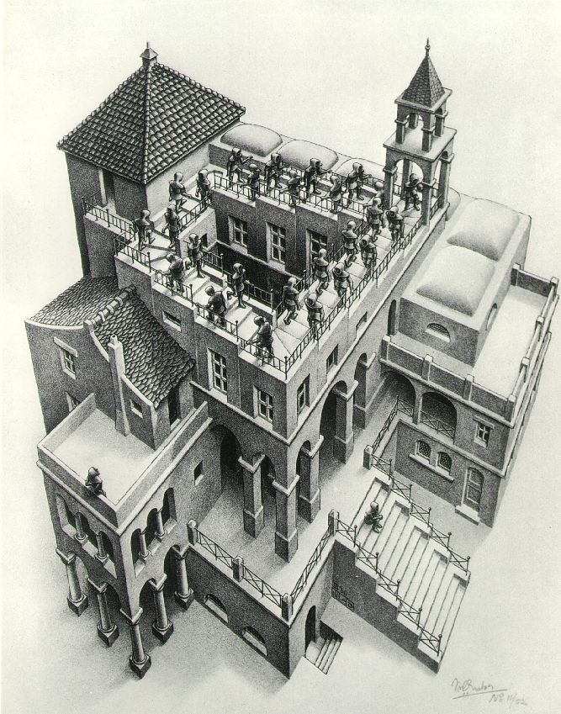
Priority Queues and Heaps
Lecture 16
CS2110 Spring 2017

Slide 2

Announcements
Next week’s section: make your BugTrees hashable.
Watch the tutorial videos on hashing:
  http://www.cs.cornell.edu/courses/cs2110/2017sp/online/hashing/01hashing.html
  Also linked from Recitation 07 on Lecture Notes page
  As usual, watch videos BEFORE recitation so you can complete the assignment DURING recitation.
This lecture has a plot twist! See if you can spot it coming.

Slide 3

Readings and Homework
Read Chapter 26 “A Heap Implementation” to learn about heaps
Exercise: Salespeople often make matrices that show all the great features of their product that the competitor’s product lacks. Try this for a heap versus a BST. First, try and
sell someone on a BST: List some
desirable properties of a BST
that a heap lacks. Now be the heap
salesperson: List some good things
about heaps that a BST lacks. Can
you think of situations where you
would favor one over the other?
With ZipUltra heaps, you’ve got it made in the shade my friend!

Slide 4
Abstract vs concrete data structures
Abstract data structures are interfaces
  they specify only interface (method names and specs)
  not implementation (method bodies, fields, …)
Abstract data structures can have multiple possible implementations.

Slide 5
Abstract vs concrete data structures
interface List defines an “abstract data type”.
It has methods: add, get, remove, …
Various classes implement List:
Class: | ArrayList | LinkedList
Backing storage: | array | chained nodes
add(i, val) | O(n) | O(n)
add(0, val) | O(n) | O(1)
add(n, val) | O(1) | O(1)
get(i) | O(1) | O(n)
get(0) | O(1) | O(1)
get(n) | O(1) | O(1)

Slide 6
Stacks and queues are restricted lists
Stack (LIFO) implemented using a List
allows only add(0,val), remove(0) (push, pop)
Queue (FIFO) implemented using a List
allows only add(n,val), remove(0) (enqueue, dequeue)
These operations are O(1) in a LinkedList (not true in ArrayList)
Both efficiently implementable using a singly linked list with head and tail
head
55
12
19
16
tail

Slide 7
Interface Bag (not In Java Collections)
interface Bag<E>
implements Iterable {
void add(E obj);
boolean contains(E obj);
boolean remove(E obj);
int size();
boolean isEmpty();
Iterator<E> iterator()
}
Also called multiset
Like a set except that a value can be in it more than once. Example: a bag of coins
Refinements of Bag: Stack, Queue, PriorityQueue

Slide 8
Priority queue
Bag in which data items are Comparable
Smaller elements (determined by compareTo()) have higher priority
remove() return the element with the highest priority = least element in the compareTo() ordering
break ties arbitrarily

Slide 9
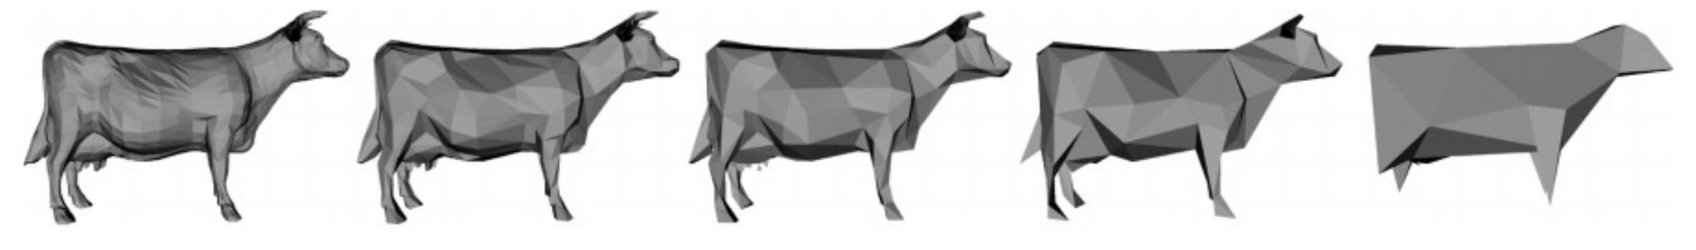
Many uses of priority queues (& heaps)
Surface simplification [Garland and Heckbert 1997]
Event-driven simulation: customers in a line
Collision detection: "next time of contact" for colliding bodies
Graph searching: Dijkstra's algorithm, Prim's algorithm
AI Path Planning: A* search
Statistics: maintain largest M values in a sequence
Operating systems: load balancing, interrupt handling
Discrete optimization: bin packing, scheduling
College: prioritizing assignments for multiple classes.

Slide 10
java.util.PriorityQueue<E>
interface PriorityQueue<E> { TIME
boolean add(E e) {...} //insert e. log
void clear() {...} //remove all elems.
E peek() {...} //return min elem. constant
E poll() {...} //remove/return min elem. log
boolean contains(E e) linear
boolean remove(E e) linear
int size() {...} constant
Iterator<E> iterator()
}
IF implemented with a heap!

Slide 11
Priority queues as lists
Maintain as unordered list
add() put new element at front – O(1)
poll() must search the list – O(n)
peek() must search the list – O(n)
Maintain as ordered list
add() must search the list – O(n)
poll() min element at front – O(1)
peek() O(1)
Can we do better?

Slide 12
Heap: binary tree with certain properties
A heap is a concrete data structure that can be used to implement priority queues
Gives better complexity than either ordered or unordered list implementation:
  add(): O(log n) (n is the size of the heap)
  poll(): O(log n)
O(n log n) to process n elements
Do not confuse with heap memory, where the Java virtual machine allocates space for objects – different usage of the word heap

Slide 13
Heap: first property
Every element is >= its parent
4
6
14
21
8
19
35
22
38
55
10
20
Note: 19, 20 < 35: Smaller elements
can be deeper in the tree!

Slide 14
Heap: second property: is complete, has no holes
Every level (except last) completely filled.
Nodes on bottom level are as far left as possible.
4
6
14
21
8
19
35
22
38
55
10
20

Slide 15
Heap: Second property: has no “holes”
Not a heap because it has two holes
4
6
14
21
8
19
22
55
10
20
Not a heap because:
missing a node on level 2
bottom level nodes are not as far left as possible
missing nodes

Slide 16
Heap
Binary tree with data at each node
Satisfies the Heap Order Invariant:
Binary tree is complete (no holes)
1. Every element is ≥ its parent.
2. Every level (except last) completely filled. Nodes on bottom level are as far left as possible.

Slide 17
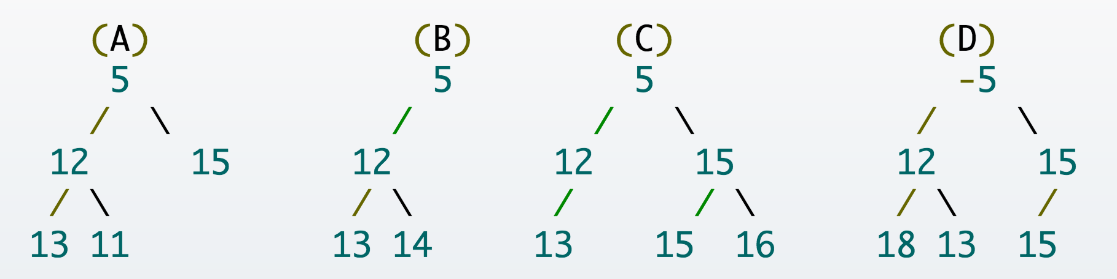
Heap Quiz 1: Heap it real.
Which of the following are valid heaps?

Slide 18
add(e)
4
6
14
21
8
19
35
22
38
55
10
20

Slide 19
add(e)
4
6
14
21
8
19
35
22
38
55
10
20
5
1. Put in the new element in a new node

Slide 20
add()
4
6
14
21
8
5
35
22
38
55
10
20
19
2. Bubble new element up if less than parent

Slide 21
add()
4
6
5
21
8
14
35
22
38
55
10
20
19
2. Bubble new element up if less than parent

Slide 22
add()
4
6
5
21
8
14
35
22
38
55
10
20
19

Slide 23
add()
4
6
5
21
8
14
35
22
38
55
10
20
19
2
1. Put in the new element in a new node

Slide 24
add()
4
6
5
21
8
14
2
22
38
55
10
20
19
35
2. Bubble new element up if less than parent

Slide 25
add()
4
6
2
21
8
14
5
22
38
55
10
20
19
35
2. Bubble new element up if less than parent

Slide 26
add()
2
6
4
21
8
14
5
22
38
55
10
20
19
35
2. Bubble new element up if less than parent

Slide 27
add()
2
6
4
21
8
14
5
22
38
55
10
20
19
35

Slide 28
add(e)
Add e at the leftmost empty leaf
Bubble e up until it no longer violates heap order
The heap invariant is maintained!

Slide 29
add() to a tree of size n
Time is O(log n), since the tree is balanced
  size of tree is exponential as a function of depth
  depth of tree is logarithmic as a function of size

Slide 30
Numbering the nodes in a heap
Number node starting at root row by row, left to right
Level-order traversal
0
4
1
6
2
14
3
21
4
8
5
19
6
35
7
22
8
38
9
55
Children of node k are nodes 2k+1 and 2k+2
Parent of node k is node (k-1)/2

Slide 31
Implementing Heaps
public class HeapNode {
private int value;
private HeapNode left;
private HeapNode right;
...
}

Slide 32
Implementing Heaps
public class HeapNode {
private int[] heap;
...
}

Slide 33
Store a heap in an array (or ArrayList) b!
Heap nodes in b in order, going across each level from left to right, top to bottom
Children of b[k] are b[2k + 1] and b[2k + 2]
Parent of b[k] is b[(k – 1)/2]
to parent
0 1 2 3 4 5 6 7 8 9
to children
Tree structure is implicit. No need for explicit links!

Slide 34
add() --assuming there is space
/** An instance of a heap */
class Heap<E> {
E[] b= new E[50]; // heap is b[0..n-1]
int n= 0; // heap invariant is true
/** Add e to the heap */
public void add(E e) {
b[n]= e;
n= n + 1;
bubbleUp(n - 1); // given on next slide
}
}

Slide 35
add(). Remember, heap is in b[0..n-1]
class Heap<E> {
/** Bubble element #k up to its position.
* Pre: heap inv holds except maybe for k */
private void bubbleUp(int k) {
// inv: p is parent of k and every elmnt
// except perhaps k is >= its parent
while ( ) {
}
}
int p= (k-1)/2;
k > 0 && b[k].compareTo(b[p]) < 0
swap(b[k], b[p]);
k= p;
p= (k-1)/2;

Slide 36
Heap Quiz 2: Pile it on!
Here's a heap, stored in an array:
[1 5 7 6 7 10]
Write the array after execution of add(4)? Assume the existing array is large enough to store the additional element.
A. [1 5 7 6 7 10 4]
B. [1 4 5 6 7 10 7]
C. [1 5 4 6 7 10 7]
D. [1 4 56 7 6 7 10]

Slide 37
poll()
4
6
5
21
8
14
35
22
38
55
10
20
19

Slide 38
poll()
4
6
5
21
8
14
35
22
38
55
10
20
19
1. Save top element in a local variable

Slide 39
poll()
4
6
5
21
8
14
35
22
38
55
10
20
19
2. Assign last value to the root, delete last value from heap

Slide 40
poll()
4
19
6
5
21
8
14
35
22
38
55
10
20
3. Bubble root value down

Slide 41
poll()
4
5
6
19
21
8
14
35
22
38
55
10
20
3. Bubble root value down

Slide 42
poll()
4
5
6
14
21
8
19
35
22
38
55
10
20
3. Bubble root value down

Slide 43
poll()
4
5
6
14
21
8
19
35
22
38
55
10
20
1. Save top element in a local variable

Slide 44
poll()
4 5
6
14
21
8
19
35
22
38
55
10
20
2. Assign last value to the root, delete last value from heap

Slide 45
poll()
4 5
6
14
21
8
19
35
22
38
55
10
20
2. Assign last value to the root, delete last value from heap

Slide 46
poll()
4 5
20
6
14
21
8
19
35
22
38
55
10
3. Bubble root value down

Slide 47
poll()
4 5
6
20
14
21
8
19
35
22
38
55
10
3. Bubble root value down

Slide 48
poll()
4 5
6
8
14
21
20
19
35
22
38
55
10
3. Bubble root value down

Slide 49
poll()
4 5
6
8
14
21
10
19
35
22
38
55
20

Slide 50
poll()
4 5
6
8
14
21
10
19
35
22
38
55
20
3. Bubble root value down

Slide 51
poll()
Save the least element (the root)
Assign last element of the heap to the root.
Remove last element of the heap.
Bubble element down –always with smaller child, until heap invariant is true again.
The heap invariant is maintained!
Return the saved element
Time is O(log n), since the tree is balanced

Slide 52
poll(). Remember, heap is in b[0..n-1]
/** Remove and return the smallest element
* (return null if list is empty) */
public E poll() {
if (n == 0) return null;
E v= b[0]; // smallest value at root.
n= n – 1; // move last
b[0]= b[n]; // element to root
bubbleDown(0);
return v;
}

Slide 53
c’s smaller child
/** Tree has n node.
* Return index of smaller child of node k
(2k+2 if k >= n) */
public int smallerChild(int k, int n) {
int c= 2*k + 2; // k’s right child
if (c >= n || b[c-1].compareTo(b[c]) < 0)
c= c-1;
return c;
}

Slide 54
/** Bubble root down to its heap position.
Pre: b[0..n-1] is a heap except maybe b[0] */
private void bubbleDown() {
// inv: b[0..n-1] is a heap except maybe b[k] AND
// b[c] is b[k]’s smallest child
while ( ) {
}
}
int k= 0;
int c= smallerChild(k, n);
c < n && b[k].compareTo(b[c]) > 0
swap(b[k], b[c]);
k= c;
c= smallerChild(k, n);

Slide 55
Change heap behaviour a bit
Separate priority from value and do this:
add(e, p); //add element e with priority p (a double)
THIS IS EASY!
Be able to change priority
change(e, p); //change priority of e to p
THIS IS HARD!
Big question: How do we find e in the heap?
Searching heap takes time proportional to its size! No good!
Once found, change priority and bubble up or down. OKAY
Assignment A6: implement this heap! Use a second data structure to make change-priority expected log n time

Slide 56
HeapSort(b, n) —Sort b[0..n-1]
Whet your appetite –use heap to get exactly n log n
in-place sorting algorithm. 2 steps, each is O(n log n)
  Make b[0..n-1] into a max-heap (in place)
  for (k= n-1; k > 0; k= k-1) {
  b[k]= poll –i.e. take max element out of heap.
  }
This algorithm is on course website
A max-heap has max value at root

