Slide 1
CS/ENGRD 2110
Spring 2017
THERE IS ROOM IN THE BALCONY!
Romeo, Romeo, where art thou!
Up in the balcony, where it’s cheaper!
Lecture 1: Overview and intro to types
http://courses.cs.cornell.edu/cs2110/2017sp

Slide 2
Welcome to CS2110!
OO Programming and Data Structures
382 Freshmen
138 Sophomores
049 Juniors
045 Seniors
036 Meng/Masters
023 Graduate PhD
003 Continuing Education
676 Total
As of Wed morn, 25 Jan
Instructors:
David Gries, Scott Wehrwein
Recitation leaders (Tas): 23
Consultants: 19
Letter grade: 674
S/U grade: 12

Slide 3
Welcome to CS2110!
Learning about:
OO, abstract data types, generics, Java Collections, …
Reasoning about complex problems, analyzing algorithms we create to solve them, and implementing algorithms with elegant, easy-to-understand, correct code
Testing; Reasoning about correctness
Data structures: linked lists, trees, hash tables, graphs, etc.
Recursion
Algorithmic complexity
Parallelism —threads of execution

Slide 4

Usefulness of 2110
This summer I'm working in particle physics, making simula-tions of some of the background signal we’d expect to see in our detector for an experiment run in the particle accelerator. What I'm working on a clustering algorithm to put together energy depositions from several quantized points in the detector to learn what the initial particle's energy and position was. After some thought, I decided the best first sweep over this data would be to do a depth first search starting about a high energy deposition in the calorimeter. It works great, and my PI was very excited about the results!

Slide 5
Usefulness of 2110
I am working at a startup in Silicon Valley this summer … that does subscription-based financial management and billing among other things. It has been pretty incredible the amount I've learned from your class that relates to this internship and I have definitely decided to pursue computer science (I was initially engineering physics).

Slide 6
Is CS2110 right for you?
Knowledge of Java not required
  Only ~30% of you know Java –others know Matlab, Python …
  Requirement: comfort with some programming language, on the level of CS1110 (Python based) and CS1112 (Matlab based).
  Prior knowledge of OO not required.
  We assume you do not know Java!
  If you know Java, the first 3 weeks will be easier for you but you STILL have to learn things, probably unlearn what you learned

Slide 7
Homework!
Homework 1. Read article Why Software is So Bad.
Link: Course website -> Lectures notes (Lecture 1)
Homework 2. Get Java, Eclipse, DrJava on your computer.
Homework 3. Spend some time perusing the course website.
Look at course information, resources, links, etc.
Homework 4. BEFORE EACH LECTURE/RECITATION: download pdf form of the slides, bring to class and look at them during lecture. We project not only PPT but also Eclipse and other things. Having PPT slides in paper form or on your laptop/tablet can help you during the lecture.

Slide 8


Lectures
TR 10:10-11am, Statler auditorium
  Attendance mandatory
ENGRD 2110 or CS 2110?
  Same course! We call it CS 2110 in online materials
  Non-engineers sign up for CS 2110
  Engineers should sign up for ENGRD 2110

Slide 9
Sections (Recitations)
Some time EARLY, visit StudentCenter and change your section to even out the numbers
T 12:20 4 sections:
T 1:25 3 sections:
T 2:30 2 sections:
T 3:35 2 section:
W 12:20 3 sections:
W 01:25 3 sections:
W 02:30 2 sections:
W 07:30 1 section:
Attendance mandatory
Sometimes flipped: you watch videos beforehand, come to recitation and do something
Sometimes review, help on homework, new material
No permission needed to switch sections, but do register for whichever one you attend

Slide 10
CS2111
An “enrichment” course
Help students who might feel overwhelmed by CS2110
Gives more explanation of core ideas behind Java, programming, data structures, assignments, etc.
Taught by Gries and Wehrwein, 1 credit S/U
Only for students who also take CS2110
Only requirement: Attend weekly lecture
I would just like to thank you for taking the time to hold CS2111 this year. You have no idea how the class helped and impacted a lot of us. I would never had "survived" CS2110 without your generous share of your knowledge. I appreciated your time.

Slide 11
Academic Excellence Workshops
Two-hour labs: students work together in cooperative setting
One credit S/U course based on attendance
Time and location TBA
Visit Olin 167 and ask about AEWs
See website for more info:
www.engineering.cornell.edu/academics/undergraduate/curriculum/courses/workshops/index.cfm

Slide 12
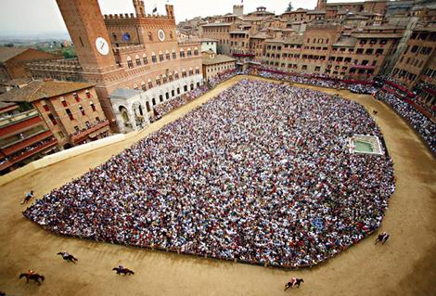
Piazza
Click link on our “links” web page to register
Incredible resource for 24 x 7 help with anything
We keep an eye on it
and answer questions.
YOU can (and will)
too. Visit the Piazza
often.

Slide 13
Resources
Book: Frank M. Carrano, Data Structures and Abstractions with Java, 3nd ed., Prentice Hall. It is OPTIONAL!
  2nd edition is okay. E-book not required
  Share textbook. Need access to it from time to time
  Copies on reserve in Engr Library
PPT slides (on course website and Piazza) outline all of OO in Java. Has index at beginning
Great Java resource: online materials at Oracle JDK web site.
VideoNote: videos of lectures from Fall 2015.
http://www.videonote.com/cornell. Log in with netid

Slide 14
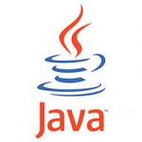

Obtaining Java and Eclipse
Follow instructions on our Resources web page
  Make sure you have Java JDK 1.8, if not download and install. We explain how on the web page.
  Then download and install the Eclipse IDE
Test it out: launch Eclipse and click “new>Java Project”
  This is one of a few ways Java can be used
  When program runs, output is visible
  in a little console window

Slide 15

DrJava IDE
IDE: Integrated Development Environment
DrJava is a much simpler IDE, few features
We use it only to demo Java features and programming concepts. Has an “interactions pane”, which allows trying things without requiring a complete Java program. Great tool!
DON’T use it for course assignments –use Eclipse
Free at www.drjava.org. Download the jar file, not the app!!!

Slide 16
Coursework
7–8 programming assignments (37%)
Two prelims (14% – 16%)
Final exam (30%)
Course evaluation (1%)
Work in recitations (1-3%)
Formula will change as course
progresses and we make changes
in assignments, give quizzes, etc.
Exams are most important aspect in determining final grade

Slide 17



Assignments: a real learning experience
Teams of one or two
  A0 and then A1 will be posted soon on the CMS
  Finding a partner: choose your own or contact your TA. Piazza can be helpful.
One way to do
an assignment:
Wait until the day
before it is due.
Result: Frustration, anger,
impatience, long lines in
consulting room. No fun.
Not a good educational experience

Slide 18



Assignments: a real learning experience
One way to do an assignment:
Read the handout immediately.
Work on it every (other) day. Ponder. Look things up. Get help in consulting room, with no lines, or office hours. Fun, hard work, a great learning experience
Piano lessons:
Practice Daily?
Or put off practicing until an hour before weekly lesson?

Slide 19
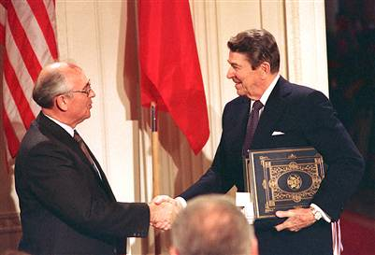
Academic Integrity… Trust but verify!
98% of you are honest and don’t try to cheat
We use artificial intelligence tools to check each homework assignment, so catch the other 2%
  The software is accurate!
  It tests your code and notices similarities between code written by different people
Sure, you can fool this software
  … but it’s easier to just do the assignments
  … and if you try to fool it and screw up, you might fail the assignment or even the whole course.

Slide 20
Types in Java
References in text and in JavaSummary
type: A.14 slide 4
variable: A.13 slide 7
variable declaration: A.15 slide 7
Primitive types, A.16, back inside cover slide 5
Constants, A.17 slide 20
Assignment, A.18-A.20 slide 8
Casting, A.21 slide 6
Expressions: A.22-A.23
Precedences: A.24, back inside cover
Unicode character codes, back inside cover

Slide 21
Type: Set of values together with operations on them.
Type integer:
values: …, –3, –2, –1, 0, 1, 2, 3, …
operations: +, –, *, /, unary –
God’s integers!
Can represent them in many ways — decimal, binary, octal, maybe as strokes ||||
(that’s 4)
Do you know how your computer represents them?

Slide 22
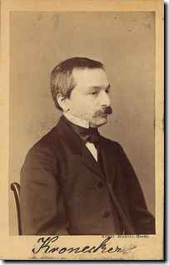
The integers as the basis
Leopold Kronecker (1823-1891), Prussian mathematician,
Argued that arithmetic and analysis should be founded on the whole numbers (integers):
Die ganzen Zahlen hat der liebe Gott gemacht, alles andere ist Menschenwerk.
The beloved God made the whole numbers, everything else is the work of man.
He insisted on the constructibility of math objects. Real numbers –do they really exist?
You can’t compute most of them because they have an infinite number of digits.
God’s integers!

Slide 23
Type: Set of values together with operations on them.
Valid Python sequence:
x= 100;
x= ‘Hello World’;
x= (1, 2, 3, 4, 5 );
Matlab and Python are weakly typed:
One variable can contain at different
times a number, a string, an array, etc.
One isn’t so concerned with types.
Corresponding Java
int x;
x= 100;
x= “Hello”;
Java strongly typed:
A variable must be declared before it is used and can contain only values of the type with which it is declared
Declaration of x:
x can contain only values of type int
Illegal assignment: “Hello” is not an int

Slide 24
Weakly typed versus strongly typed
Weakly typed:
Shorter programs, generally.
Programmer has more freedom, language is more liberal
in applying operations to values.
Strongly typed:
Programmer has to be more disciplined. Declarations
provide a place for comments about variables.
More errors caught at compile-time (e.g. it’s a syntax error
to assign a string to an int variable).
Note: weak and strong typing not well defined; literature has several definitions

Slide 25
Type: Set of values together with operations on them.
Java Type int:
values: –2³¹ .. 2³¹–1
operations: +, –, *, /, %, unary –
b % c : remainder when b is divided by c.
67 % 60 = 7
Java designers decided on this Principle: primitive operations on type int should yield an int.

Slide 26
Most-used ‘primitive’ types
Inside back cover, A-6..7
b % c : remainder when b is divided by c.
67 % 60 = 7
int: values: –2³¹ .. 2³¹–1
operations: +, –, *, /, %, unary –
double: values like : –22.51E6, 24.9
operations: +, –, *, /, %, unary –
Write values in “scientific notation”
char: values like : 'V' '$' '\n'
operations: none
Use single quotes for type char.
'\n' is new-line char
boolean: values: true false
operations: ! (not), && (and), || (or)
Can’t use integers
as booleans!

Slide 27
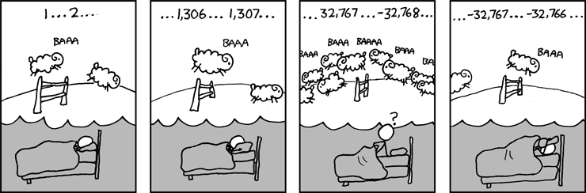
About ‘primitive’ type int
Inside back cover, A-6..7
Java Principle: A basic operation of type int must produce an int
int: values: –2³¹ .. 2³¹–1, i.e.
operations: +, –, *, /, %, unary –
Integer.MAX_VALUE: name for max int value: 2³¹–1: 2147483647
Integer.MAX_VALUE + 1 is
–2³¹: -2147483648 WRAP-AROUND

Slide 28
Primitive number types
Inside back cover, A-6..7
Integer types: byte short int long
1 byte 2 bytes 4 bytes 8 bytes
Real types: float double –22.51E6
4 bytes 8 bytes 24.9
usual
operators
usual
operators
Use these to save space.
Have an array of 1,000,000 integers in range 0..7?
Use a byte array rather than an int array
Don’t worry about this in next 7-8 weeks. Use int and double.

Slide 29
Casting among types
Page A-9, inside back cover
29
(int) 3.2 casts double value 3.2 to an int
any number type
any number expression
may be automatic cast
narrow
wider
byte short int long float double
must be explicit cast, may truncate
(int) is a unary prefix operator, just like –
– – 3 evaluates to 3
– (int) 3.2 evaluates to –3

Slide 30
Char is a number type!
Page A-9, inside back cover
30
char is a number type: (int) 'V' (char) 86
Unicode repr. in decimal: 86
'V'
Unicode: 16-bit char repr. Encodes chars in just about all languages. In java, use hexadecimal (base 16) char literals:
'\u0041' is 'A'
'\u0042' is 'B'
'\u0056' is 'V'
'\u0024' is ‘$'
'\u0950' is 'ॐ’ —Om, the sound of the universe
'\u5927' is '大' —大衛 is (I think) a transliteration
'\u885b' is '衛' of David into Chinese (Da Wei)
See www.unicode.org

Slide 31
Basic variable declaration
Page A-6
31
Declaration: gives name of variable, type of value it can contain
int x;
Declaration of x, can contain an int value
double area;
Declaration of area, can contain a double value
int[] a;
Declaration of a, can contain a pointer to an int array. We explain arrays much later
x
5
area
20.1
a
int
double
int[]

Slide 32
Assignment statement
32
Much like in other languages —need ‘;’ at end:
<variable>= <expression> ;
int x;
x= 10;
… other code
x= x+1;
Have to declare x before assigning to it.
int x= 10;
… other code
x= x+1;
Can combine declaration with an initializing assignment. Shorthand for a declaration followed by an assignment.

Slide 33
Assignment statement type restriction
33
Every expression has a type, which depends on its operators and the types of its operands in a natural way.
Rule: In x= e; type of e has to be same as or narrower than type of x. Reason: To avoid possibly losing info without the programmer realizing it.
double y= 5 + 1;
The value of 5+1 is automatically cast from type int to type double.
int x= 75.5 + 1;
Illegal: The exp value is of type double.
int x= (int) (75.5 + 1);
You can cast to int explicitly. 76 will be stored in x.

Slide 34
A function in Matlab, Python, and Java
34
function s = sum(a, b)
% Return sum of a and b
s= a + b;
Matlab
def sum(a, b):
""" return sum of a and b"""
return a + b
Python
Specification:
in comment
before function
/** return sum of a and b */
public static double sum(double a, double b) {
return a + b;
}
Declarations of parameters a and b
return type

