Slide 1
Threads, Concurrency, and Parallelism
Lecture 24– CS2110 – Spring 2017

Slide 2
Concurrency & Parallelism
So far, our programs have been sequential: they do one thing after another, one thing at a time.
Let’s start writing programs that do more than one thing at at a time.

Slide 3
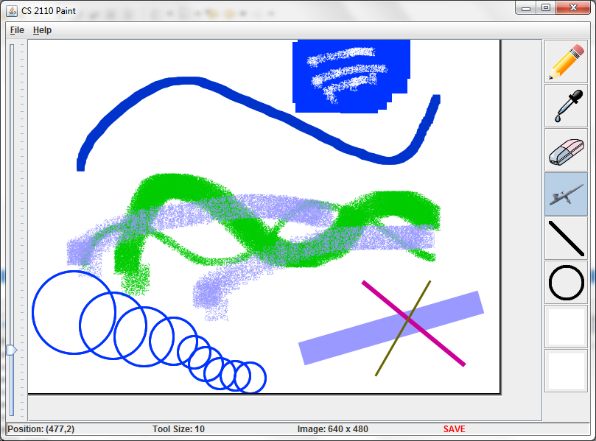



Concurrent Work

Slide 4
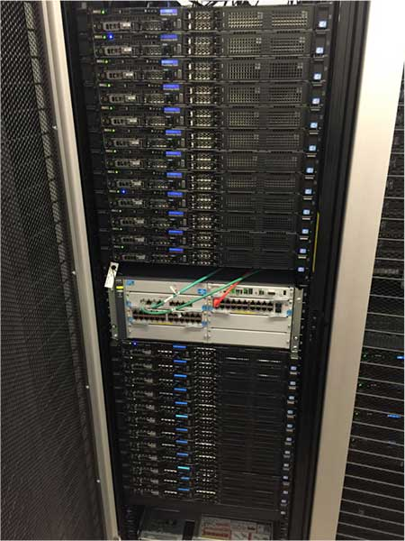
Concurrency in Multiple Machines
Datacenters and clusters are everywhere:
  Industrial:
  Google, Microsoft, Amazon, Apple, Facebook…
  Scientific:
  Several big clusters just in Gates Hall.

Slide 5
Multicore Processors
Every desktop, laptop, tablet, and smartphone you can buy has multiple processors.

Slide 6
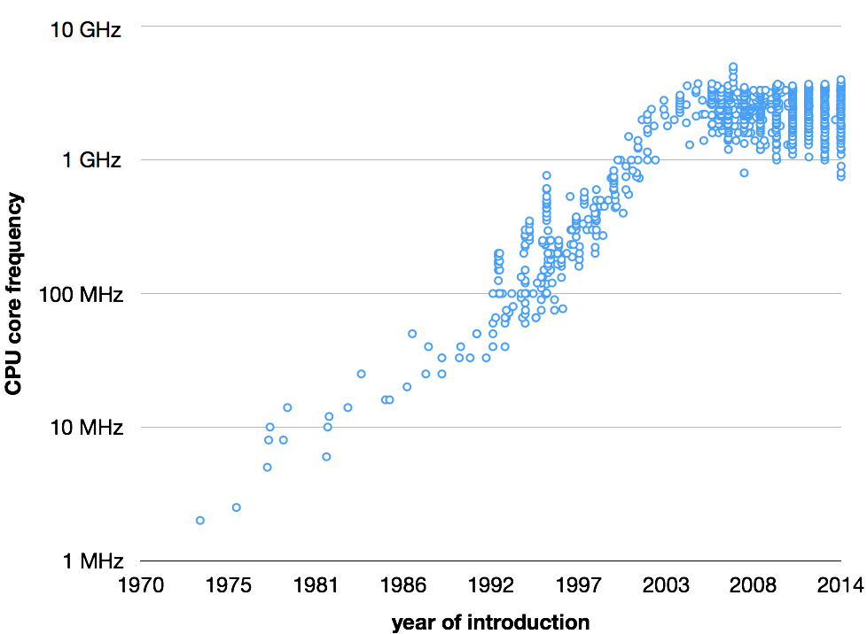

Slide 7
Concurrency & Parallelism
Parallelism is about using additional computational resources to produce an answer faster.
Concurrency is about controlling access by multiple threads to shared resources.
A thread or thread of execution is a sequential stream of computational work.

Slide 8
Java: What is a Thread?
8
A separate “execution” that runs within a single program and can perform a computational task independently and concurrently with other threads
Many applications do their work in just a single thread: the one that called main() at startup
  But there may still be extra threads...
  ... Garbage collection runs in a “background” thread
  GUIs have a separate thread that listens for events and “dispatches” calls to methods to process them
Today: learn to create new threads of our own in Java

Slide 9
Thread
9
A thread is an object that “independently computes”
  Needs to be created, like any object
  Then “started” --causes some method to be called. It runs side by side with other threads in the same program; they see the same global data
The actual executions could occur on different CPU cores, but but don’t have to
  We can also simulate threads by multiplexing a smaller number of cores over a larger number of threads

Slide 10
Java class Thread
10
threads are instances of class Thread
  Can create many, but they do consume space & time
The Java Virtual Machine creates the thread that executes your main method.
Threads have a priority
  Higher priority threads are executed preferentially
  By default, newly created threads have initial priority equal to the thread that created it (but priority can be changed)

Slide 11
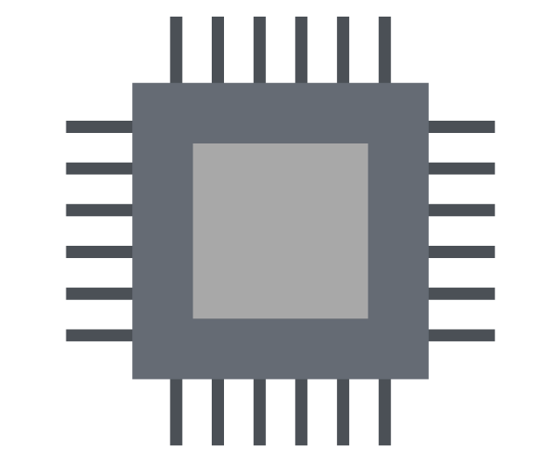
Threads in Java
public static void main() {
...
}
Main Thread
CPU
CPU

Slide 12
Threads in Java
public static void main() {
...
}
void run() {
...
}
Main Thread
void run() {
...
}
CPU

Slide 13
Threads in Java
public static void main() {
...
}
void run() {
...
}
Main Thread
void run() {
...
}
CPU

Slide 14
Starting a new Java thread
Make a new class that implements Runnable.
Put your code for the thread in the run() method.
Don’t call the run method directly!
Construct a new Thread with the Runnable:
SomeRunnable r = new SomeRunnable(...);
Thread t = new Thread(r);
Call the Thread’s start() method.

Slide 15
Sequential version:
starting
prime
composite
done!
main
check1
main
check2
main
time

Slide 16
Parallel version:
starting
done!
main
prime
check1
check2
composite
time

Slide 17
Creating a new Thread (Method 1)
17
class PrimeThread extends Thread {
long a, b;
PrimeThread(long a, long b) {
this.a= a; this.b= b;
}
@Override public void run() {
//compute primes between a and b
...
}
}
Call run() directly?
no new thread is used:
Calling p.start() will run it
overrides
Thread.run()
PrimeThread p= new PrimeThread(143, 195);
p.start();
Do this and
Java invokes run() in new thread

Slide 18
Creating a new Thread (Method 1)
method run() executes in one thread while main program coninues to execute
18
Calls run() to execute in a new Thread and then returns
class PTd extends Thread {
long a, b;
PTd (long a, long b) {
this.a= a; this.b= b;
}
@Override public void run() {
//compute primes between a, b
...
}
}
PTd@20
Thread
start()
run()
sleep(long)
interrupt
isInterrupted
yield
isAlive
getId() getName getPriority
Calls start() in Thread partition
PTd p= new PTd (143, 195);
p.start();
… continue doing other stuff …
PTd
a___ b___
run()

Slide 19
Creating a new Thread (Method 2)
19
class PrimeRun implements Runnable {
long a, b;
PrimeRun(long a, long b) {
this.a= a; this.b= b;
}
public void run() {
//compute primes between a and b
...
}
}
PrimeRun p= new PrimeRun(143, 195);
new Thread(p).start();

Slide 20
Example
We’ll demo this with different values of M and R.
Code will be on course website
20
public class ThreadTest extends Thread {
int M= 1000; int R= 600;
public static void main(String[] args) {
new ThreadTest().start();
for (int h= 0; true; h= h+1) {
sleep(M);
System.out.format("%s %d\n", Thread.currentThread(), h);
}
}
@Override public void run() {
for (int k= 0; true; k= k+1) {
sleep(R);
System.out.format("%s %d\n", Thread.currentThread(), k);
}
}
sleep(…) requires a throws clause
—or else catch it

Slide 21
Example
Thread name, priority, thread group
21
public class ThreadTest extends Thread {
int M= 1000; int R= 600;
public static void main(String[] args) {
new ThreadTest().start();
for (int h= 0; true; h= h+1) {
sleep(M);
…format("%s %d\n", Thread.currentThread(), h);
}
}
@Override public void run() {
for (int k= 0; true; k= k+1) {
sleep(R);
…format("%s %d\n", Thread.currentThread(), k);
}
}
Thread[Thread-0,5,main] 0
Thread[main,5,main] 0
Thread[Thread-0,5,main] 1
Thread[Thread-0,5,main] 2
Thread[main,5,main] 1
Thread[Thread-0,5,main] 3
Thread[main,5,main] 2
Thread[Thread-0,5,main] 4
Thread[Thread-0,5,main] 5
Thread[main,5,main] 3
…

Slide 22
Example
waiting...
running...
waiting...
running...
waiting...
running...
waiting...
running...
waiting...
running...
waiting...
running...
waiting...
running...
waiting...
running...
waiting...
running...
waiting...
running...
done
22
public class ThreadTest extends Thread {
static boolean ok = true;
public static void main(String[] args) {
new ThreadTest().start();
for (int i = 0; i < 10; i++) {
System.out.println("waiting...");
yield();
}
ok = false;
}
public void run() {
while (ok) {
System.out.println("running...");
yield();
}
System.out.println("done");
}
}
If threads happen to be sharing
a CPU, yield allows other waiting
threads to run.

Slide 23
Terminating Threads is Tricky
The safe way: return from the run() method.
  Use a flag field to tell the thread when to exit.
Avoid old and dangerous APIs: stop(), interrupt(), suspend(), destroy()…
  These can leave the thread in a “broken” state.

Slide 24

Background (daemon) Threads
24
In many applications we have a notion of “foreground” and “background” (daemon) threads
  Foreground threads are doing visible work, like interacting with the user or updating the display
  Background threads do things like maintaining data structures (rebalancing trees, garbage collection, etc.) A daemon can continue even when the thread that created it stops.
On your computer, the same notion of background workers explains why so many things are always running in the task manager.

Slide 25
Background (daemon) Threads
25
demon: an evil spirit
daemon. Fernando Corbato, 1963, first to use term. Inspired by Maxwell’s daemon, an imaginary agent in physics and thermodynamics that helped to sort molecules.
from the Greek δαίμων. Unix System Administration Handbook, page 403: … “Daemons have no particular bias toward good or evil but rather serve to help define a person's character or personality. The ancient Greeks' concept of a "personal daemon" was similar to the modern concept of a "guardian angel"—eudaemonia is the state of being helped or protected by a kindly spirit. As a rule, UNIX systems seem to be infested with both daemons and demons.

Slide 26
Producer & Consumer
generate a prime;
queue.add(p);
q = queue.remove();
System.out.println(q);
queue
producer
consumer

Slide 27
Producer & Consumers
q = queue.remove();
System.out.println(q);
generate a prime;
queue.add(p);
q = queue.remove();
System.out.println(q);
queue
q = queue.remove();
System.out.println(q);
producer
consumers

Slide 28
Timing is Everything
Thread 1
Thread 2
if (!q.isEmpty()) {
if (!q.isEmpty()) {
long p = q.remove();
long p = q.remove();

Slide 29
A Fortunate Interleaving
Thread 1
Thread 2
queue length: 1
if (!q.isEmpty()) {
Condition is true!
Remove an element.
long p = q.remove();
queue length: 0
Condition is false.
Do nothing.
if (!q.isEmpty()) {
long p = q.remove();
queue length: 0
time

Slide 30
Another Fortunate Interleaving
Thread 1
Thread 2
queue length: 1
if (!q.isEmpty()) {
long p = q.remove();
queue length: 0
if (!q.isEmpty()) {
long p = q.remove();
queue length: 0
time

Slide 31
An Unfortunate Interleaving
Thread 1
Thread 2
queue length: 1
Condition is true.
if (!q.isEmpty()) {
queue length: 1
if (!q.isEmpty()) {
Condition is still true.
queue length: 1
Remove an element.
long p = q.remove();
queue length: 0
long p = q.remove();
NoSuchElementException!
time

Slide 32
Beginning to think about
avoiding race conditions
32
You know that race conditions can create problems:
Basic idea of race condition: Two different threads access the same variable in a way that destroys correctness.
Process t1 Process t2
… ...
x= x + 1; x= x + 1;
But x= x+1; is not an “atomic action”: it takes several step
Two threads may want to use the same stack, or
Hash table, or linked list, or … at the same time.

Slide 33
Synchronization
33
Java has one primary tool for preventing race conditions.
you must use it by carefully and explicitly – it isn’t automatic.
  Called a synchronization barrier
  Think of it as a kind of lock
    Even if several threads try to acquire the lock at once, only one can succeed at a time, while others wait
    When it releases the lock, another thread can acquire it
    Can’t predict the order in which contending threads get the lock but it should be “fair” if priorities are the same

Slide 34
Synchronized Blocks
a.k.a. locks or mutual exclusion
synchronized (obj) {
...
}
At most one thread can be in a synchronized (obj) block
for the same obj at any given time.

Slide 35
Synchronized Blocks
a.k.a. locks or mutual exclusion
synchronized (q) {
if (!q.isEmpty()) {
q.remove();
}
}
At most one consumer thread can be trying to remove
something from the queue at a time.

Slide 36
Solution: use with synchronization
36
private Stack<String> stack= new Stack<String>();
public void doSomething() {
synchronized (stack) {
if (stack.isEmpty()) return;
String s= stack.pop();
}
//do something with s...
}
synchronized block
Put critical operations in a synchronized block
Can’t be interrupted by other synchronized blocks
on the same object
Can run concurrently with non-synchronized code
Or code synchronized on a different object!

Slide 37
Example: a lucky scenario
37
private Stack<String> stack= new Stack<String>();
public void doSomething() {
if (stack.isEmpty()) return;
String s= stack.pop();
//do something with s...
}
Suppose threads A and B want to call doSomething(),
and there is one element on the stack
1. thread A tests stack.isEmpty() false
2. thread A pops ⇒ stack is now empty
3. thread B tests stack.isEmpty() ⇒ true
4. thread B just returns – nothing to do

Slide 38
What Can i Be at the End?
Thread 1
Thread 2
Initially, i = 0
i += 1;
i += 1;
Finally, i = ?

Slide 39
What Can i Be at the End?
Thread 1
Thread 2
Initially, i = 0
i += 1;
i += 1;
Finally, i = 2 or 1!

Slide 40
What Can i Be at the End?
Thread 1
Thread 2
Initially, i = 0
tmp = load i;
tmp = tmp + 1;
store tmp to i;
tmp = load i;
tmp = tmp + 1;
store tmp to i;

Slide 41
What Can i Be at the End?
Thread 1
Thread 2
Initially, i = 0
tmp = load i;
Load 0 from memory
Load 0 from memory
tmp = load i;
tmp = tmp + 1;
store tmp to i;
Store 1 to memory
tmp = tmp + 1;
store tmp to i;
Store 1 to memory
time
Finally, i = 1

Slide 42
A Pretty Good Rule
Whenever you read or write variables that multiple threads might access, always wrap the code in a synchronized block.
(Following this rule will not magically make your code correct, and it is not always strictly necessary to write correct code. But it is usually a good idea.)

Slide 43
Race Conditions
When the result of running two (or more) threads depends on the relative timing of the executions.
Can cause extremely subtle bugs!
Bugs that seem to disappear when you look for them!

Slide 44
Race conditions
44
Typical race condition: two processes wanting to change a stack at the same time. Or make conflicting changes to a database at the same time.
Race conditions are bad news
  Race conditions can cause many kinds of bugs, not just the example we see here!
  Common cause for “blue screens”: null pointer exceptions, damaged data structures
  Concurrency makes proving programs correct much harder!

Slide 45
Deadlock
Use synchronized blocks to avoid race conditions.
But locks are shared resources that can create their own problems. Like other resources: files, network sockets, etc.
If thread A holds a resource that thread B needs to continue, and thread B holds a different resource that thread A needs to continue, you have deadlock.

Slide 46




Dining philosopher problem
Five philosophers sitting at a table.
Each repeatedly does this:
1. think
2. eat
What do they eat?
spaghetti.
46
Need TWO forks to eat spaghetti!

Slide 47
Dining philosopher problem
Each does repeatedly :
1. think
2. eat (2 forks)
eat is then:
pick up left fork
pick up right fork
eat spaghetti
put down left fork
put down right fork
46
At one point, they all pick up their left forks
DEADLOCK!

Slide 48
Dining philosopher problem
Simple solution to deadlock:
Number the forks. Pick up smaller one first
1. think
2. eat (2 forks)
eat is then:
pick up smaller fork
pick up bigger fork
eat spaghetti
put down bigger fork
put down smaller fork
46
48
5
4
3
1
2

