Slide 1
Graph Search
Lecture 17
CS 2110 Fall 2017

Slide 2
Announcements
For the next lecture, you MUST watch the tutorial on the shortest path algorithm beforehand:
http://www.cs.cornell.edu/courses/cs2110/2017fa/online/shortestPath/shortestPath.html
Thursday's lecture will assume that you understand it. Watch the tutorial once or twice and execute the algorithm on a small graph.

Slide 3


Graphs

Slide 4
Representing Graphs
1
2
4
3
Adjacency List
Adjacency Matrix
1 2 3 4
1
2
3
4
1
2
4
2
3
0 1 0 1
0 0 1 0
0 0 0 0
0 1 1 0
3
4
2
3

Slide 5
Graph Algorithms
Search
  Depth-first search
  Breadth-first search
Shortest paths
  Dijkstra's algorithm
Spanning trees
Algorithms based on properties
Minimum spanning trees
  Prim's algorithm
  Kruskal's algorithm

Slide 6

Search on Graphs
Given a graph $\left(V,E\right)$ and a vertex $u∈V$
We want to "visit" each node that is reachable from $u$
3
2
1
4
7
5
6
8
There are many paths to some nodes.
How do we visit all nodes efficiently, without doing extra work?
3
2
1
4
7
5
6
8

Slide 7
Depth-First Search
Intuition: Recursively visit all vertices that are reachable along unvisited paths.
/** Visit all nodes reachable on unvisited paths from u.
Precondition: u is unvisited. */
public static void dfs(int u) {
visited[u] = true;
for all edges (u,v):
if(!visited[v]):
dfs(v);
}
}
3
2
3
1
2
1
4
7
7
5
5
6
8
8
dfs(1) visits the nodes in this order: 1, 2, 3, 5, 7, 8

Slide 8
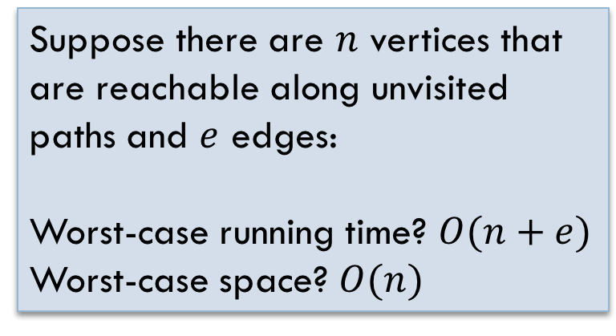
Depth-First Search
Intuition: Recursively visit all vertices that are reachable along unvisited paths.
/** Visit all nodes reachable on unvisited paths from u.
Precondition: u is unvisited. */
public static void dfs(int u) {
visited[u] = true;
for all edges (u,v):
if(!visited[v]):
dfs(v);
}
}
Suppose there are $n$ vertices that are reachable along unvisited paths and $e$ edges:
Worst-case running time? $O(n+e)$
Worst-case space? $O(n)$

Slide 9
Depth-First Search in Java
public class Node {
boolean visited;
List<Node> neighbors;
/** Visit all nodes reachable on unvisited paths from this node.
Precondition: this node is unvisited. */
public void dfs() {
visited= true;
for (Node n: neighbors) {
if (!n.visited) n.dfs();
}
}
}
Each vertex of the graph is an object of type Node
No need for a parameter. The object is the node.

Slide 10
Depth-First Search Iteratively
Intuition: Visit all vertices that are reachable along unvisited paths from the current node.
/** Visit all nodes reachable on unvisited paths from u.
Precondition: u is unvisited. */
public static void dfs(int u) {
Stack s= (u);// Not Java!
while ( ) {
u= s.pop();
if (u not visited) {
visit u;
for each edge (u, v):
s.push(v);
}
}
}
3
2
3
2
1
1
4
7
s is not empty
7
5
5
6
8
8
3
5
2
5
5
Stack:
7
8
1

Slide 11
Breadth-First Search
/** Visit all nodes reachable on unvisited paths from u.
Precondition: u is unvisited. */
public static void bfs(int u) {
Queue q= (u);// Not Java!
while ( q is not empty ) {
u= q.remove();
if (u not visited) {
visit u;
for each (u, v):
q.add(v);
}
}
}
Intuition: Iteratively process the graph in "layers" moving further away from the source node.
3
2
3
2
1
1
4
7
7
5
5
6
8
8
Queue:
2
5
3
5
8
5
1
7

Slide 12
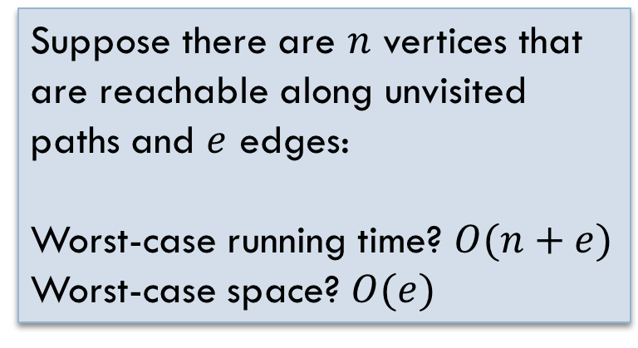
Analyzing BFS
/** Visit all nodes reachable on unvisited paths from u.
Precondition: u is unvisited. */
public static void bfs(int u) {
Queue q= (u);// Not Java!
while ( ) {
u= q.remove();
if (u not visited) {
visit u;
for each (u, v):
q.add(v);
}
}
}
Intuition: Iteratively process the graph in "layers" moving further away from the source node.
Suppose there are $n$ vertices that are reachable along unvisited paths and $e$ edges:
Worst-case running time? $O(n+e)$
Worst-case space? $O(e)$

Slide 13


Comparing Search Algorithms
DFS
BFS
Visits: 1, 2, 3, 5, 7, 8
Time: $O(n+e)$
Space: $O(n)$
Visits: 1, 2, 5, 7, 3, 8
Time: $O(n+e)$
Space: $O(e)$
2
3
1
4
7
5
6
8
Notes:
Other factors: completeness

