Slide 1
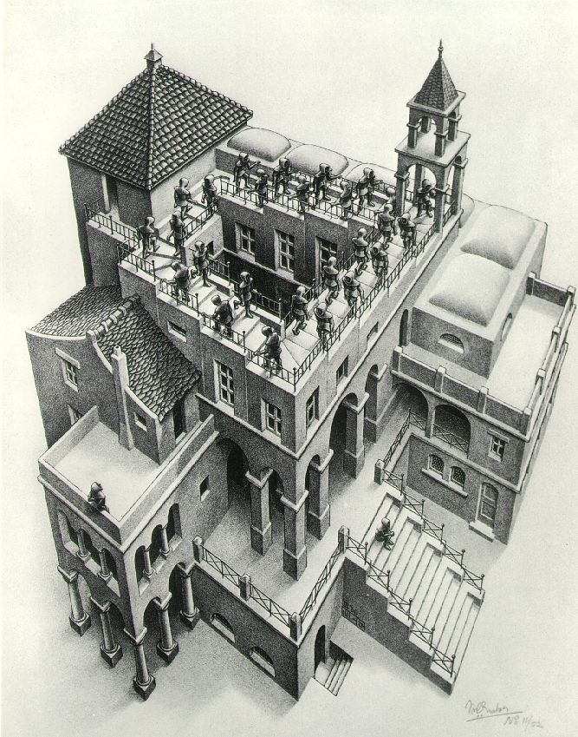
Heaps And
Priority Queues
Lecture 16
CS2110 Fall 2017

Slide 2
Abstract vs concrete data structures
Abstract data structures are interfaces
  they specify only interface (method names and specs)
  not implementation (method bodies, fields, …)
Concrete data structures are classes. Abstract data structures can have multiple possible implementations by different concrete data structures.

Slide 3
Abstract vs concrete data structures
interface List defines an “abstract data type”.
It has methods: add, get, remove, …
Various classes ("concrete data types") implement List:
Class: | ArrayList | LinkedList
Backing storage: | array | chained nodes
add(i, val) | O(n) | O(n)
add(0, val) | O(n) | O(1)
add(n, val) | O(1) | O(1)
get(i) | O(1) | O(n)
get(0) | O(1) | O(1)
get(n) | O(1) | O(1)

Slide 4
Concrete Data Types

Slide 5
Concrete data structures
Array
LinkedList (singley-linked, doubly-linked)
Trees (binary, general)
Heaps

Slide 6
Heaps
A heap is a binary tree with certain properties (it's a concrete data structure)
  Heap Order Invariant: every element in the tree is >= its parent
  Complete Binary Tree: every level of the tree (except last) is completely filled, there are no holes
Do not confuse with heap memory, where the Java virtual machine allocates space for objects – different usage of the word heap

Slide 7
Order Property
Every element is >= its parent
4
6
14
21
8
19
35
22
38
55
10
20
Note: 19, 20 < 35: Smaller elements
can be deeper in the tree!

Slide 8
Completeness Property
Every level (except last) completely filled.
Nodes on bottom level are as far left as possible.
4
6
14
21
8
19
35
22
38
55
10
20

Slide 9
Completeness Property
Not a heap because it has two holes
4
6
14
21
8
19
22
55
10
20
Not a heap because:
missing a node on level 2
bottom level nodes are not as far left as possible
missing nodes

Slide 10
Heaps
A heap is a binary tree with certain properties (it's a concrete data structure)
  Heap Order Invariant: every element in the tree is >= its parent
  Complete Binary Tree: every level of the tree (except last) is completely filled, there are no holes
A heap implements two key methods:
  add(e): adds a new element to the heap
  poll(): deletes the least element and returns it

Slide 11
add(e)
4
6
14
21
8
19
35
22
38
55
10
20

Slide 12
add(e)
4
6
14
21
8
19
35
22
38
55
10
20
5
1. Put in the new element in a new node

Slide 13
add()
4
6
14
21
8
5
35
22
38
55
10
20
19
2. Bubble new element up if less than parent

Slide 14
add()
4
6
5
21
8
14
35
22
38
55
10
20
19
2. Bubble new element up if less than parent

Slide 15
add()
4
6
5
21
8
14
35
22
38
55
10
20
19

Slide 16
add(e)
Add e at the leftmost empty leaf
Bubble e up until it no longer violates heap order
The heap invariant is maintained!

Slide 17
add(e) to a tree of size n
Time is O(log n), since the tree is balanced
  size of tree is exponential as a function of depth
  depth of tree is logarithmic as a function of size

Slide 18
poll()
4
6
5
21
8
14
35
22
38
55
10
20
19

Slide 19
poll()
4
6
5
21
8
14
35
22
38
55
10
20
19
1. Save top element in a local variable

Slide 20
poll()
4
6
5
21
8
14
35
22
38
55
10
20
19
2. Assign last value to the root, delete last value from heap

Slide 21
poll()
4
19
6
5
21
8
14
35
22
38
55
10
20
3. Bubble root value down

Slide 22
poll()
4
5
6
19
21
8
14
35
22
38
55
10
20
3. Bubble root value down

Slide 23
poll()
4
5
6
14
21
8
19
35
22
38
55
10
20
3. Bubble root value down

Slide 24
poll()
Save the least element (the root)
Assign last element of the heap to the root.
Remove last element of the heap.
Bubble element down –always with smaller child, until heap invariant is true again.
The heap invariant is maintained!
Return the saved element
Time is O(log n), since the tree is balanced

Slide 25
Implementing Heaps
public class HeapNode<E> {
private E value;
private HeapNode left;
private HeapNode right;
...
}

Slide 26
Implementing Heaps
public class Heap<E> {
private E[] heap;
...
}

Slide 27
Numbering the nodes in a heap
Number node starting at root row by row, left to right
Level-order traversal
0
4
1
6
2
14
3
21
4
8
5
19
6
35
7
22
8
38
9
55
Children of node k are nodes 2k+1 and 2k+2
Parent of node k is node (k-1)/2

Slide 28
Store a heap in an array (or ArrayList) b!
Heap nodes in b in order, going across each level from left to right, top to bottom
Children of b[k] are b[2k + 1] and b[2k + 2]
Parent of b[k] is b[(k – 1)/2]
to parent
0 1 2 3 4 5 6 7 8 9
to children
Tree structure is implicit. No need for explicit links!

Slide 29
add() --assuming there is space
/** An instance of a heap */
class Heap<E> {
E[] b= new E[50]; // heap is b[0..n-1]
int n= 0; // heap invariant is true
/** Add e to the heap */
public void add(E e) {
b[n]= e;
n= n + 1;
bubbleUp(n - 1); // given on next slide
}
}

Slide 30
add(). Remember, heap is in b[0..n-1]
class Heap<E> {
/** Bubble element #k up to its position.
* Pre: heap inv holds except maybe for k */
private void bubbleUp(int k) {
// inv: p is parent of k and every elmnt
// except perhaps k is >= its parent
while ( ) {
}
}
int p= (k-1)/2;
k > 0 && b[k].compareTo(b[p]) < 0
swap(b[k], b[p]);
k= p;
p= (k-1)/2;

Slide 31
poll(). Remember, heap is in b[0..n-1]
/** Remove and return the smallest element
* (return null if list is empty) */
public E poll() {
if (n == 0) return null;
E v= b[0]; // smallest value at root.
n= n – 1; // move last
b[0]= b[n]; // element to root
bubbleDown(0);
return v;
}

Slide 32
c’s smaller child
/** Tree has n node.
* Return index of smaller child of node k
(2k+2 if k >= n) */
public int smallerChild(int k, int n) {
int c= 2*k + 2; // k’s right child
if (c >= n || b[c-1].compareTo(b[c]) < 0)
c= c-1;
return c;
}

Slide 33
/** Bubble root down to its heap position.
Pre: b[0..n-1] is a heap except maybe b[0] */
private void bubbleDown() {
// inv: b[0..n-1] is a heap except maybe b[k] AND
// b[c] is b[k]’s smallest child
while ( ) {
}
}
int k= 0;
int c= smallerChild(k, n);
c < n && b[k].compareTo(b[c]) > 0
swap(b[k], b[c]);
k= c;
c= smallerChild(k, n);

Slide 34
Abstract Data Types

Slide 35
Some Abstract Data Types
List
Stack (LIFO) implemented using a List
allows only add(0,val), remove(0) (push, pop)
Queue (FIFO) implemented using a List
allows only add(n,val), remove(0) (enqueue, dequeue)
Both efficiently implementable using a singly linked list with head and tail
head
55
12
19
16
tail
PriorityQueue

Slide 36
Priority Queue
Data structure in which data items are Comparable
Smaller elements (determined by compareTo()) have higher priority
remove() return the element with the highest priority = least element in the compareTo() ordering
break ties arbitrarily

Slide 37
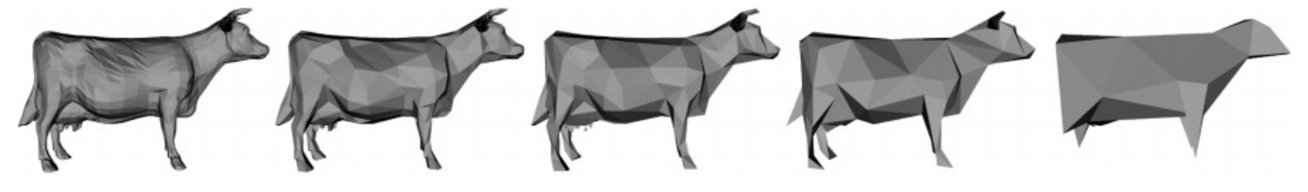
Many uses of priority queues (& heaps)
Surface simplification [Garland and Heckbert 1997]
Event-driven simulation: customers in a line
Collision detection: "next time of contact" for colliding bodies
Graph searching: Dijkstra's algorithm, Prim's algorithm
AI Path Planning: A* search
Statistics: maintain largest M values in a sequence
Operating systems: load balancing, interrupt handling
Discrete optimization: bin packing, scheduling
College: prioritizing assignments for multiple classes.

Slide 38
java.util.PriorityQueue<E>
interface PriorityQueue<E> { TIME
boolean add(E e) {...} //insert e. log
void clear() {...} //remove all elems.
E peek() {...} //return min elem. constant
E poll() {...} //remove/return min elem. log
boolean contains(E e) linear
boolean remove(E e) linear
int size() {...} constant
Iterator<E> iterator()
}
IF implemented with a heap!

Slide 39
Priority queues as lists
Maintain as a list
add() put new element at front – O(1)
poll() must search the list – O(n)
peek() must search the list – O(n)
Maintain as an ordered list
add() must search the list – O(n)
poll() min element at front – O(1)
peek() O(1)
Can we do better?

Slide 40
Priority queues as heaps
A heap is can be used to implement priority queues
Gives better complexity than either ordered or unordered list implementation:
  add(): O(log n) (n is the size of the heap)
  peek(): O(1)
  poll(): O(log n)

Slide 41
What if the priority is independent from the value?
Separate priority from value and do this:
add(e, p); //add element e with priority p (a double)
THIS IS EASY!
Be able to change priority
change(e, p); //change priority of e to p
THIS IS HARD!
Big question: How do we find e in the heap?
Searching heap takes time proportional to its size! No good!
Once found, change priority and bubble up or down. OKAY
Assignment A6: implement this heap! Use a second data structure to make change-priority expected log n time

