Slide 1
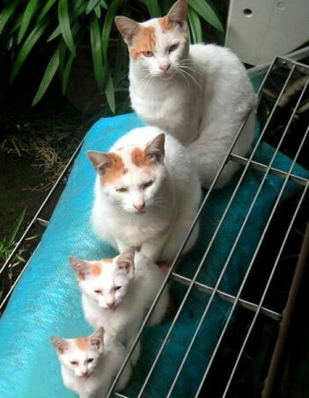
Recursion
Lecture 8
CS2110 – Fall 2017

Slide 2
Five things
Note: We’ve covered almost everything in Java! Just a few more things, which will be covered from time to time.
A1 grades will be made available soon. Thanks for your patience.
Recursion: Look at Java Hypertext entry for “method calls”.
Prelim 1 is in 2 weeks
(Thurs 28 September, 5:30, 7:30)
Visit exams page of course website to see what time you will take the prelim.
Piazza: If you are not on the Piazza, contact a TA or consultant and ask them to put you on it.

Slide 3
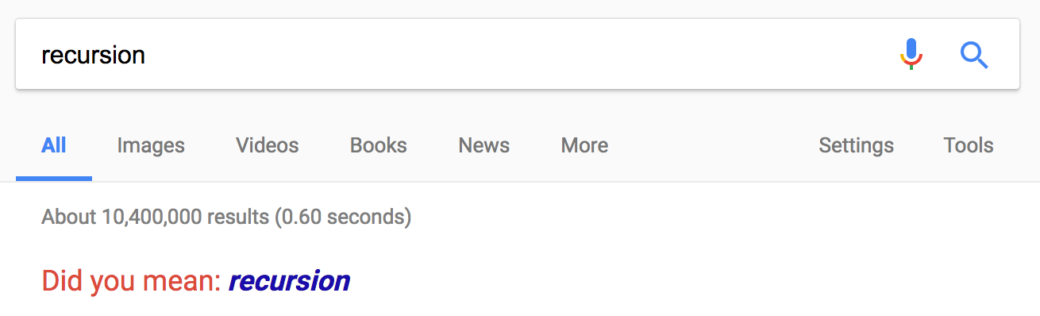
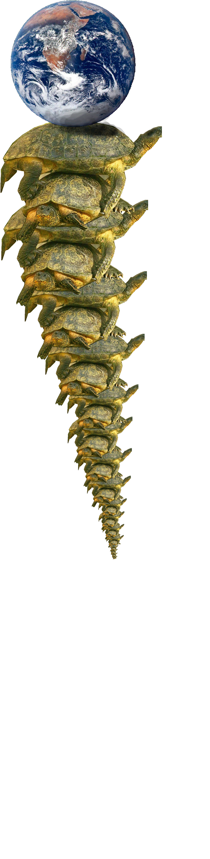
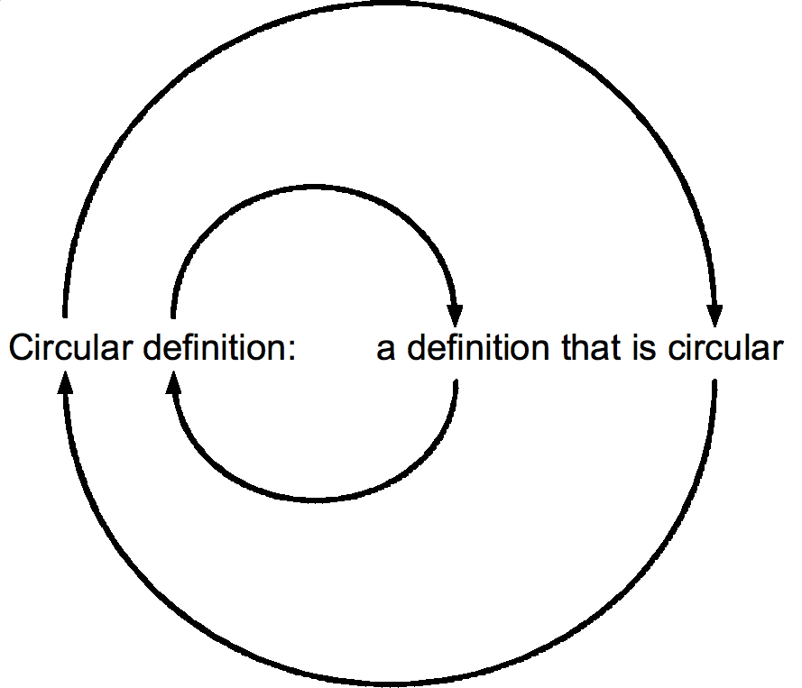
To Understand Recursion…

Slide 4
Recursion – Real Life Examples
<noun phrase> = <noun>, or
<adjective> <noun phrase>, or
<adverb> <noun phrase>
Example:
terrible
horrible
no-good
very
bad
day

Slide 5
Recursion – Real Life Examples
<noun phrase> = <noun>, or
<adjective> <noun phrase>, or
<adverb> <noun phrase>
ancestor(p) = parent(p), or
parent(ancestor(p))
0! = 1
n! = n * (n-1)!
great great great great great great great great great great great
great great grandmother.
1, 1, 2, 6, 24, 120, 720, 5050, 40320, 362880, 3628800, 39916800, 479001600…

Slide 6
Sum the digits in a non-negative integer
/** = sum of digits in n.
* Precondition: n >= 0 */
public static int sumDigs(int n) {
if (n < 10) return n;
// { n has at least two digits }
// return first digit + sum of rest
return n%10 + sum(n/10);
}
sum calls itself!
sum(7) = 7
sum(8703) = 3 + sum(870)
= 3 + 8 + sum(70)
= 3 + 8 + 7 + sum(0)

Slide 7
Two different questions, two different answers
1. How is it executed?
(or, why does this even work?)
2. How do we understand recursive methods?
(or, how do we write/develop recursive methods?)

Slide 8
Stacks and Queues
stack grows
Stack: list with (at least) two basic ops:
* Push an element onto its top
* Pop (remove) top element
Last-In-First-Out (LIFO)
top element
2nd element
...
bottom element
Like a stack of trays in a cafeteria
Queue: list with (at least) two basic ops:
* Append an element
* Remove first element
First-In-First-Out (FIFO)
first second … last
Americans wait in a line. The Brits wait in a queue !

Slide 9
Stack Frame
A “frame” contains information about a method call:
local variables
parameters
return info
At runtime Java maintains a
stack that contains frames
for all method calls that are being executed but have not completed.
a frame
Method call: push a frame for call on stack. Assign argument values to parameters. Execute method body. Use the frame for the call to reference local variables and parameters.
End of method call: pop its frame from the stack; if it is a function leave the return value on top of stack.

Slide 10
Questions about local variables
public static void m(…) {
…
while (…) {
int d= 5;
…
}
}
public static void m(…) {
int d;
…
while (…) {
d= 5;
…
}
}
In a call m(…)
when is local variable d created and when is it destroyed?
Which version of procedure m do you like better? Why?

Slide 11
Memorize method call execution!
A frame for a call contains parameters, local variables, and other information needed to properly execute a method call.
To execute a method call:
push a frame for the call on the stack,
assign argument values to parameters,
execute method body,
pop frame for call from stack, and (for a function) push returned value on stack
When executing method body look in frame
for call for parameters and local variables.

Slide 12
Frames for methods sum main method in the system
public static int sum(int n) {
if (n < 10) return n;
return n%10 + sum(n/10);
}
public static void main(
String[] args) {
int r= sum(824);
System.out.println(r);
}
n ___
return info
frame:
r ___ args ___
return info
frame:
?
return info
Frame for method in the system that calls method main
frame:

Slide 13
Example: Sum the digits in a non-negative integer
public static int sum(int n) {
if (n < 10) return n;
return n%10 + sum(n/10);
}
public static void main(
String[] args) {
int r= sum(824);
System.out.println(r);
}
main
r ___ args ___
return info
Frame for method in the system that calls method main: main is then called
system
?
return info

Slide 14
Example: Sum the digits in a non-negative integer
public static int sum(int n) {
if (n < 10) return n;
return n%10 + sum(n/10);
}
public static void main(
String[] args) {
int r= sum(824);
System.out.println(r);
}
824
n ___
return info
main
r ___ args ___
return info
Method main calls sum:
?
return info
system

Slide 15
Example: Sum the digits in a non-negative integer
public static int sum(int n) {
if (n < 10) return n;
return n%10 + sum(n/10);
}
public static void main(
String[] args) {
int r= sum(824);
System.out.println(r);
}
82
n ___
return info
824
n ___
return info
main
r ___ args ___
return info
n >= 10 sum calls sum:
?
return info
system

Slide 16
Example: Sum the digits in a non-negative integer
public static int sum(int n) {
if (n < 10) return n;
return n%10 + sum(n/10);
}
public static void main(
String[] args) {
int r= sum(824);
System.out.println(r);
}
8
n ___
return info
82
n ___
return info
824
n ___
return info
main
r ___ args ___
return info
n >= 10. sum calls sum:
?
return info
system

Slide 17
Example: Sum the digits in a non-negative integer
public static int sum(int n) {
if (n < 10) return n;
return n%10 + sum(n/10);
}
public static void main(
String[] args) {
int r= sum(824);
System.out.println(r);
}
8
n ___
return info
8
82
n ___
return info
824
n ___
return info
main
r ___ args ___
return info
n < 10 sum stops: frame is popped and n is put on stack:
?
return info
system

Slide 18
Example: Sum the digits in a non-negative integer
public static int sum(int n) {
if (n < 10) return n;
return n%10 + sum(n/10);
}
public static void main(
String[] args) {
int r= sum(824);
System.out.println(r);
}
8
82
n ___
return info
10
824
n ___
return info
main
r ___ args ___
return info
Using return value 8 stack computes
2 + 8 = 10 pops frame from stack puts return value 10 on stack
?
return info

Slide 19
Example: Sum the digits in a non-negative integer
public static int sum(int n) {
if (n < 10) return n;
return n%10 + sum(n/10);
}
public static void main(
String[] args) {
int r= sum(824);
System.out.println(r);
}
10
824
n ___
return info
14
main
r ___ args ___
return info
Using return value 10 stack computes
4 + 10 = 14 pops frame from stack puts return value 14 on stack
?
return info

Slide 20
Example: Sum the digits in a non-negative integer
public static int sum(int n) {
if (n < 10) return n;
return n%10 + sum(n/10);
}
public static void main(
String[] args) {
int r= sum(824);
System.out.println(r);
}
14
14
main
r ___ args __
return info
Using return value 14 main stores
14 in r and removes 14 from stack
?
return info

Slide 21
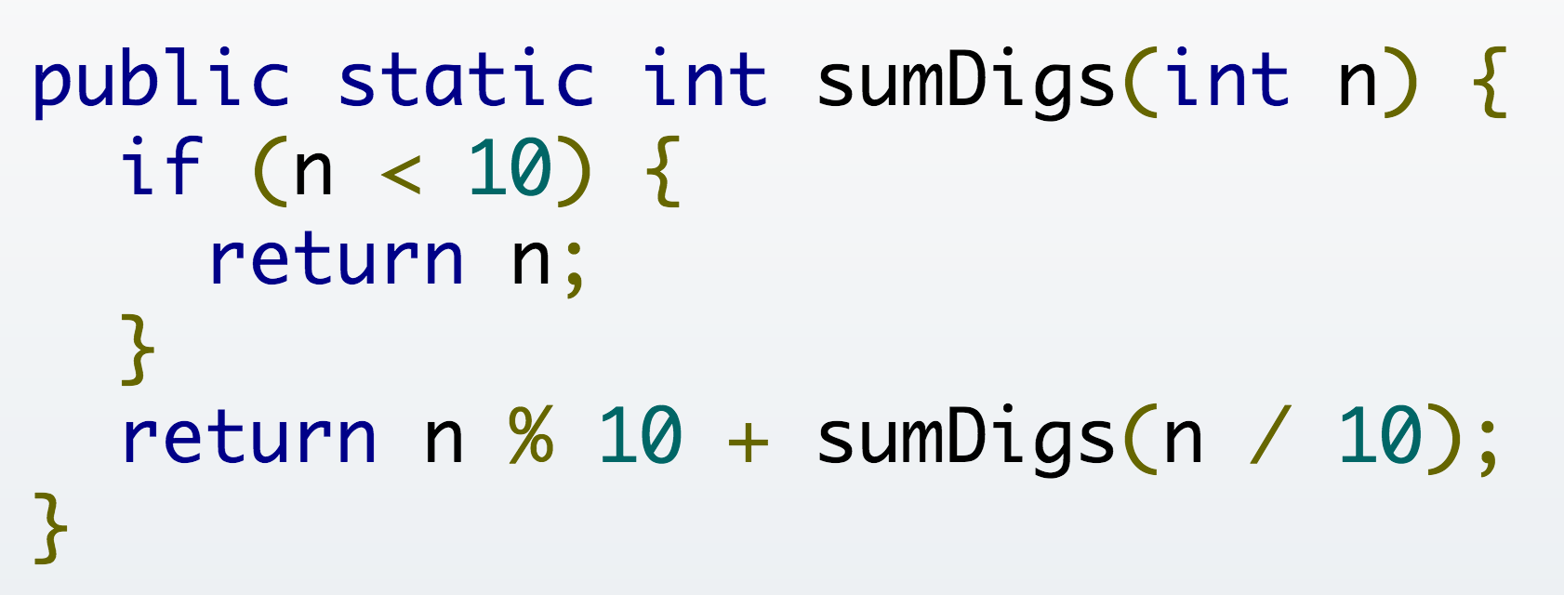
Poll time!
Assume my program's main method calls
sumDigs(1837420)
During this call, what is the maximum number of stack frames above (not including) main's stack frame?

Slide 22
Two different questions, two different answers
1. How is it executed?
(or, why does this even work?)
It’s not magic! Trace the code’s execution using the method call algorithm, drawing the stack frames as you go.
Use only to gain understanding / assurance that recursion works.
2. How do we understand recursive methods?
(or, how do we write/develop recursive methods?)
This requires a totally different approach.

Slide 23
Back to Real Life Examples
Factorial function:
0! = 1
n! = n * (n-1)! for n > 0
(e.g.: 4! = 4*3*2*1=24)
Exponentiation:
b⁰ = 1
b^{c} = b * b^{c-1} for c > 0
Easy to make math definition into a Java function!
public static int fact(int n) {
if (n == 0) return 1;
return n * fact(n-1);
}
public static int exp(int b, int c) {
if (c == 0) return 1;
return b * exp(b, c-1);
}

Slide 24
How to understand what a call does
Make a copy of the method spec, replacing the parameters of the method by the arguments
  spec says that the value of a call equals the sum of the digits of n
sumDigs(654)
/** = sum of the digits of n.
* Precondition: n >= 0 */
public static int sumDigs(int n) {
if (n < 10) return n;
// n has at least two digits
return n%10 + sumDigs(n/10);
}
sum of digits of n
sum of digits of 654

Slide 25
Understanding a recursive method
Step 1. Have a precise spec!
Step 2. Check that the method works in the base case(s): That is, Cases where the parameter is small enough that the result can be computed simply and without recursive calls.
If n < 10 then n consists
of a single digit.
Looking at the spec we
see that that digit is the
required sum.
/** = sum of the digits of n.
* Precondition: n >= 0 */
public static int sumDigs(int n) {
if (n < 10) return n;
// n has at least two digits
return n%10 + sumDigs(n/10);
}

Slide 26
Understanding a recursive method
/** = sum of the digits of n.
* Precondition: n >= 0 */
public static int sumDigs(int n) {
if (n < 10) return n;
// n has at least two digits
return n%10 + sumDigs(n/10);
}
Step 1. Have a precise spec!
Step 2. Check that the method works in the base case(s).
Step 3. Look at the recursive
case(s). In your mind replace
each recursive call by what it
does according to the method spec and verify that the correct result is then obtained.
return n%10 + sum(n/10);
return n%10 + (sum of digits of n/10); // e.g. n = 843

Slide 27
Understanding a recursive method
/** = sum of the digits of n.
* Precondition: n >= 0 */
public static int sumDigs(int n) {
if (n < 10) return n;
// n has at least two digits
return n%10 + sumDigs(n/10);
}
Step 1. Have a precise spec!
Step 2. Check that the method works in the base case(s).
Step 3. Look at the recursive
case(s). In your mind replace
each recursive call by what it
does acc. to the spec and verify correctness.
Step 4. (No infinite recursion) Make sure that the args of recursive calls are in some sense smaller than the pars of the method.
n/10 < n, so it will get smaller until it has one digit

Slide 28
Understanding a recursive method
Important! Can’t do step 3 without precise spec.
Step 1. Have a precise spec!
Step 2. Check that the method works in the base case(s).
Step 3. Look at the recursive
case(s). In your mind replace
each recursive call by what it
does according to the spec and verify correctness.
Once you get the hang of it this is what makes recursion easy! This way of thinking is based on math induction which we don’t cover in this course.
Step 4. (No infinite recursion) Make sure that the args of recursive calls are in some sense smaller than the parameters of the method

Slide 29
Writing a recursive method
Step 1. Have a precise spec!
Step 2. Write the base case(s): Cases in which no recursive calls are needed. Generally for “small” values of the parameters.
Step 3. Look at all other cases. See how to define these cases in terms of smaller problems of the same kind. Then implement those definitions using recursive calls for those smaller problems of the same kind. Done suitably, point 4 (about termination) is automatically satisfied.
Step 4. (No infinite recursion) Make sure that the args of recursive calls are in some sense smaller than the parameters of the method

Slide 30
Two different questions, two different answers
2. How do we understand recursive methods?
(or, how do we write/develop recursive methods?)
Step 1. Have a precise spec!
Step 2. Check that the method works in the base case(s).
Step 3. Look at the recursive case(s). In your mind replace each recursive call by what it does according to the spec and verify correctness.
Step 4. (No infinite recursion) Make sure that the args of recursive calls are in some sense smaller than the parameters of the method

Slide 31
Examples of writing recursive functions
For the rest of the class we demo writing recursive functions using the approach outlined below. The java file we develop will be placed on the course webpage some time after the lecture.
Step 1. Have a precise spec!
Step 2. Write the base case(s).
Step 3. Look at all other cases. See how to define these cases in terms of smaller problems of the same kind. Then implement those definitions using recursive calls for those smaller problems of the same kind.
Step 4. Make sure recursive calls are “smaller” (no infinite recursion).

Slide 32
Check palindrome-hood
A String palindrome is a String that reads the same backward and forward:
A String with at least two characters is a palindrome if
(0) its first and last characters are equal and
(1) chars between first & last form a palindrome:
e.g. AMANAPLANACANALPANAMA
A recursive definition!
isPal(“racecar”) → true isPal(“pumpkin”) → false
have to be the same
have to be a palindrome

Slide 33
A man a plan a caret a ban a myriad a sum a lac a liar a hoop a pint a catalpa a gas an oil a bird a yell a vat a caw a pax a wag a tax a nay a ram a cap a yam a gay a tsar a wall a car a luger a ward a bin a woman a vassal a wolf a tuna a nit a pall a fret a watt a bay a daub a tan a cab a datum a gall a hat a fag a zap a say a jaw a lay a wet a gallop a tug a trot a trap a tram a torr a caper a top a tonk a toll a ball a fair a sax a minim a tenor a bass a passer a capital a rut an amen a ted a cabal a tang a sun an ass a maw a sag a jam a dam a sub a salt an axon a sail an ad a wadi a radian a room a rood a rip a tad a pariah a revel a reel a reed a pool a plug a pin a peek a parabola a dog a pat a cud a nu a fan a pal a rum a nod an eta a lag an eel a batik a mug a mot a nap a maxim a mood a leek a grub a gob a gel a drab a citadel a total a cedar a tap a gag a rat a manor a bar a gal a cola a pap a yaw a tab a raj a gab a nag a pagan a bag a jar a bat a way a papa a local a gar a baron a mat a rag a gap a tar a decal a tot a led a tic a bard a leg a bog a burg a keel a doom a mix a map an atom a gum a kit a baleen a gala a ten a don a mural a pan a faun a ducat a pagoda a lob a rap a keep a nip a gulp a loop a deer a leer a lever a hair a pad a tapir a door a moor an aid a raid a wad an alias an ox an atlas a bus a madam a jag a saw a mass an anus a gnat a lab a cadet an em a natural a tip a caress a pass a baronet a minimax a sari a fall a ballot a knot a pot a rep a carrot a mart a part a tort a gut a poll a gateway a law a jay a sap a zag a fat a hall a gamut a dab a can a tabu a day a batt a waterfall a patina a nut a flow a lass a van a mow a nib a draw a regular a call a war a stay a gam a yap a cam a ray an ax a tag a wax a paw a cat a valley a drib a lion a saga a plat a catnip a pooh a rail a calamus a dairyman a bater a canal Panama

Slide 34
Example: Is a string a palindrome?
/** = "s is a palindrome" */
public static boolean isPal(String s) {
if (s.length() <= 1)
return true;
// { s has at least 2 chars }
int n= s.length()-1;
return s.charAt(0) == s.charAt(n) && isPal(s.substring(1,n));
}
Substring from
s[1] to s[n-1]

Slide 35
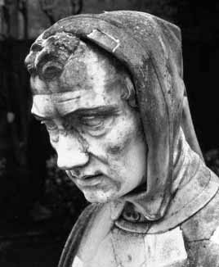
The Fibonacci Function
Mathematical definition:
fib(0) = 0
fib(1) = 1
fib(n) = fib(n − 1) + fib(n − 2) n ≥ 2
Fibonacci sequence: 0 1 1 2 3 5 8 13 …
two base cases!
Fibonacci (Leonardo Pisano) 1170-1240?
Statue in Pisa Italy
Giovanni Paganucci
1863
/** = fibonacci(n). Pre: n >= 0 */
static int fib(int n) {
if (n <= 1) return n;
// { 1 < n }
return fib(n-1) + fib(n-2);
}

Slide 36
Example: Count the e’s in a string
/** = number of times c occurs in s */
public static int countEm(char c, String s) {
if (s.length() == 0) return 0;
// { s has at least 1 character }
if (s.charAt(0) != c)
return countEm(c, s.substring(1));
// { first character of s is c}
return 1 + countEm (c, s.substring(1));
}
substring s[1..]
i.e. s[1] … s(s.length()-1)
countEm(‘e’, “it is easy to see that this has many e’s”) = 4
countEm(‘e’, “Mississippi”) = 0

