Slide 1
CS/ENGRD 2110 fall 2017
Lecture 7: Interfaces and Abstract Classes
http://courses.cs.cornell.edu/cs2110

Slide 2
Announcements
A2 is due tomorrow night (17 February)
Get started on A3 – a method every other day.
Time to do A1:
356/416 groups gave the time.
Mean: 5 hours, 22 minutes.
Median: 5 hours exactly.

Slide 3
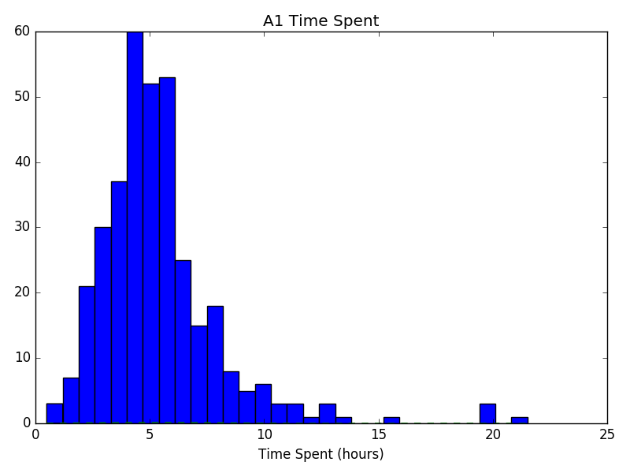
Time to do A1. On A1 FAQ notes
356/416 groups gave time.
Mean: 5 hours, 22 minutes.
Median: 5 hours exactly.

Slide 4
A Little Geometry!
(x, y)
Position of a rectangle in the plane is given by its upper-left corner
(x, y)
Position of a circle in the plane is given by the upper-left corner of its bounding box

Slide 5
A Little Geometry!
Abstract Classes
class Shape contains the coordinates of a shape in the plane. Each subclass
declares the fields to contain the size and function area
Shape
x ____
y ____
Write variables as lines instead of boxes
Rectangle
area()
width ____
height ____
Triangle
area()
base____
height ____
Circle
area()
radius __5__
5
Notes:
Encourage the students to download the code for this online
The goal is to incorporate an area method for all shapes
Note that on this slide (and others), to simplify formatting, we show a variable as its name following by underlining, and we may put the value in the underline place (as done in one case here)
x,y are coordinates that are for all shapes. Each subclass has its own relevant fields.
Explain that Circle, Square, and Triangle all have different area() functions
but Shape does not have one

Slide 6
Problem: Don’t like creation of Shape objects
Abstract Classes
PROBLEM
Since an object of Shape is not really a shape, don’t want to allow creation of objects of class Shape!
Shape
x ____
y ____
Solution
public abstract class Shape {
…
}
Rectangle
area()
width ____
height ____
Circle
area()
radius __5__
Syntactic rule: if a class C is abstract, the new-expression new C(…) cannot be used!
6

Slide 7
Attempt at writing function sumAreas
Abstract Classes
/** Return sum of areas of shapes in s */
public static double sumAreas(Shape[] s) {
}
double sum= 0;
for (int k= 0; k < s.length; k= k+1)
sum= sum + s[k].area();
return sum;
Does this work?
Problems:
Use instanceof (not getclass()!) to figure out which subclass s[k] is and cast down so that function area() can be called.
Adding new Shape subclass requires modifying sumAreas
7
Notes:
Show them the code and how each of the subclasses have a function area
but not in superclass Shape
Point out how ugly the casting makes the function
private static double sumAreas(Shape[] s){
int sum= 0;
for (int i = 0; i < s.length; i++) {
if (s] instanceof Square) {
sum+= ((Square) s]).area();
} else if (s] instanceof Triangle) {
sum+= ((Triangle) s]).area();
} else if (s] instanceof Circle) {
sum+= ((Circle) s]).area();
}
}
return total;
}
Discussion notes regarding the function:
Not very extensible: if you try to add another subclass
All methods using Shapes need to change
Bugs appear if more subclasses are added and methods aren’t fixed
Casting is ugly, verbose, and has potential for runtime errors
Also! All different types of shapes have area, but superclass Shape doesn’t have a function area - a bit strange

Slide 8
A Partial Solution:
Abstract Classes
Add method area to class Shape:
public double area() {
return 0;
}
Problem: a subclass might forget to override area().
Use this instead?
public double area() {
throw new RuntimeException(
“area not overridden”);
}
Problem: a subclass might still forget to override area().
8
Notes:
Try to solve the casting problem: Ask for ideas.
Solve our earlier problem - makes sumAreas(..) simple and clean, but has its own host of issues:
Subclasses of Shape have to remember to override - easy to lose track of, cause bugs down the line
Shapes that aren’t subclasses have 0 area, which would normally be incorrect
Now add the RuntimeException:
Gets even closer. Now we can’t call getArea on Shapes that aren’t subclasses.
Still, subclasses of Shape have to remember to override - easy to lose track of, cause bugs down the line
Makes a lot more runtime errors – compile time (syntax) errors are easier to catch and fix

Slide 9
Good solution:
Abstract Classes
In abstract class Shape, to require all subclasses
to override function area, make it abstract:
public abstract class Shape {
…
/** Return the area of this shape */
public abstract double area() ;
}
Syntax:
If a method has keyword abstract in its declaration, use a semicolon instead of a method body
9

Slide 10
Abstract Summary
Abstract Classes
1. To make it impossible to create an instance of a class C, make C abstract:
public abstract C { …}
2. In an abstract class, to require each subclass to override method m(…), make m abstract:
public abstract int m(…) ;
Syntax: the program cannot be compiled if it contains a new-expres-sion new C(…) and C is abstract.
Syntax: the program cannot be compiled if a subclass of an abstract class does not override an abstract method.
10
Notes:
Why? Java requires this so that the following doesn’t happen.
If subclasses didn’t override the abstract method, we could have a situation where the method gets called but it has no implementation to use
If we could instantiate an object of an abstract class and tried to call one of the abstract methods, it would have no implementation to use

Slide 11
Abstract class used to “define” a type
(abstract data type)
Type: set of values together with operations on them
Suppose we want to define type Stack (of ints). It’s operations are:
isEmpty() --return true iff the stack is empty
push(k) --push integer k onto the Stack
pop() --pop the top stack element
public abstract class Stack {
public abstract boolean isEmpty();
public abstract void push(int k);
public abstract int pop();
}
Naturally, need specifications
11

Slide 12
Example of subclasses of Stack
public abstract class Stack {
public abstract boolean isEmpty();
public abstract void push(int k);
public abstract int pop();
}
public class ArrayStack extends Stack{
private int n; // stack elements are in
private int[] b; // b[0..n-1]. b[0] is bottom
/** Constructor: An empty stack of max size s. */
public ArrayStack(int s) {b= new int[s];}
public boolean isEmpty() {return n == 0;}
public void push(int v) { b[n]= v; n= n+1;}
public int pop() {n= n-1; return b[n]; }
}
Missing lots of tests for errors!
Missing specs!
12

Slide 13
Example of subclasses of Stack
public abstract class Stack {
public abstract boolean isEmpty();
public abstract void push(int k);
public abstract int pop();
}
public class LinkedListStack extends Stack{
private int n; // number of elements in stack
private Node first; // top node on stack
/** Constructor: An empty stack */
public LinkedListStack() {}
public boolean isEmpty() {return n == 0;}
public void push(int v) { prepend v to list}
public int pop() { …}
}
Missing lots of tests for errors!
Missing specs!
13

Slide 14
Flexibility!
public abstract class Stack { … }
public class LinkedListStack extends Stack { … }
public class ArrayStack extends Stack { … }
/** A class that needs a stack */
public class C {
Stack st= new ArrayStack(20);
…
public void m() {
}
}
Choose an array implementation, max of 20 values
Store the ptr in a variable of type Stack!
…
st.push(5);
…
Use only methods available in abstract class Stack
14

Slide 15
Flexibility!
public abstract class Stack { … }
public class LinkedListStack extends Stack { … }
public class ArrayStack extends Stack { … }
/** A class that needs a stack */
public class C {
Stack st= new ArrayStack(20);
…
public void m() {
}
}
LinkedListStack();
…
st.push(5);
…
Want to use a linked list instead of an array? Just change the new-expression!
15

Slide 16
Interfaces
An interface is like an abstract class all of whose components are public abstract methods. Just have a different syntax
We don’t tell you immediately WHY Java has this feature, this construct. First let us define the interface and see how it is used. The why will become clear as more and more examples are shown.
(an interface can have a few other kinds of components, but they are limited. For now, it is easiest to introduce the interface by assuming it can have only public abstract methods and nothing else. Go with that for now!)
16

Slide 17
Interfaces
An interface is like an abstract class all of whose components are public abstract methods. Just have a different syntax
public abstract class Stack {
public abstract boolean isEmpty();
public abstract void push(int k);
public abstract int pop();
}
Here is an abstract class. Contains only public abstract methods
public interface Stack {
public abstract boolean isEmpty();
public abstract void push(int k);
public abstract int pop();
}
Here is how we declare it as an interface
17

Slide 18
Interfaces
public abstract class Stack {
public abstract boolean isEmpty();
public abstract void push(int k);
public abstract int pop();
}
public interface Stack {
boolean isEmpty();
void push(int k);
int pop();
}
Since methods have to be public and abstract, we can leave off those keywords.
Extend a class
class StackArray
extends Stack {
…
}
Implement an interface
class StackArray
implements Stack {
…
}
18

Slide 19
A start at understanding use of interfaces
Have this class hierarchy:
class Animal { … }
class Mammal extends Animal { ... }
class Bird extends Animal { … }
class Human extends Mammal {. … }
class Dog extends Mammal { … }
class Parrot extends Bird { … }
Animal
Mammal
Bird
Human
Dog
Parrot

Slide 20
A start at understanding use of interfaces
Humans and Parrots can whistle. Other Animals cannot.
“listenTo” is given as a whistling method:
public void listenTo(String w) { System.out.println(w); }
We need a way of indicating that
classes Human and Parrot
have this method listenTo
Animal
Mammal
Bird
Human
Dog
Parrot

Slide 21
A start at understanding use of interfaces
public interface Whistle {
void listenTo(String w) ;
}
public class Human extends Mammal
implements Whistle {
…
public void listenTo(String w) {
System.out.println(w);
}
}
(similarly for Parrot)
Animal
Whistle
Mammal
Bird
Human
Dog
Parrot

Slide 22
Here’s what an object of class Human looks like
public interface Whistle { void listenTo(String w) ; }
public class Human extends Mammal implements Whistle {
…
public void listenTo(String w) { …}
}
Usual drawing of object
Draw it this way
Add interface dimension
Human@1
Animal
Animal
Mammal
Mammal
Whistle
Human
Human

Slide 23
Here’s what an object of class Human looks like
public interface Whistle { void listenTo(String w) ; }
public class Human extends Mammal implements Whistle {
…
public void listenTo(String w) { …}
}
A dimension for each class that is extended and interface that is implemented
Animal
Mammal
Whistle
Human

Slide 24
Here’s what an object of class Human looks like
Human h= new Human();
Object ob= h;
Animal a= (Animal) ob;
Mammal m= h;
Whistle w= h;
h, ob, a, m, and w all point to the same object.
The object can be (and is) cast to any “partition” in it: h, ob, a, m, and w.
Animal
Mammal
Whistle
Upward casts: can be implicit; inserted by Java
Downward casts: must be explicit
Human

Slide 25
A real use of interface: sorting
Consider an array of Shapes: want to sort by increasing area
Consider an array of ints: want to sort them in increasing order
Consider an array of Dates: want to put in chronological order
We don’t want to write three different sorting procedures!
The sorting procedure should be the same in all cases. What differs is how elements of the array are compared.
So, write ONE sort procedure, tell it the function to be used to compare elements. To do that, we will use an interface.

Slide 26
Interface Comparable<T>
Package java.lang contains this interface
public interface Comparable<T> {
/** = a negative integer if this object < c,
= 0 if this object = c,
= a positive integer if this object > c.
Throw a ClassCastException if c can’t
be cast to the class of this object. */
int compareTo(T c);
}

Slide 27
Real example: Comparable<T>
We implement Comparable<T> in class Shape
public abstract class Shape {
…
/** Return the area of this shape */
public abstract double area() ;
}
Implements Comparable<Shape>
/** Return negative number, 0, or a positive number
depending on whether this are is <, =, or > c’s area */
public int compareTo(Shape c) {
double diff= area() – c.area();
return diff == 0 ? 0 : (diff < 0 ? -1 : 1);
}

Slide 28
Arrays.sort has this method.
/** Sort array b. Elements of b must implement interface Comparable<T>. Its method compareTo is used to determine ordering of elements of b. */
Arrays.sort(Object[] b)
Shape implements Comparable, so we can write
// Store an array of values in shapes
Shape[] shapes= ...; ...
Arrays.sort(shapes);

Slide 29
What an object of subclasses look like
public abstract class Shape implements Comparable<Shape>{ … }
public class Circle extends Shape { … }
public class Rectangle extends Shape { … }
When sort procedure is comparing elements of a Shape array, each element is a Shape. Sort procedure views it from Comparable perspective!
Object
Comparable
Object
Comparable
Shape
Shape
Circle
Rectangle

Slide 30
Abstract Classes vs. Interfaces
Abstract class represents something
Share common code between subclasses
Interface is what something can do. Defines an “abstract data type”
A contract to fulfill
Software engineering purpose
Similarities:
Can’t instantiate
Must implement abstract methods
Later we’ll use interfaces to define “abstract data types”
  (e.g. List, Set, Stack, Queue, etc)
30

