Slide 1
CS/ENGRD 2110
Fall2017
Lecture 4: The class hierarchy; static components
http://cs.cornell.edu/courses/cs2110

Slide 2
Announcements
A0, HW1 due tonight
Next week’s recitation: loop invariants
You do some stuff first
for ( … ) {
…
}
You hope something is true
How do you know that your code is correct?

Slide 3

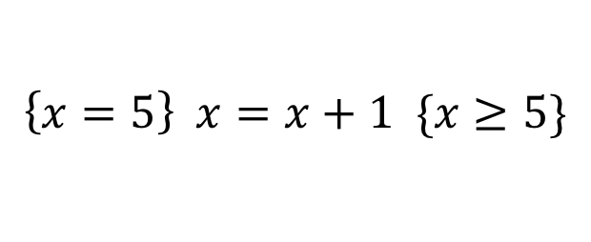
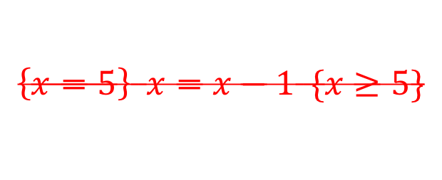
Hoare Triples
Precondition
(an assumption)
Code
Postcondition
(property that is true when
after code finishes)
{P} C {Q}
$$\left\{x=5\right\} x=x+1 \{x≥5\}$$
$$\left\{x=5\right\} x=x−1 \{x≥5\}$$
There are videos to watch before recitation.
Watch them before your recitation.

Slide 4
Where am I? Big ideas so far.
Java variables have types (L1)
  A type is a set of values and operations on them
  (int: +, -, *, /, %, etc.)
Classes define new types (L2)
  Methods are the operations on objects of that class.
  Fields allow objects to contain data (L3)

Slide 5
Class House
public class House {
private int bdrs; // number of bedrooms, >= 0.
private int baths; // number of bathrooms, in 1..5
/** Constructor: number of bedrooms b1, number of bathrooms b2
* Prec: b1 >= 0, 0 < b2 <= 5 */
public House(int b1, int b2);
/** Return number of bedrooms */
public int getBeds() {
return bdrs;
}
/** Return number of bathrooms */
public int getBaths() {
return baths;
}
}
House@af8
House
bdrs
3
baths
1
House(…) getBeds() getBaths()
setBeds(…) setBaths(…)
toString()
equals(Object) hashCode()
Contains other methods!

Slide 6
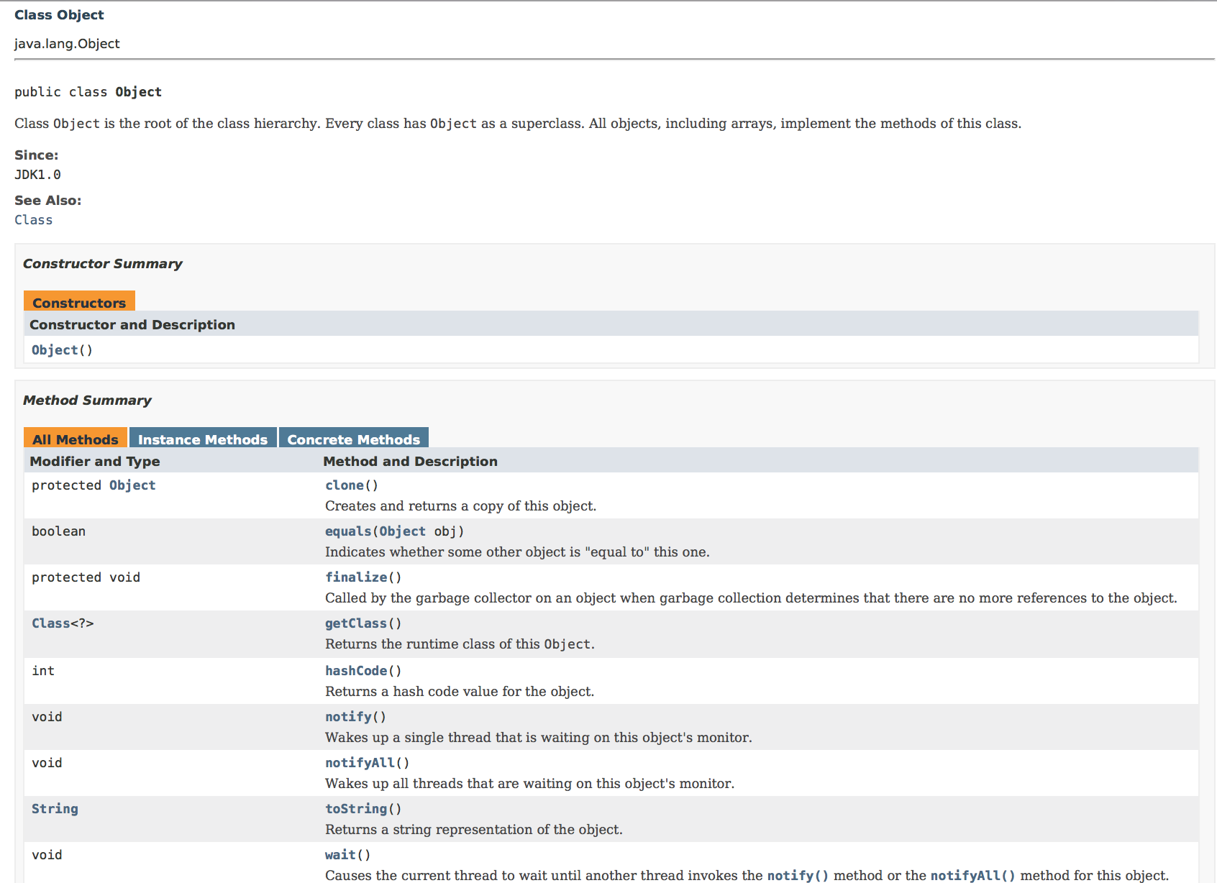
Class Object

Slide 7
Class Object: the superest class of all
public class House {
private int bdrs; // number of bedrooms, >= 0.
private int baths; // number of bathrooms, in 1..5
/** Constructor: number of bedrooms b1, number of bathrooms b2
* Prec: b1 >= 0, 0 < b2 <= 5 */
public House(int b1, int b2);
/** Return number of bedrooms */
public int getBeds() {
return bdrs;
}
/** Return number of bathrooms */
public int getBaths() {
return baths;
}
}
extends Object {
Java: Every class that does not
extend another extends class Object.
House@af8
Object
House
toString()
equals(Object) hashCode()
bdrs
3
baths
1
House(…) getBeds() getBaths()
setBeds(…) setBaths(…)
We often omit the Object partition to reduce clutter; we know that it is always there.
Notes:
Before this, demo Object using Meta and Empty.

Slide 8
Classes can extend other classes
We saw this in L2!
/** An instance is a subclass of JFrame */
public class C extends javax.swing.JFrame {
}
C@6667f34e
JFrame
C: subclass of JFrame
JFrame: superclass of C
C inherits all methods that are in a JFrame
hide() show()
setTitle(String) getTitle()
getX() getY() setLocation(int, int)
getWidth() getHeight() …
C
Object has 2 partitions:
one for JFrame methods,
one for C methods

Slide 9
Accessing superclass things
Subclasses are different classes
  Public fields and methods can be accessed
  Private fields and methods cannot be accessed
  Protected fields can be access by subclasses

Slide 10

Keywords: this
this keyword: this evaluates to the name of the object in which it occurs
Makes it possible for an object to access its own name (or pointer)
Example: Referencing a shadowed class field
public class Apartment extends House {
private int floor;
private Apartment downstairs;
//constructor
public Apartment(int floor,
Apartment downstairs) {
floor= floor;
downstairs = downstairs;
}
}
public class Apartment extends House {
private int floor;
private Apartment downstairs;
//constructor
public Apartment(int floor,
Apartment downstairs) {
this.floor= floor;
this.downstairs = downstairs;
}
}
this avoids overshadowed field name
Inside-out rule shows that field x is inaccessible!

Slide 11
Overriding methods
Apartment@af8
Object defines a method toString() that returns the name of the object
Apartment@af8
Object
toString()
equals(Object) hashCode()
House
bdrs
3
baths
1
Java Convention: Define toString() in any class to return a representation of an object, giving info about the values in its fields.
New definitions of toString() override the definition in Object.toString()
House(…) getBeds() getBaths()
setBeds(…) setBaths(…)
floor
2
Apartment
upstairs
Apartment@f34
Apartment(…) isBelow(…)
toString()

Slide 12
Overriding methods
Apartment@af8
public class Apartment{
…
/** Return a representation of an
Apartment*/
@Override
public String toString() {
return "" +(getBeds() +getBaths()) + " room apartment on " + floor + "th floor";
}
}
Object
toString()
equals(Object) hashCode()
House
bdrs
3
baths
1
House(…) getBeds() getBaths()
setBeds(…) setBaths(…)
floor
2
Apartment
upstairs
Apartment@f34
Apartment(…) isBelow(…)
toString()
a.toString() calls this method
toString()

Slide 13
When should you make a subclass?
The inheritance hierarchy should reflect modeling semantics, not implementation shortcuts
A should extend B if and only if A “is a” B
  An elephant is an animal, so Elephant extends Animal
  A car is a vehicle, so Car extends Vehicle
  An instance of any class is an object, so
  AnyClass extends java.lang.Object
Don’t use extends just to get access to protected fields!

Slide 14
When should you make a subclass?
Which of the following seem like reasonable designs?
  Triangle extends Shape { … }
  PHDTester extends PHD { … }
  BankAccount extends CheckingAccount { … }

Slide 15
When should you make a subclass?
Which of the following seem like reasonable designs?
  Triangle extends Shape { … }
    Yes! A triangle is a kind of shape.
  PHDTester extends PHD { … }
    No! A PHDTester “tests a” PHD, but itself is not a PHD.
  BankAccount extends CheckingAccount { … }
    No! A checking account is a kind of bank account; we likely would prefer:
  CheckingAccount extends BankAccount { ... }

Slide 16
Static Methods
Most methods are instance methods: every instance of the class has a copy of the method
There is only one copy of a static method. There is not a copy in each object.
You should make a method static if the body does not refer to any field or method in the object.

Slide 17
An Example
/** = “this object is below”.
Pre: a is not null. */
public boolean isBelow(Apartment a){
return this == a.downstairs;
}
/** = “a is below b”.
Pre: b and c are not null. */
public static boolean isBelow(Apartment b, Apartment a){
return b == a.downstairs;
}

Slide 18
Referencing a static method
static: there is only one copy of the method. It is not in each object
A@af
A@b4
bdrs
H
H
2
bdrs
2
baths
1
baths
1
floor
4
A
floor
4
A
dstrs
A@af
dstrs
A@af
isBelow(A)
isBelow(A)
isBelow(Apartment, Apartment)
Container for Apartment
contains: objects
, static components
public static void main(String[] args) {
Apartment.isBelow(a, b);
}

Slide 19
Good example of static methods
java.lang.Math
http://docs.oracle.com/javase/8/docs/api/java/lang/Math.html
Or find it by googling
Java 8 Math

Slide 20
Static Fields
There is only one copy of a static method. There is not a copy in each object.
There is only one copy of a static field. There is not a copy in each object.
What are static fields good for?

Slide 21
Use of static variables: Maintain info about created objects
public class Apartment extends House {
public static int numAps; // number of Apartments created
}
/** Constructor: */
public Apartment(…) {
…
numAps= numAps + 1;
}
A@af
A@b4
bdrs
H
H
2
bdrs
2
baths
1
baths
1
floor
4
A
floor
4
A
dstrs
A@af
dstrs
A@af
To have numAps contain the number of objects of class Apartment that have been created, simply increment it in constructors.
numAps
2
numAps stored in the Container for Apartment
To access: Apartment.numAps

Slide 22
Class java.awt.Color uses static variables
An instance of class Color describes a color in the RGB (Red-Green-Blue) color space. The class contains about 20 static variables, each of which is (i.e. contains a pointer to) a non-changeable Color object for a given color:
public static final Color black = …;
public static final Color blue = …;
public static final Color cyan = new Color(0, 255, 255);
public static final Color darkGray = …;
public static final Color gray = …;
public static final Color green = …;
…

Slide 23
Uses of static variables:
Implement the singleton pattern
Only one WhiteHouse can ever exist.
public class WhiteHouse extends House{
private static final WhiteHouse instance= new WhiteHouse();
private WhiteHouse() { } // ... constructor
public static WhiteHouse getInstance() {
return instance;
}
// ... methods
}
WhiteHouse@x3k3
WH
…
instance
WhiteHouse@x3k3
Box for WhiteHouse

